Slide 1
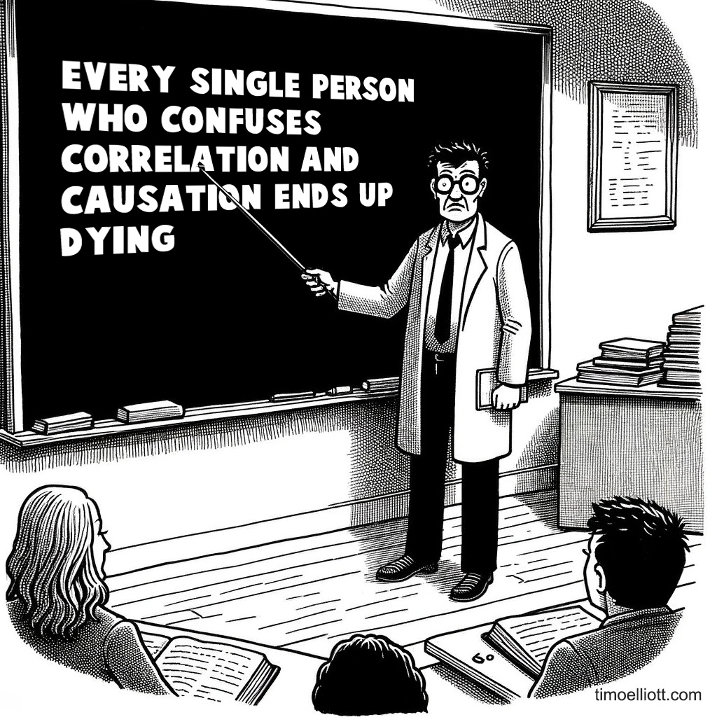
Causality and Correlation
Causality, Decision Making, and Data Science
Lecture 2

Slide 2
Announcements
HW0!
Due Monday SEPTEMBER 29, 11:59pm
HW1!
Two parts
Part 1 is due Monday Oct 6
Do this in small groups (up to three)
Reading responses!
You should have done one for today, don’t forget to do them every day!
Remember to fill out the exit ticket at the end of class
Remember your name tag!
If you are still having trouble with permission codes for econ115, email the course staff list.

Slide 3
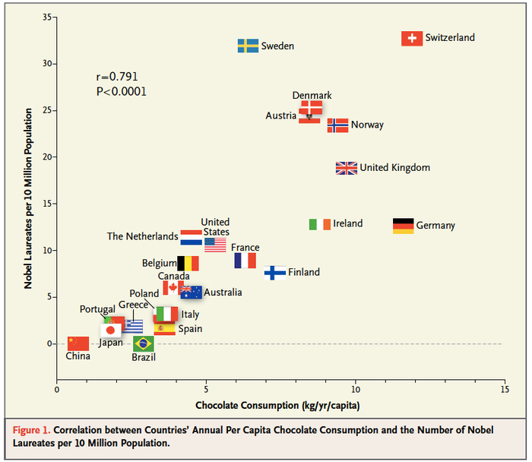
Correlation
Chocolate consumption is correlated with winning the Nobel prize.

Slide 4


Correlation
Ice cream consumption is correlated shark attacks.

Slide 5
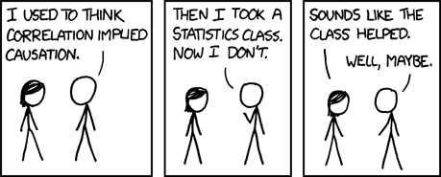
We all know that correlation doesn’t imply causation
But what is correlation? What is causation?

Slide 6
Agenda
What is correlation?
What is causality?
The fundamental problem of causal inference
Observational comparisons and ATE

Slide 7
What is Correlation?

Slide 8
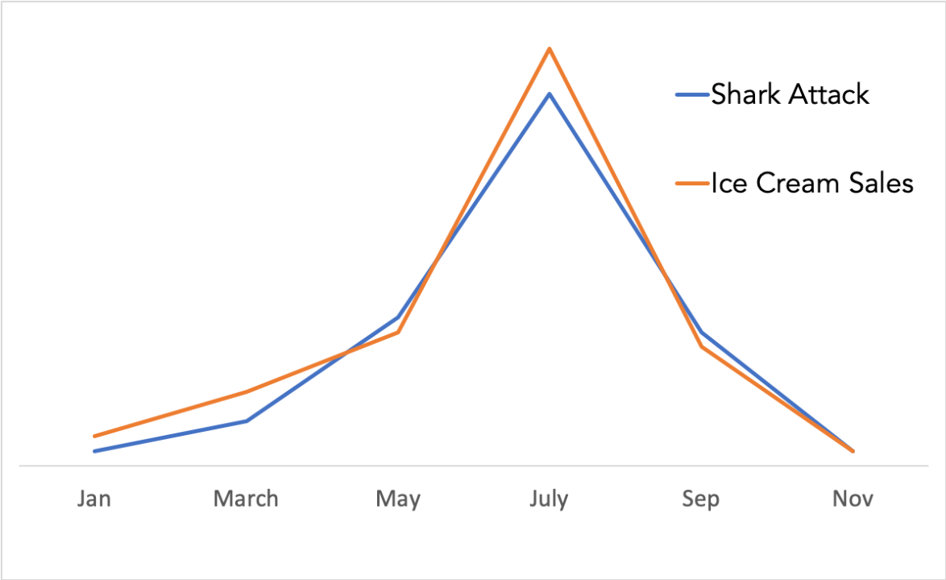
Intuition: Correlation is “two things happening together”
Apocryphal graph that is all over the internet
As chocolate consumption goes up, so do Nobel prizes
As ice cream sales go up/down, so do shark attacks.

Slide 9
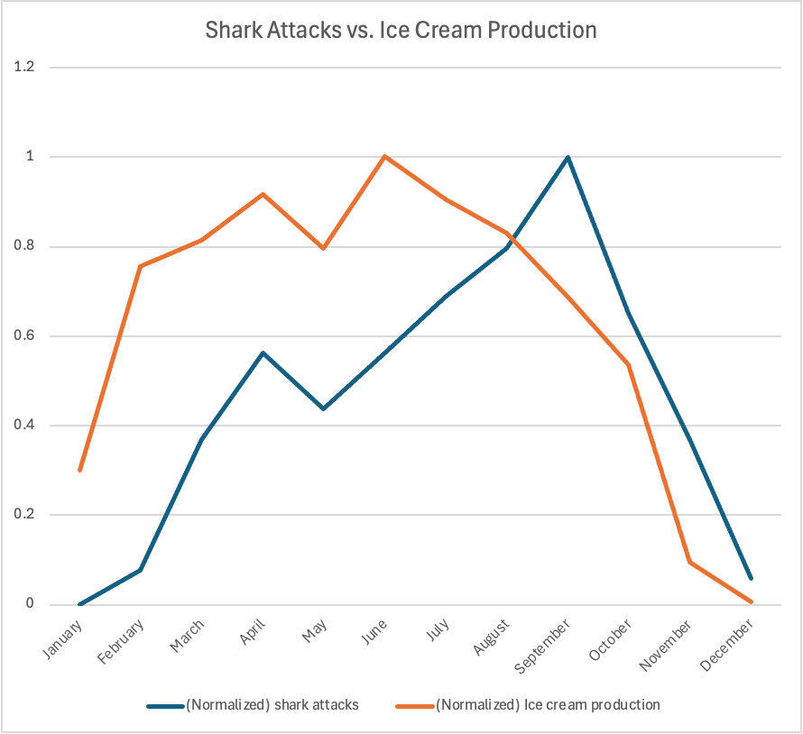
Intuition: Correlation is “two things happening together”
As chocolate consumption goes up, so do Nobel prizes
Data Mary could find (in 15 minutes).
Shark attack data is from www.floridamuseum.ufl.edu/shark-attacks, and is for Florida, 1926-2024
Ice cream data is 2023 production data, from FRED (Federal Reserve)

Slide 10


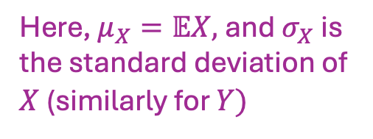
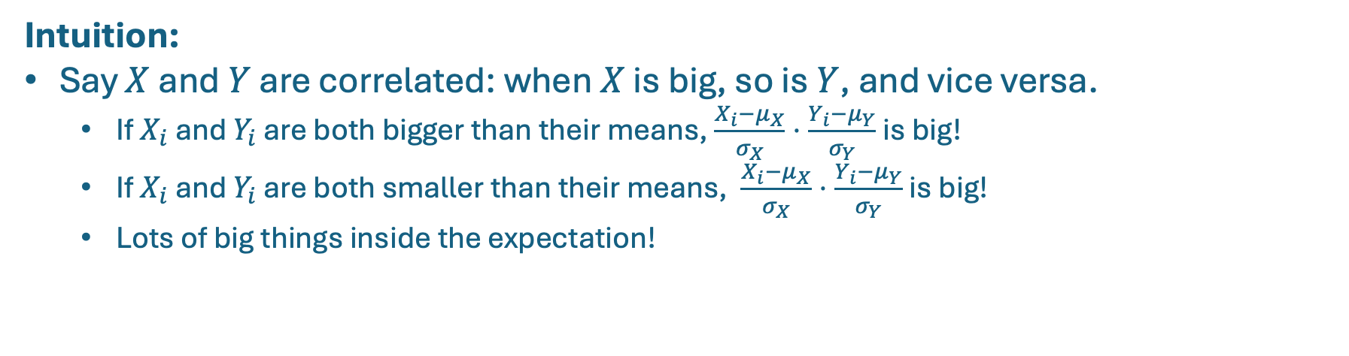
Formal Definition
Say $X$ and $Y$ are random variables.
Formally, the correlation between $X$ and $Y$ is:
$$corr(X,Y)=𝔼\left[\frac{X−μ_{X}}{σ_{X}}⋅\frac{Y−μ_{Y}}{σ_{Y}}\right]$$
Here, $μ_{X}=𝔼X,$and $σ_{X}$is the standard deviation of $X$ (similarly for $Y)$
Intuition:
Say $X$ and $Y$ are correlated: when $X$ is big, so is $Y$, and vice versa.
If $X_{i}$ and $Y_{i}$ are both bigger than their means, $\frac{X_{i}−μ_{X}}{σ_{X}}⋅\frac{Y_{i}−μ_{Y}}{σ_{Y}}$is big!
If $X_{i}$ and $Y_{i}$ are both smaller than their means, $\frac{X_{i}−μ_{X}}{σ_{X}}⋅\frac{Y_{i}−μ_{Y}}{σ_{Y}}$is big!
Lots of big things inside the expectation!

Slide 11

Example
Population of N=11 people:
X: Log(Earnings) | Y: Yrs of education
6.0009 | 18
5.7987 | 12
5.4157 | 11
6.3277 | 16
5.4807 | 10
6.0697 | 18
6.2525 | 15
5.9917 | 12
5.9910 | 18
5.8584 | 14
6.0035 | 15
This person has 12 years of education and makes $e^{5.7987}≈330$ dollars per week.
Each row is a person!

Slide 12
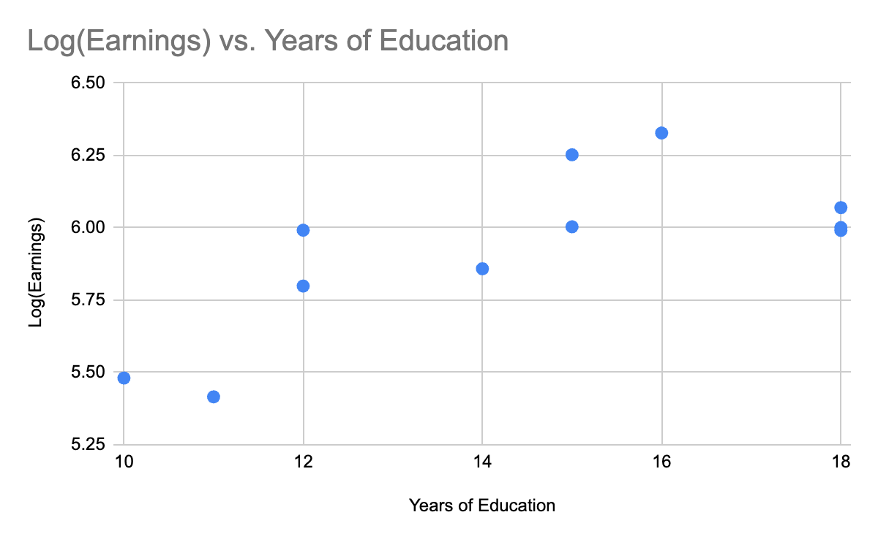
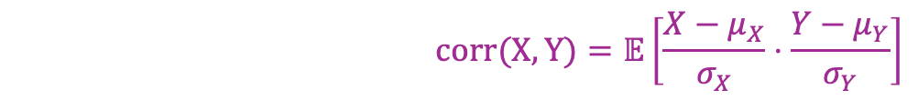
Let’s go through the mechanics
$$corr(X,Y)=𝔼\left[\frac{X−μ_{X}}{σ_{X}}⋅\frac{Y−μ_{Y}}{σ_{Y}}\right]$$
Log(Earnings) | Yrs of education
6.0009 | 18
5.7987 | 12
5.4157 | 11
6.3277 | 16
5.4807 | 10
6.0697 | 18
6.2525 | 15
5.9917 | 12
5.9910 | 18
5.8584 | 14
6.0035 | 15

Slide 13
Let’s go through the mechanics
$$corr(X,Y)=𝔼\left[\frac{X−μ_{X}}{σ_{X}}⋅\frac{Y−μ_{Y}}{σ_{Y}}\right]$$
Log(Earnings) | Yrs of education
6.0009 | 18
5.7987 | 12
5.4157 | 11
6.3277 | 16
5.4807 | 10
6.0697 | 18
6.2525 | 15
5.9917 | 12
5.9910 | 18
5.8584 | 14
6.0035 | 15
Step 1: Subtract the mean from each variable
Subtract mean from each!
Average:
5.9264
14.455

Slide 14
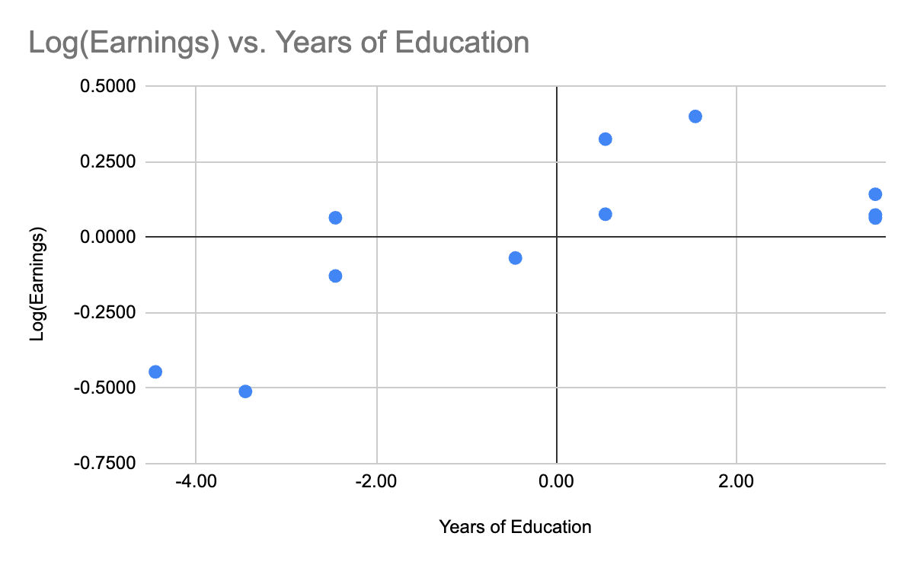
Let’s go through the mechanics
$$corr(X,Y)=𝔼\left[\frac{X−μ_{X}}{σ_{X}}⋅\frac{Y−μ_{Y}}{σ_{Y}}\right]$$
Log(Earnings) | Yrs of education
0.0745 | 3.55
-0.1277 | -2.45
-0.5107 | -3.45
0.4013 | 1.55
-0.4457 | -4.45
0.1433 | 3.55
0.3261 | 0.55
0.0653 | -2.45
0.0646 | 3.55
-0.0680 | -0.45
0.0771 | 0.55
Step 1: Subtract the mean from each variable
Average:
0
0

Slide 15
Let’s go through the mechanics
$$corr(X,Y)=𝔼\left[\frac{X−μ_{X}}{σ_{X}}⋅\frac{Y−μ_{Y}}{σ_{Y}}\right]$$
Log(Earnings) | Yrs of education
0.0745 | 3.55
-0.1277 | -2.45
-0.5107 | -3.45
0.4013 | 1.55
-0.4457 | -4.45
0.1433 | 3.55
0.3261 | 0.55
0.0653 | -2.45
0.0646 | 3.55
-0.0680 | -0.45
0.0771 | 0.55
Step 2: Divide by standard deviation
Divide Std. Dev from each!
Std. Dev:
0.2677
2.78

Slide 16
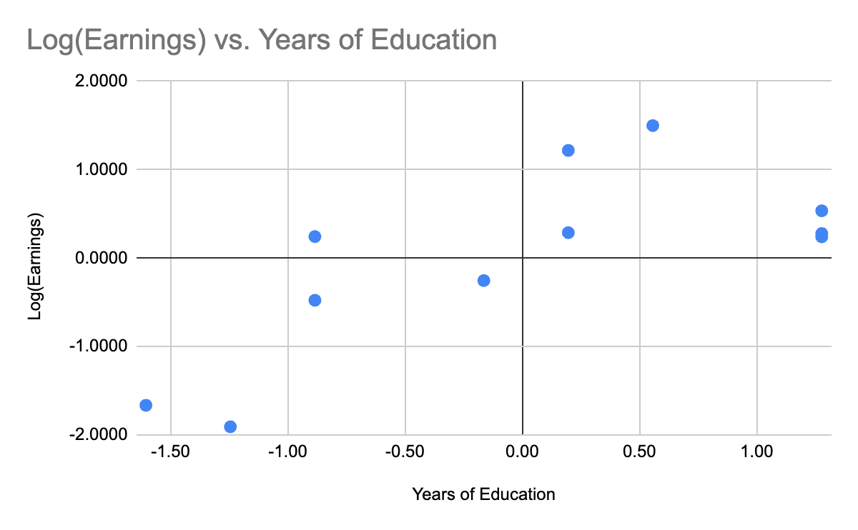
Let’s go through the mechanics
$$corr(X,Y)=𝔼\left[\frac{X−μ_{X}}{σ_{X}}⋅\frac{Y−μ_{Y}}{σ_{Y}}\right]$$
Log(Earnings) | Yrs of education
0.2783 | 1.28
-0.4771 | -0.88
-1.9078 | -1.24
1.4991 | 0.56
-1.6650 | -1.61
0.5353 | 1.28
1.2182 | 0.20
0.2439 | -0.88
0.2413 | 1.28
-0.2541 | -0.16
0.2880 | 0.20
Step 2: Divide by standard deviation
Std. Dev:
1
1

Slide 17
Let’s go through the mechanics
$$corr(X,Y)=𝔼\left[\frac{X−μ_{X}}{σ_{X}}⋅\frac{Y−μ_{Y}}{σ_{Y}}\right]$$
Log(Earnings) | Yrs of education
0.2783 | 1.28
-0.4771 | -0.88
-1.9078 | -1.24
1.4991 | 0.56
-1.6650 | -1.61
0.5353 | 1.28
1.2182 | 0.20
0.2439 | -0.88
0.2413 | 1.28
-0.2541 | -0.16
0.2880 | 0.20
Step 3: Calculate the expected product
Std. Dev:
1
1

Slide 18
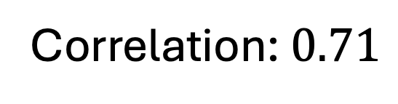
Let’s go through the mechanics
$$corr(X,Y)=𝔼\left[\frac{X−μ_{X}}{σ_{X}}⋅\frac{Y−μ_{Y}}{σ_{Y}}\right]$$
Log(Earnings) | Yrs of education | Product
0.2783 | 1.28 | 0.36
-0.4771 | -0.88 | 0.42
-1.9078 | -1.24 | 2.37
1.4991 | 0.56 | 0.83
-1.6650 | -1.61 | 2.67
0.5353 | 1.28 | 0.68
1.2182 | 0.20 | 0.24
0.2439 | -0.88 | -0.22
0.2413 | 1.28 | 0.31
-0.2541 | -0.16 | 0.04
0.2880 | 0.20 | 0.06
Step 3: Calculate the expected product
Correlation: $0.71$
Mean:
0.71

Slide 19
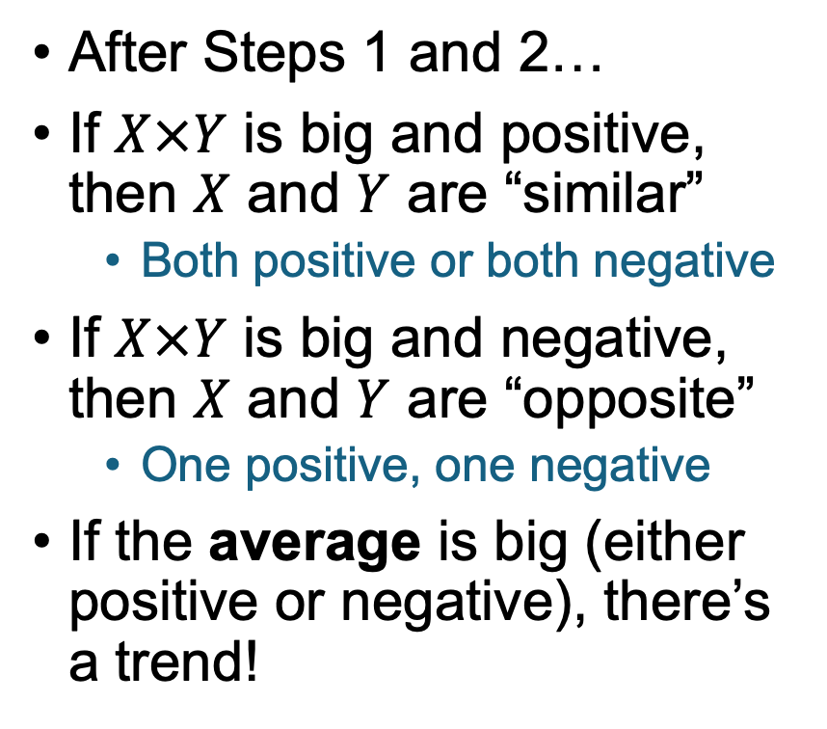
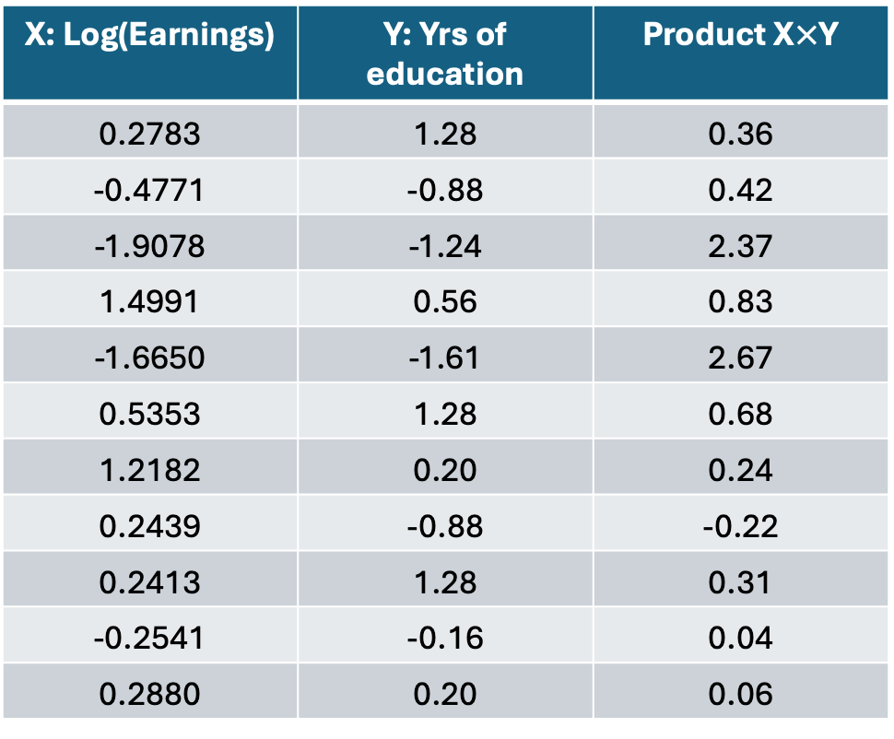
Does this capture our intuition?
$$corr(X,Y)=𝔼\left[\frac{X−μ_{X}}{σ_{X}}⋅\frac{Y−μ_{Y}}{σ_{Y}}\right]$$
X: Log(Earnings) | Y: Yrs of education | Product X$×$Y
0.2783 | 1.28 | 0.36
-0.4771 | -0.88 | 0.42
-1.9078 | -1.24 | 2.37
1.4991 | 0.56 | 0.83
-1.6650 | -1.61 | 2.67
0.5353 | 1.28 | 0.68
1.2182 | 0.20 | 0.24
0.2439 | -0.88 | -0.22
0.2413 | 1.28 | 0.31
-0.2541 | -0.16 | 0.04
0.2880 | 0.20 | 0.06
After Steps 1 and 2…
If $X×Y$ is big and positive, then $X$ and $Y$ are “similar”
Both positive or both negative
If $X×Y$ is big and negative, then $X$ and $Y$ are “opposite”
One positive, one negative
If the average is big (either positive or negative), there’s a trend!
Mean:
0.71

Slide 20
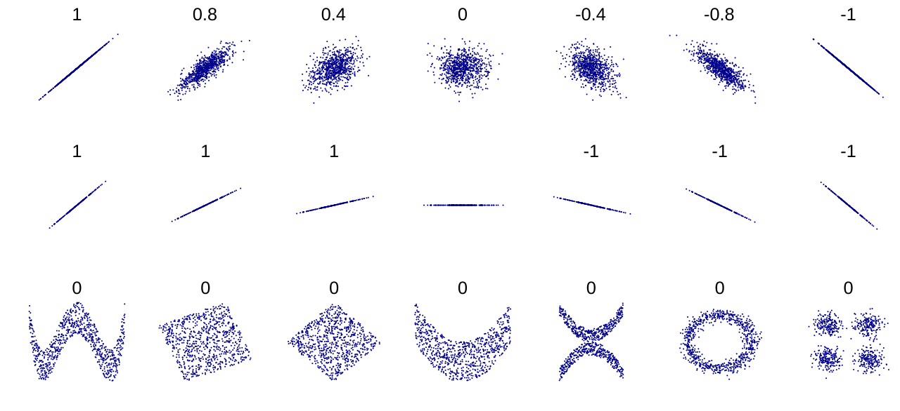
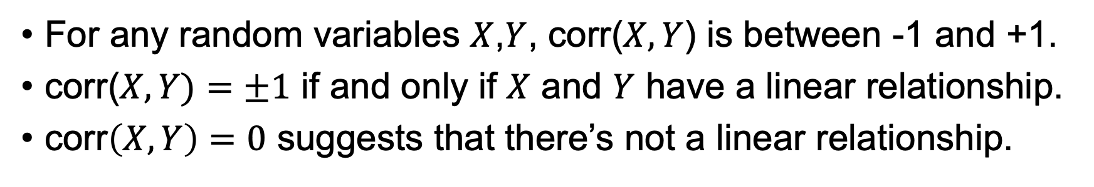
Facts about correlation
For any random variables $X$,$Y$, corr($X,Y$) is between -1 and +1.
corr($X,Y)=±1$ if and only if $X$ and $Y$ have a linear relationship.
corr$\left(X,Y\right)=0$ suggests that there’s not a linear relationship.
correlation
data set
Examples from Wikipedia ☺

Slide 21
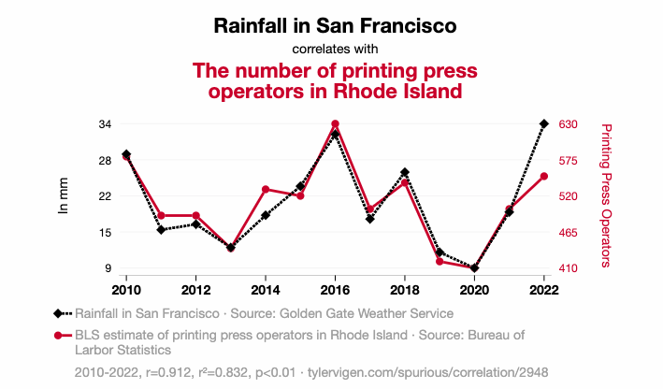
For a fun time
Check out “Spurious Correlations” (both a website and a book)

Slide 22
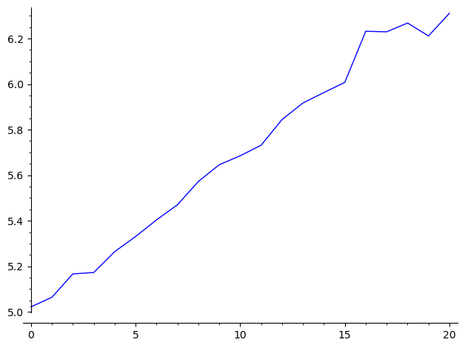

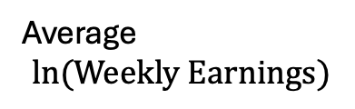
But not all correlations seem spurious…
Earnings is correlated with years of schooling:
Average
$$\ln{(Weekly Earnings)}$$
Data is from the 1980 census, including men born between 1930 and 1939 with positive value for usual weekly wage.
There are about 330,000 people in this sample.
$$Years of schooling$$

Slide 23

Segue: Correlation and Causation
Does more education cause more earnings?
Does more earnings cause more education?
Might something else be going on?
Discuss!

Slide 24

Segue: Correlation and Causation
Does more education cause more earnings?
Does more earnings cause more education?
Might something else be going on?
Maybe? Hopefully you learn something in school, which makes you more valuable to an employer.
Probably not, since this is about earnings later in life, vs. education earlier in life.
Lots of possible confounding variables.
e.g., Wealthy parents $⇒$ more likely to have the resources to go to college
Wealthy parents $⇒$ better connections $⇒$ more likely to get a high-paying job.

Slide 25
Confounding Variables
A confounding variable is a variable that influences both the dependent and the independent variable.
This graph is a causal diagram. There is an edge from X to Y if X affects Y.
Independent Variable
Amount of Education
Parents’ income
Income later in life
Confounding Variable
Dependent Variable

Slide 26
What is causality?

Slide 27
Causal Statements Examples
The aspirin made my headache go away.
Eating spoiled food causes people to get ill.
Mask-wearing has a causal effect on COVID rates.
Having laptops in the class has a negative causal effect on learning.
Being African-American lowers the chances of getting a job interview.
Going to college has an effect on your earnings.
He got a good grade because he studied hard.

Slide 28

You all thought about a 1-sentence definition of causality before class
Share your definition with your neighbor(s).
Which of the examples from the previous slide do your definitions capture?
Revise your definitions if you want.
The aspirin made my headache go away.
Eating spoiled food causes people to get ill.
Mask-wearing has a causal effect on COVID rates.
Having laptops in the class has a negative causal effect on learning.
Being African-American lowers the chances of getting a job interview.
Going to college has an effect on your earnings.
He got a good grade because he studied hard.

Slide 29
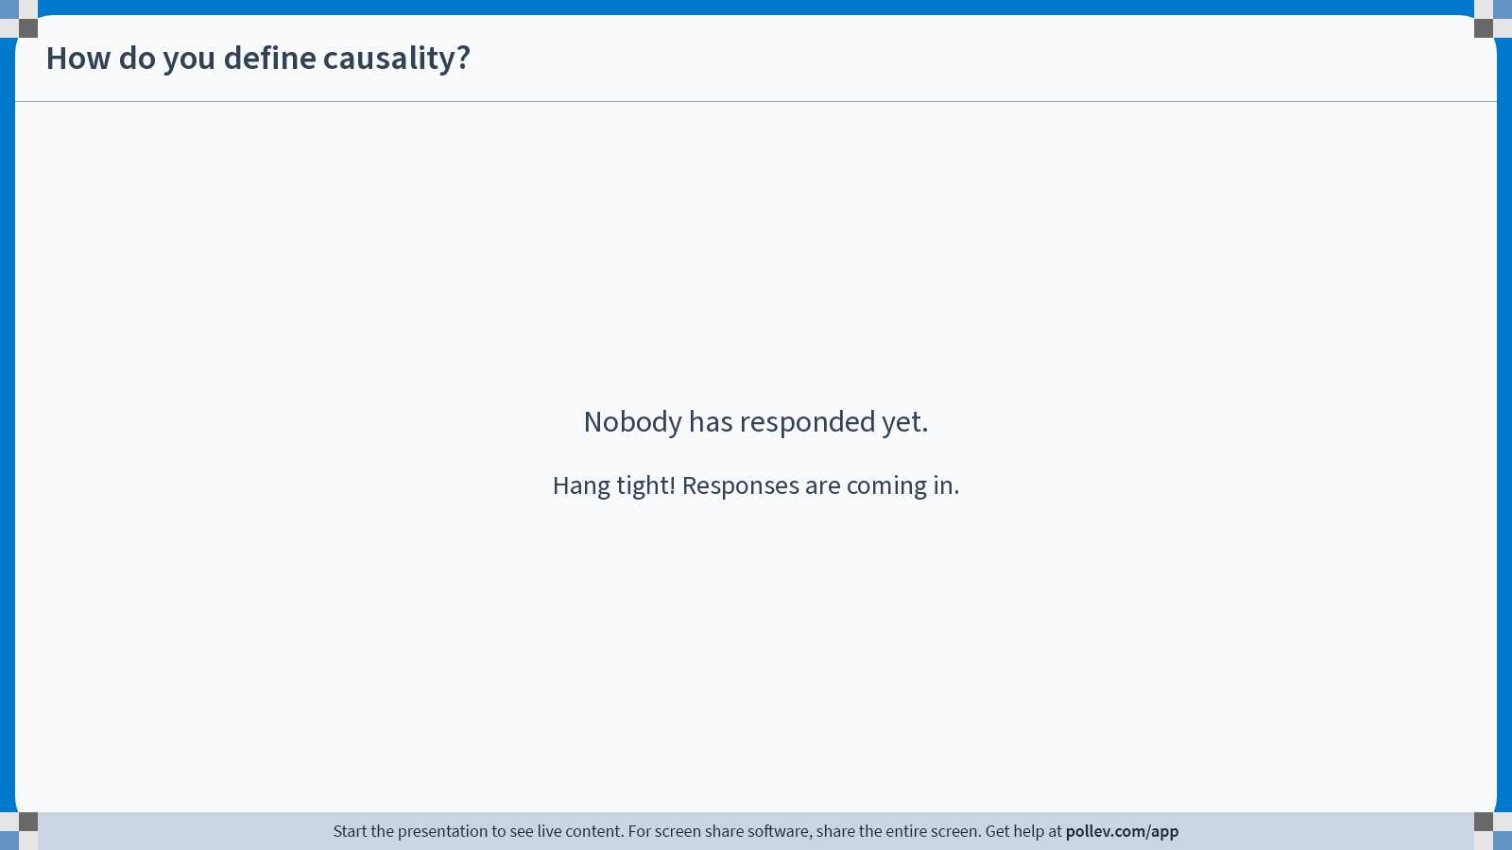
Notes:
Do not modify the notes in this section to avoid tampering with the Poll Everywhere activity. More info at polleverywhere.com/support How do you define causality?
https://www.polleverywhere.com/discourses/1y1v8IeHsc1faMW4X477F

Slide 30
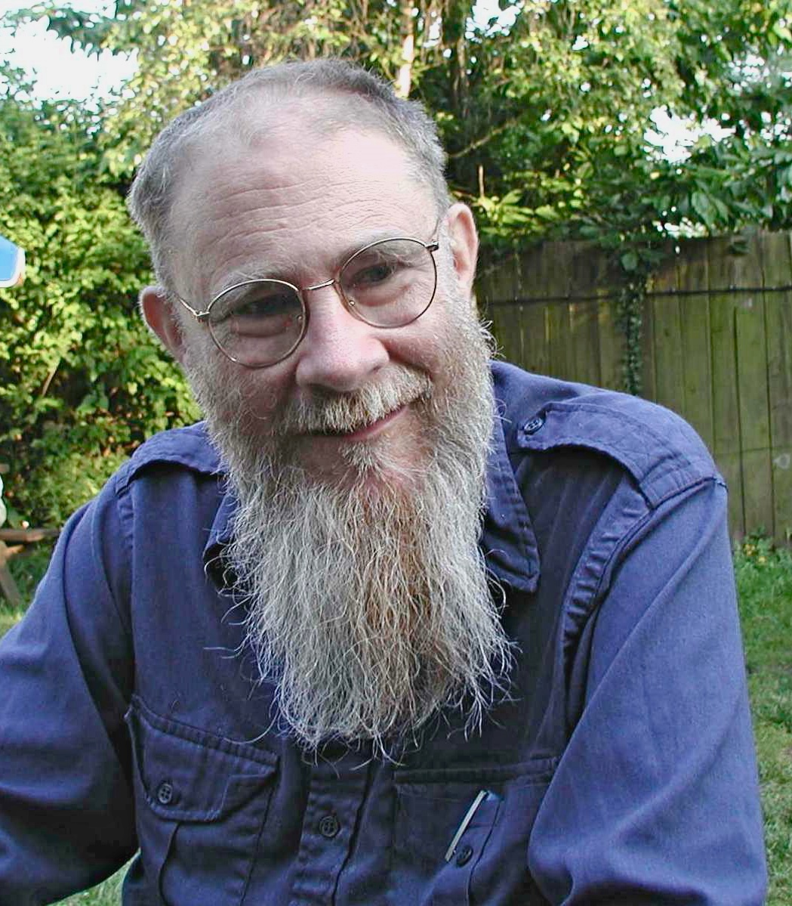

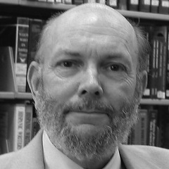
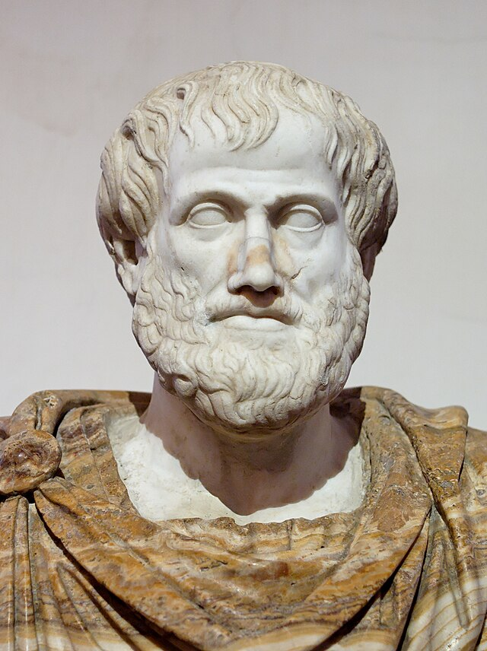
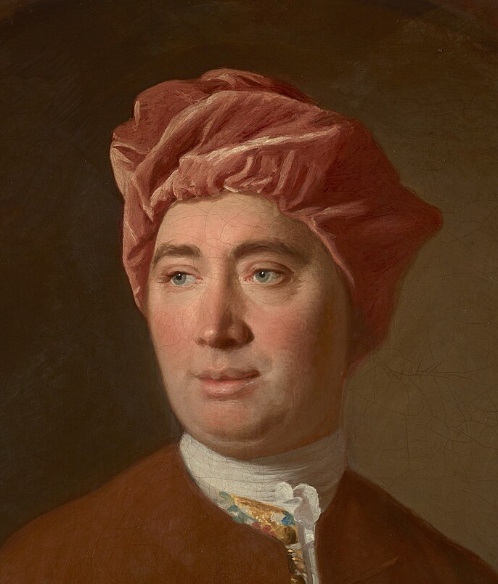
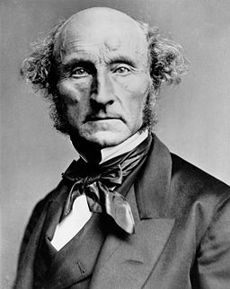
This is a tricky question Philosophers have been debating it for centuries
Disclaimer: This slide is drastically oversimplifying and leaves out many thinkers.
X causes Y if X generally happens before Y, and if there’s a law of nature to explain the causal relationship.
X causes Y if:
It makes sense to think about “what if X didn’t happen,” and
If X didn’t happen, then Y wouldn’t have happened.
Four types of causes:
Material: “Out of which the thing is made”
Formal: “Into which the thing is made”
Efficient: “What makes the thing”
Final: “For which the thing is made”
X causes Y if X generally happens before Y.
Lewis
Rubin
Holland
(1970’s, 80’s, …)
Aristotle
(4th c. BCE)
Hume
(18th c.)
Mill
(19th c.)
*Statisticians had been using this view for a while, e.g. Neyman in the 1920’s
Notes:
The “Hume” bubble here represents “regularity-based” accounts. The obvious downside is that it *doesn’t* distinguish beween causality and correlation.
The ”Mill” bubble is a stand-in for Structural or Inferential accounts. Issues include: How do we know the laws of nature? Also, the laws of nature don’t always play nice with our causal intuition: e.g., the laws of physics are symmetric w.r.t. time; non-locality and non-determinism in QM are hard to fit in with “causal” intuition.
Lewis was a philosopher.
Rubin is a statistician
Holland is a statistician who coined the “Rubin Causal Model”
It’s also sometimes attributed to Neyman, a mathematician/statistician in the 1920’s

Slide 31
We’re going to work with a counterfactual framework.
The statement “the aspirin caused my headache to go away” means:
In a world where I took the aspirin, my headache went away
In a world where I did not take the aspirin, I still had a headache
The statement “going to college caused me to earn more money” means:
In a world where I went to college, I made more money
In a world where I didn’t go to college, I made less money

Slide 32

Average Treatment Effect (ATE) informal definition; formal definition coming later
The ATE of aspirin on “whether your headache goes away”:
Pick someone in the population at random.
ATE is the expected difference in headache recovery between the world where they took aspirin and the world in which they didn’t.
The ATE of college on earnings:
Pick someone in the population at random.
ATE is the expected difference between how much they would make in the world where they went to college and the world where they didn’t.
Why do we only care about the average? I care about me…
We’ll talk about heterogeneous effects later in the quarter… for now let’s focus on the average.

Slide 33

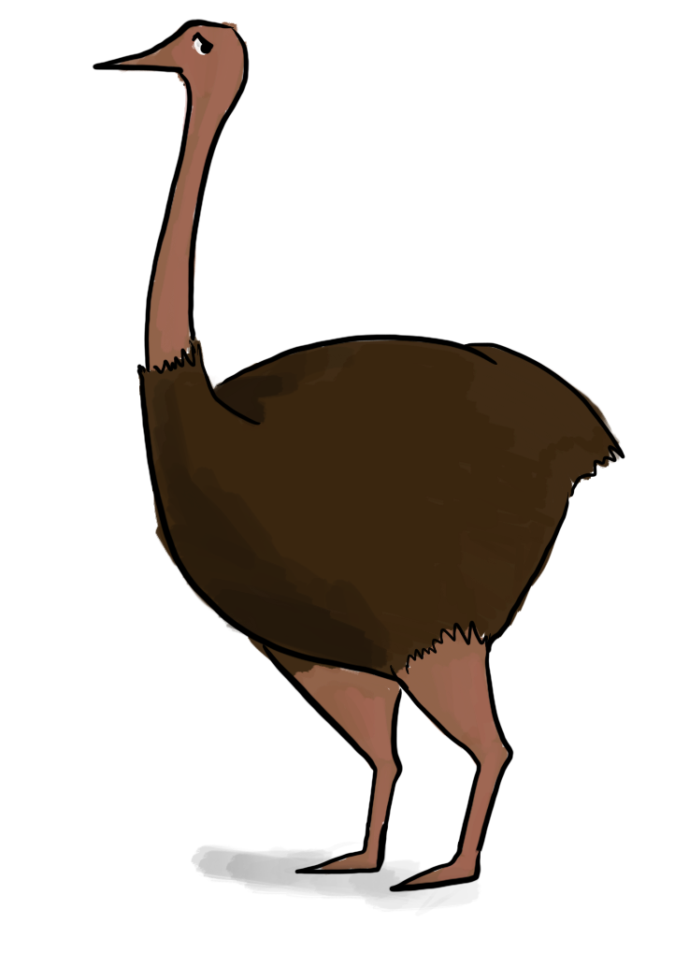




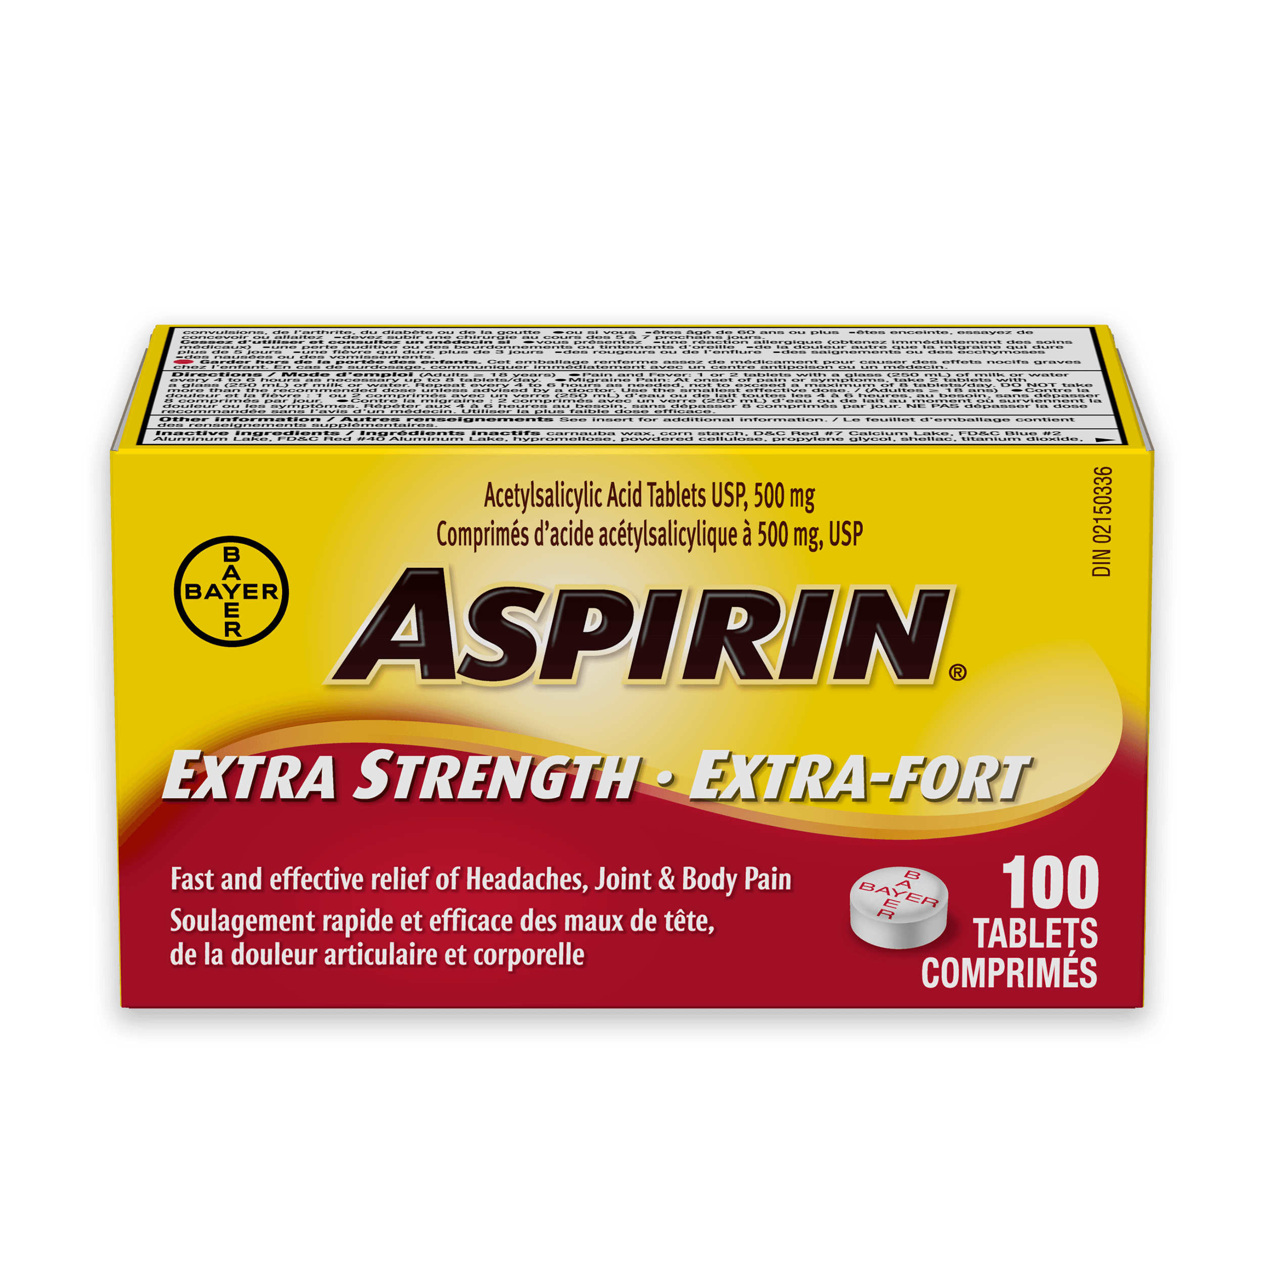



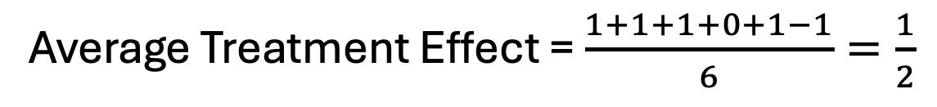
Example
Say we have this population:
Does aspirin help?
+1
0
+1
-1
+1
+1
Average Treatment Effect = $\frac{1+1+1+0+1−1}{6}=\frac{1}{2}$

Slide 34
“The fundamental problem of causal inference”
(Paul Holland, Journal of the American Statistical Association, 1986)

Slide 35

The fundamental problem of causal inference
We can’t know what would have happened in that other world!
Outcome
Take aspirin
The world proceeds…
No aspirin
Outcome

Slide 36

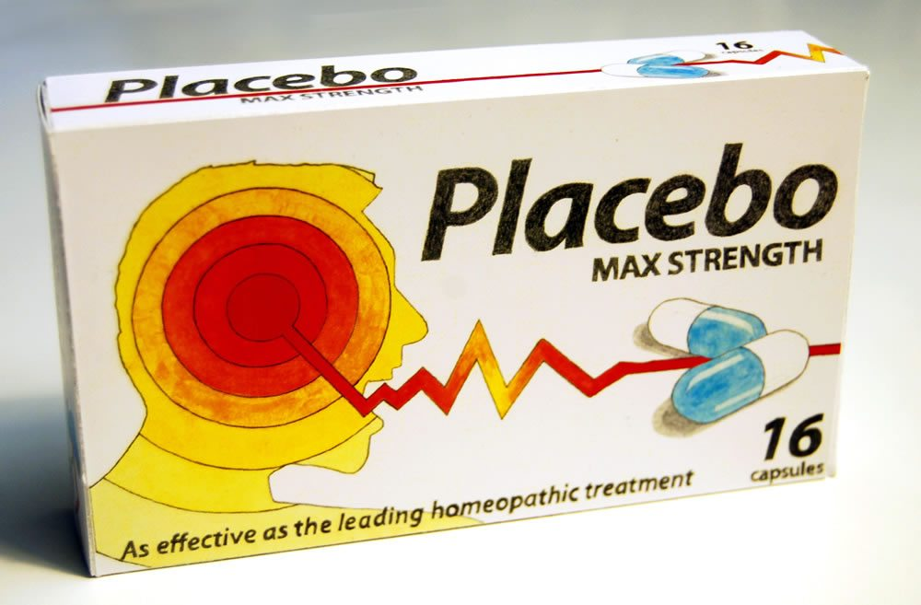
The fundamental problem of causal inference
We can’t know what would have happened in that other world!
Outcome
Take aspirin
The world proceeds…
REDACTED
No aspirin
Outcome

Slide 37
What can we do?
Compare lots of aspirin-takers to non-aspirin-takers
No aspirin
No aspirin
No aspirin
Aspirin
Aspirin
Aspirin

Slide 38
What can we do?
2. Look at the same person over time, who sometimes takes aspirin and sometimes does not.
Monday:
Tuesday:
Wednesday:

Slide 39
What are potential problems with these approaches?
Comparing aspirin-takers to non-aspirin-takers
Comparing aspirin-taking past self with my non-aspirin-taking present self
Discuss!

Slide 40
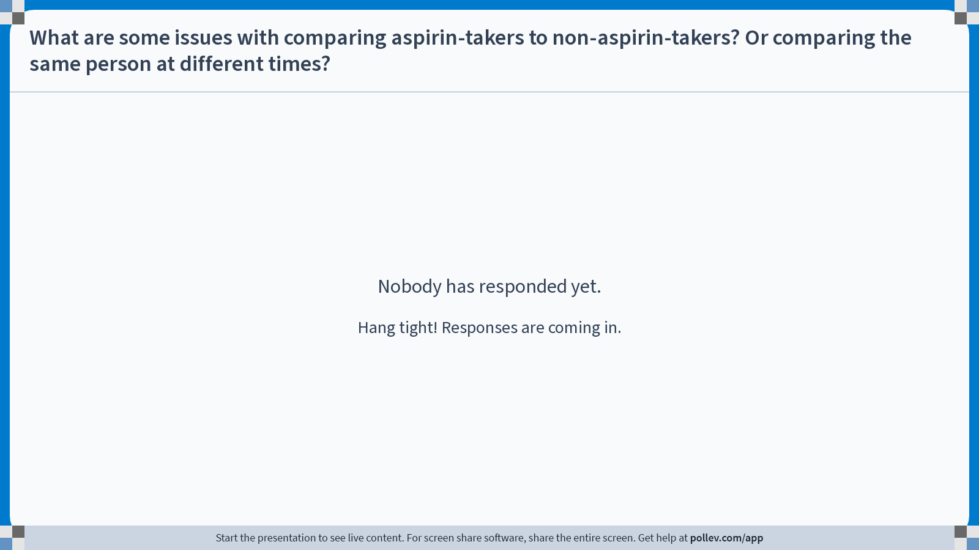
Notes:
Do not modify the notes in this section to avoid tampering with the Poll Everywhere activity. More info at polleverywhere.com/support What are some issues with comparing aspirin-takers to non-aspirin-takers? Or comparing the same person at different times?
https://www.polleverywhere.com/discourses/wm8D6o7p0X8LlXFm92tOh

Slide 41
Problem: Confounding Variables! Different people are different! The same person at different times is different!
I’m the sort of person who cares about my health. I take aspirin, and I also get lots of sleep.
Taking medicine when sick
Being health-conscious
Recovering from illness faster
Getting lots of sleep
Taking medicine when sick
Aspirin always works for me! That’s why I always take it.
Medicine generally working well on you
Recovering from illness faster

Slide 42
If the only people who take aspirin are the health-conscious people who would get better anyway…
We would conclude that aspirin is really effective! Everyone who takes it gets better!
But the ATE is actually small; aspirin wouldn’t have worked on anyone other than the rabbit.
Confounding variables can lead to incorrect conclusions if we aren’t careful!
No aspirin
No aspirin
No aspirin
No aspirin
No aspirin
Aspirin

Slide 43
Problem: Spillovers/Interference
Some people may affect others.
All this noise is giving me a headache too…
ARGGGG!
OOWWWW I HAVE A HEADACHE!!!!
No aspirin
No aspirin
No aspirin
Aspirin
Aspirin
Aspirin

Slide 44
More seriously
Examples of spillovers include:
Job training programs: Job training programs effect the labor market, which may affect people even not in the program.
Vaccines: If some people but not others are vaccinated, the lower risk among the vaccinated may also prevent the un-vaccinated from getting sick.
…

Slide 45
But we’re going to ignore spillovers for now
Let’s focus just on Problem 1:
Confounding variables!
Maybe the sorts of people who take aspirin are different from the sorts of people who don’t.
Next, we’ll introduce some notation and try to break down this problem.

Slide 46
Time for a quick break!
Stretch, chat, etc for a few minutes…

Slide 47
Average Treatment Effect (ATE) vs Observational Comparison (Correlation)
a.k.a., What we want vs. what we have

Slide 48
Suppose we see this:
Treatment?
Outcome?

Slide 49
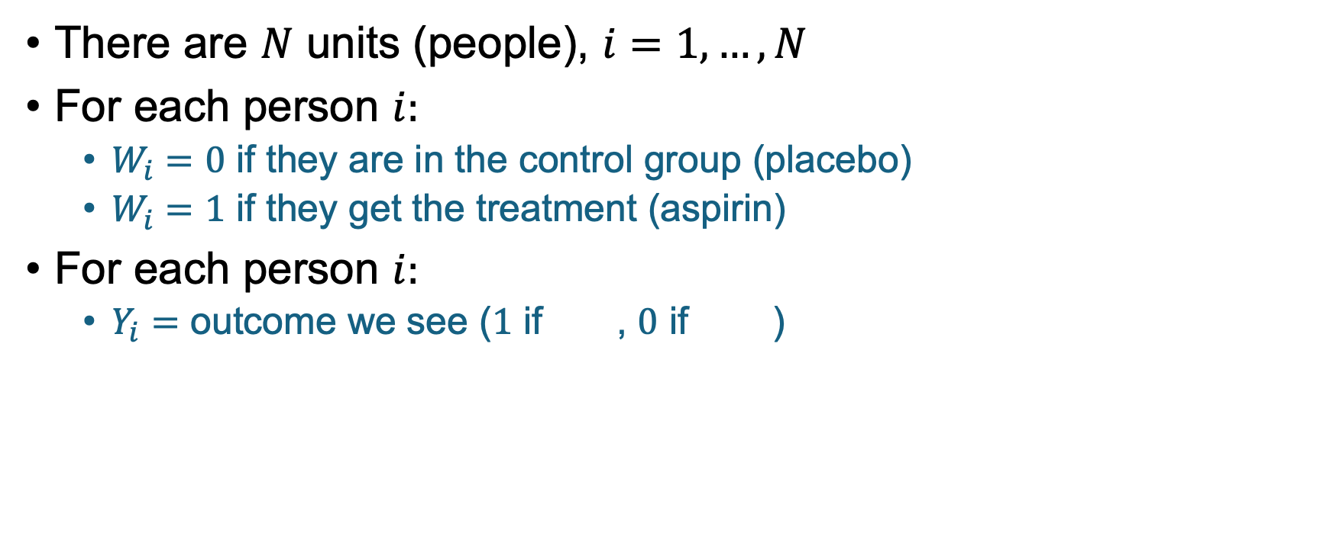
Notation
There are $N$ units (people), $i=1,…,N$
For each person $i:$
$W_{i}=0$ if they are in the control group (placebo)
$W_{i}=1$ if they get the treatment (aspirin)
For each person $i:$
$Y_{i}=$ outcome we see ($1$ if , $0$ if )

Slide 50

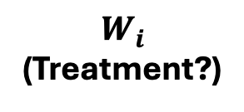



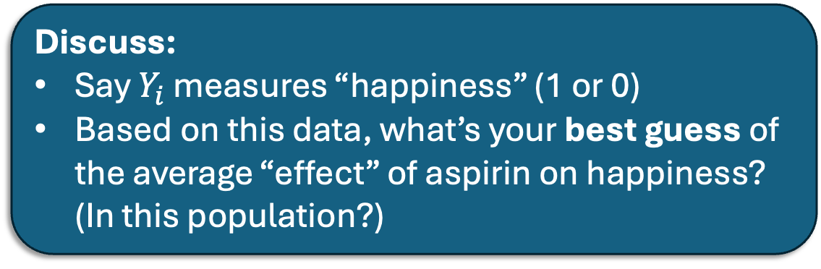
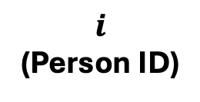












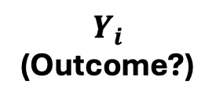



With Notation!
Discuss:
Say $Y_{i}$ measures “happiness” (1 or 0)
Based on this data, what’s your best guess of the average “effect” of aspirin on happiness? (In this population?)
$$1$$
$$2$$
$$3$$
$$4$$
$$5$$
$$6$$
$$i$$
(Person ID)
$$W_{1}=1$$
$$W_{2}=1$$
$$W_{3}=1$$
$$W_{4}=0$$
$$W_{5}=0$$
$$W_{6}=0$$
$$W_{i}$$
(Treatment?)
$$Y_{4}=0$$
$$Y_{5}=0$$
$$Y_{6}=1$$
$$Y_{1}=1$$
$$Y_{2}=1$$
$$Y_{3}=1$$
$$Y_{i}$$
(Outcome?)

Slide 51
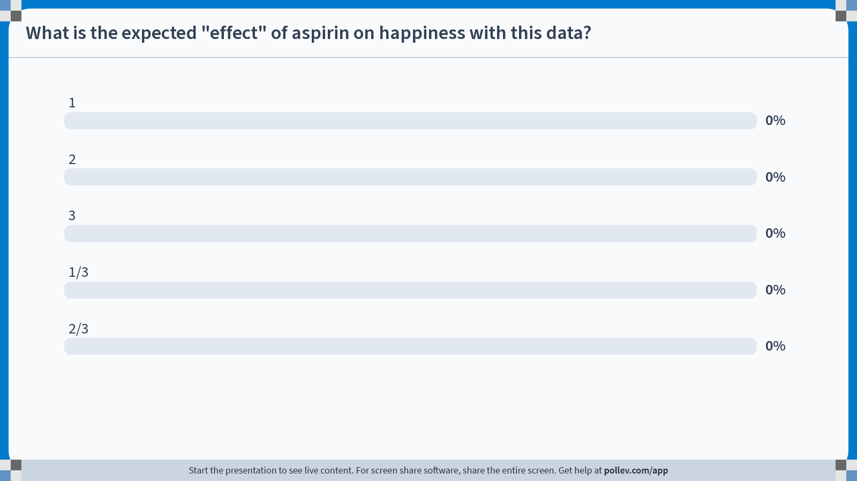
Notes:
Do not modify the notes in this section to avoid tampering with the Poll Everywhere activity. More info at polleverywhere.com/support What is the expected "effect" of aspirin on happiness with this data?
https://www.polleverywhere.com/multiple_choice_polls/LQ28wmqztxzlyuGIkw9p4?state=opened&flow=Default&onscreen=persist

Slide 52
















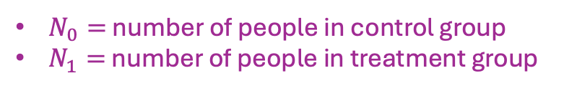






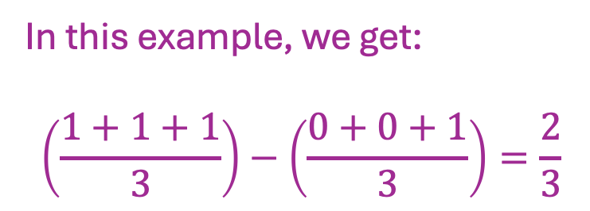
Observational Comparison
$N_{0}=$ number of people in control group
$N_{1}=$ number of people in treatment group
(Avg happiness among those with aspirin)
– (Avg happiness among those with no aspirin)
In symbols: $𝔼\left[Y_{i} \right|W_{i}=1] −𝔼\left[Y_{i} \right|W_{i}=0]$
$=\frac{1}{N_{1}}\sum_{i:W_{i}=1}{Y_{i}}−\frac{1}{N_{0}}\sum_{i:W_{i}=0}{Y_{i}}$
$$1$$
$$2$$
$$3$$
$$4$$
$$5$$
$$6$$
In this example, we get:
$$\left(\frac{1+1+1}{3}\right)−\left(\frac{0+0+1}{3}\right)=\frac{2}{3}$$
$$i$$
(Person ID)
$$W_{1}=1$$
$$W_{2}=1$$
$$W_{3}=1$$
$$W_{4}=0$$
$$W_{5}=0$$
$$W_{6}=0$$
$$W_{i}$$
(Treatment?)
$$Y_{1}=1$$
$$Y_{2}=1$$
$$Y_{3}=1$$
$$Y_{4}=0$$
$$Y_{5}=0$$
$$Y_{6}=1$$
$$Y_{i}$$
(Outcome?)

Slide 53
Observational Comparison
$N_{0}=$ number of people in control group
$N_{1}=$ number of people in treatment group
(Avg happiness among those with aspirin)
– (Avg happiness among those with no aspirin)
In symbols: $𝔼\left[Y_{i} \right|W_{i}=1] −𝔼\left[Y_{i} \right|W_{i}=0]$
$=\frac{1}{N_{1}}\sum_{i:W_{i}=1}{Y_{i}}−\frac{1}{N_{0}}\sum_{i:W_{i}=0}{Y_{i}}$
Interpreting Observational Comp.:
Choose someone at random who took aspirin.
Choose someone at random who didn’t take aspirin.
How much happier do you expect the aspirin-taker to be?
$$1$$
$$4$$
$$5$$
$$6$$
$$2$$
$$3$$
$$i$$
(Person ID)
$$W_{1}=1$$
$$W_{2}=1$$
$$W_{3}=1$$
$$W_{4}=0$$
$$W_{5}=0$$
$$W_{6}=0$$
$$W_{i}$$
(Treatment?)
$$Y_{1}=1$$
$$Y_{2}=1$$
$$Y_{3}=1$$
$$Y_{4}=0$$
$$Y_{5}=0$$
$$Y_{6}=1$$
$$Y_{i}$$
(Outcome?)

Slide 54
But this isn’t the same as ATE!

Slide 55
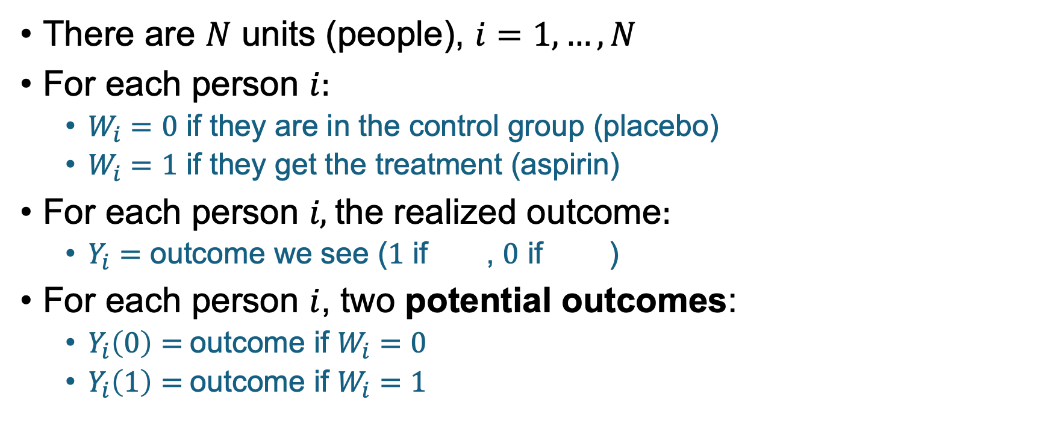
More Notation
There are $N$ units (people), $i=1,…,N$
For each person $i:$
$W_{i}=0$ if they are in the control group (placebo)
$W_{i}=1$ if they get the treatment (aspirin)
For each person $i\text{, }\text{the} \text{realized} \text{outcome}:$
$Y_{i}=$ outcome we see ($1$ if , $0$ if )
For each person $i$, two potential outcomes:
$Y_{i}\left(0\right)=$outcome if $W_{i}=0$
$Y_{i}\left(1\right)=$outcome if $W_{i}=1$

Slide 56










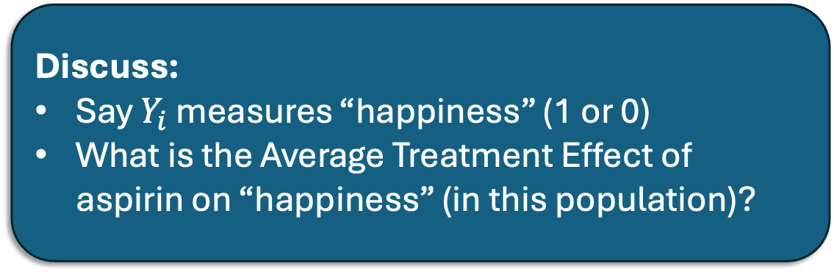




Counter-factuals with notation
Discuss:
Say $Y_{i}$ measures “happiness” (1 or 0)
What is the Average Treatment Effect of aspirin on “happiness” (in this population)?
$$1$$
$$2$$
$$3$$
$$4$$
$$5$$
$$6$$
$$i$$
(Person ID)
$$Y_{1}\left(1\right)=1$$
$$Y_{2}\left(1\right)=1$$
$$Y_{3}\left(1\right)=1$$
$$Y_{4}\left(1\right)=0$$
$$Y_{5}\left(1\right)=1$$
$$Y_{6}\left(1\right)=0$$
$$Y_{i}(1)$$
$$Y_{4}\left(0\right)=0$$
$$Y_{5}\left(0\right)=0$$
$$Y_{6}\left(0\right)=1$$
$$Y_{1}\left(0\right)=0$$
$$Y_{2}\left(0\right)=0$$
$$Y_{3}\left(0\right)=0$$
$$Y_{i}(0)$$

Slide 57
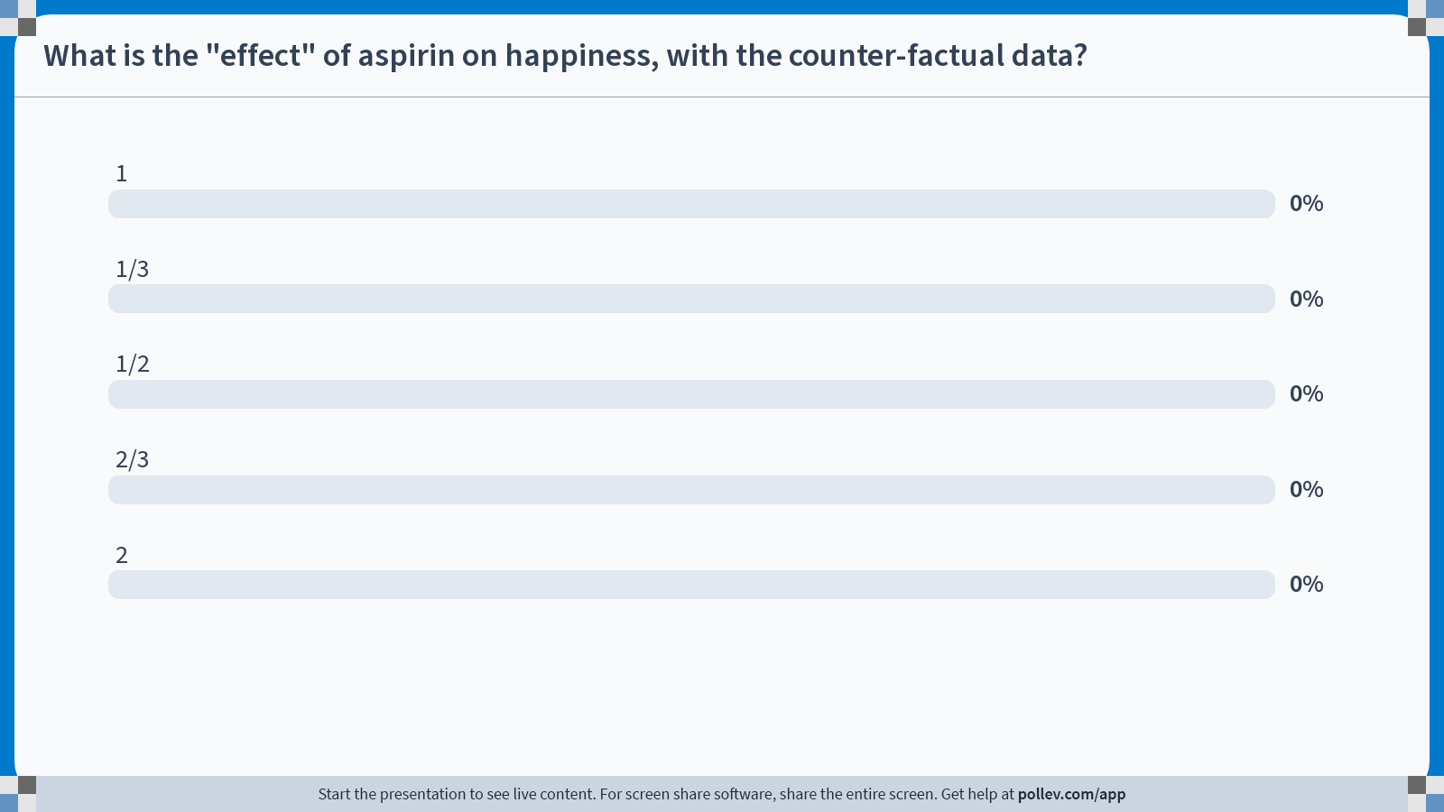
Notes:
Do not modify the notes in this section to avoid tampering with the Poll Everywhere activity. More info at polleverywhere.com/support What is the "effect" of aspirin on happiness, with the counter-factual data?
https://www.polleverywhere.com/multiple_choice_polls/U5MggXaE0DiIR6DHvnte8?state=opened&flow=Default&onscreen=persist

Slide 58


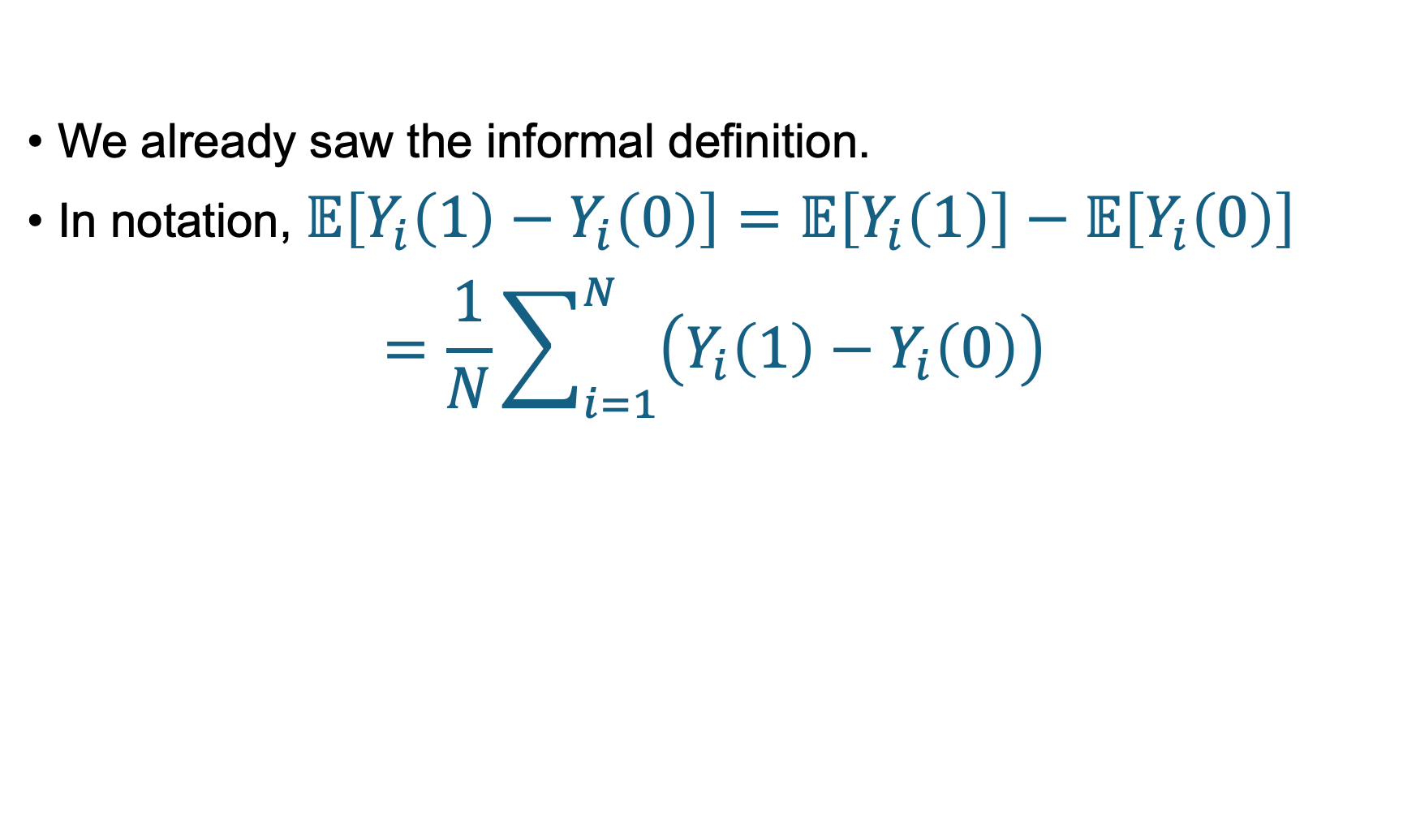



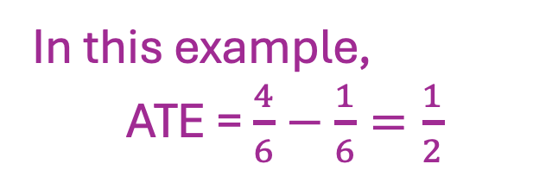














Average Treatment Effect (ATE) More formal definition
We already saw the informal definition.
In notation, $𝔼\left[Y_{i}\left(1\right)−Y_{i}\left(0\right)\right]=𝔼\left[Y_{i}\left(1\right)\right]−𝔼\left[Y_{i}\left(0\right)\right]$
$$=\frac{1}{N}\sum_{i=1}^{N}{\left(Y_{i}\left(1\right)−Y_{i}\left(0\right)\right)}$$
$$1$$
$$2$$
$$3$$
$$4$$
$$5$$
$$6$$
We already saw this too!
$$i$$
In this example,
ATE = $\frac{4}{6}−\frac{1}{6}=\frac{1}{2}$
$$Y_{1}\left(1\right)=1$$
$$Y_{2}\left(1\right)=1$$
$$Y_{3}\left(1\right)=1$$
$$Y_{4}\left(1\right)=0$$
$$Y_{5}\left(1\right)=1$$
$$Y_{6}\left(1\right)=0$$
$$Y_{1}\left(0\right)=0$$
$$Y_{2}\left(0\right)=0$$
$$Y_{3}\left(0\right)=0$$
$$Y_{4}\left(0\right)=0$$
$$Y_{5}\left(0\right)=0$$
$$Y_{6}\left(0\right)=1$$

Slide 59
Average Treatment Effect (ATE) More formal definition
We already saw the informal definition.
In notation, $𝔼\left[Y_{i}\left(1\right)−Y_{i}\left(0\right)\right]=𝔼\left[Y_{i}\left(1\right)\right]−𝔼\left[Y_{i}\left(0\right)\right]$
$$=\frac{1}{N}\sum_{i=1}^{N}{\left(Y_{i}\left(1\right)−Y_{i}\left(0\right)\right)}$$
Interpreting ATE:
Choose someone at random in the population.
ATE is how much you expect aspirin to change their happiness vs. no aspirin.
$$1$$
$$5$$
$$6$$
$$2$$
$$3$$
$$4$$
$$i$$
$$Y_{1}\left(1\right)=1$$
$$Y_{2}\left(1\right)=1$$
$$Y_{3}\left(1\right)=1$$
$$Y_{4}\left(1\right)=0$$
$$Y_{5}\left(1\right)=1$$
$$Y_{6}\left(1\right)=0$$
$$Y_{1}\left(0\right)=0$$
$$Y_{2}\left(0\right)=0$$
$$Y_{3}\left(0\right)=0$$
$$Y_{4}\left(0\right)=0$$
$$Y_{5}\left(0\right)=0$$
$$Y_{6}\left(0\right)=1$$

Slide 60
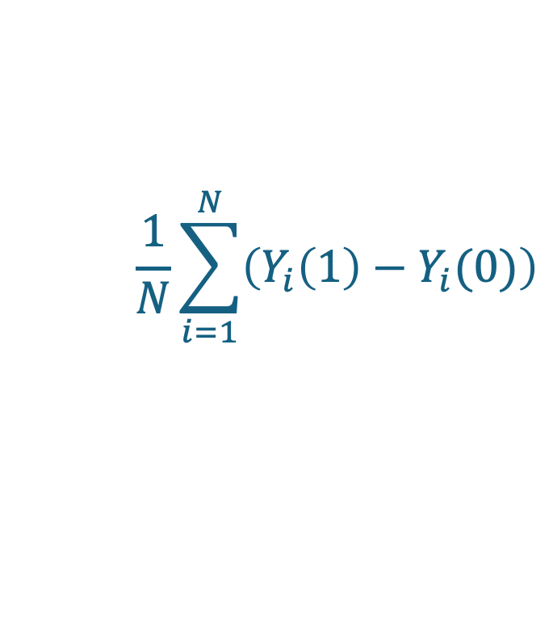
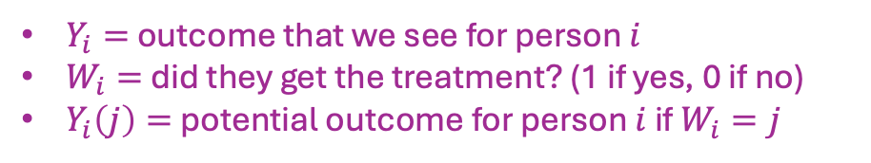
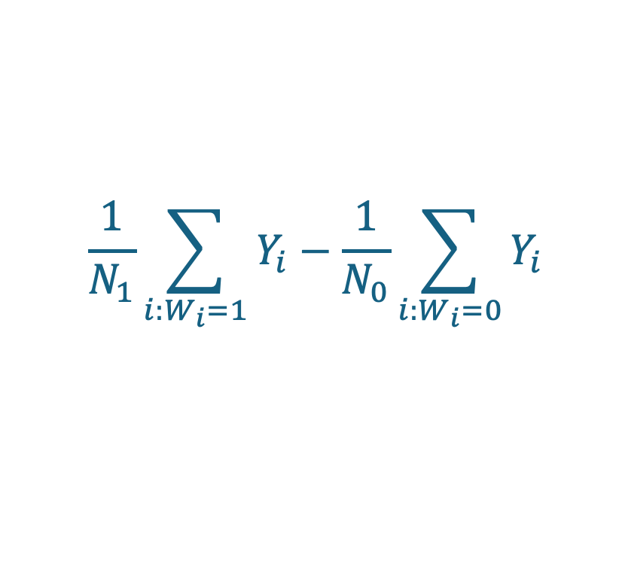
Summary What we want vs. What we have
$Y_{i}=$ outcome that we see for person $i$
$W_{i}=$ did they get the treatment? (1 if yes, 0 if no)
$Y_{i}\left(j\right)=$ potential outcome for person $i$ if $W_{i}=j$
What we want: Average Treatment Effect (ATE) / Causation
What we have: Observational Comparison / Correlation
$$\frac{1}{N}\sum_{i=1}^{N}{\left(Y_{i}\left(1\right)−Y_{i}(0)\right)}$$
$$\frac{1}{N_{1}}\sum_{i:W_{i}=1}{Y_{i}}−\frac{1}{N_{0}}\sum_{i:W_{i}=0}{Y_{i}}$$
How much better off would the average person be if they took aspirin compared to if they didn’t?
How much better off is the average person who takes aspirin compared to the average person who doesn’t?

Slide 61
Summary What we want vs. What we have
$Y_{i}=$ outcome that we see for person $i$
$W_{i}=$ did they get the treatment? (1 if yes, 0 if no)
$Y_{i}\left(j\right)=$ potential outcome for person $i$ if $W_{i}=j$
What we want: Average Treatment Effect (ATE) / Causation
What we have: Observational Comparison / Correlation
Not in general the same!!!
$$\frac{1}{N}\sum_{i=1}^{N}{\left(Y_{i}\left(1\right)−Y_{i}(0)\right)}$$
$$\frac{1}{N_{1}}\sum_{i:W_{i}=1}{Y_{i}}−\frac{1}{N_{0}}\sum_{i:W_{i}=0}{Y_{i}}$$
How much better off would the average person be if they took aspirin compared to if they didn’t?
How much better off is the average person who takes aspirin compared to the average person who doesn’t?

Slide 62
Summary What we want vs. What we have
$Y_{i}=$ outcome that we see for person $i$
$W_{i}=$ did they get the treatment? (1 if yes, 0 if no)
$Y_{i}\left(j\right)=$ potential outcome for person $i$ if $W_{i}=j$
What we want: Average Treatment Effect (ATE) / Causation
What we have: Observational Comparison / Correlation
Not in general the same!!!
$$\frac{1}{N}\sum_{i=1}^{N}{\left(Y_{i}\left(1\right)−Y_{i}(0)\right)}$$
$$\frac{1}{N_{1}}\sum_{i:W_{i}=1}{Y_{i}}−\frac{1}{N_{0}}\sum_{i:W_{i}=0}{Y_{i}}$$
These can be very different if there are confounding variables.
This is also sometimes called selection effects: the people who select into the treatment might be different than those who don’t.

Slide 63
Examples: think of confounding variables!
Effects of a job training program
Folks who are poor/unemployed get government assistance finding a job.
Can we study how well the program works by comparing participants and non-participants?
Effects of military service on income
Can we study this by comparing veterans to non-veterans?
Discuss: What sort of confounding variables might be relevant in these examples?

Slide 64
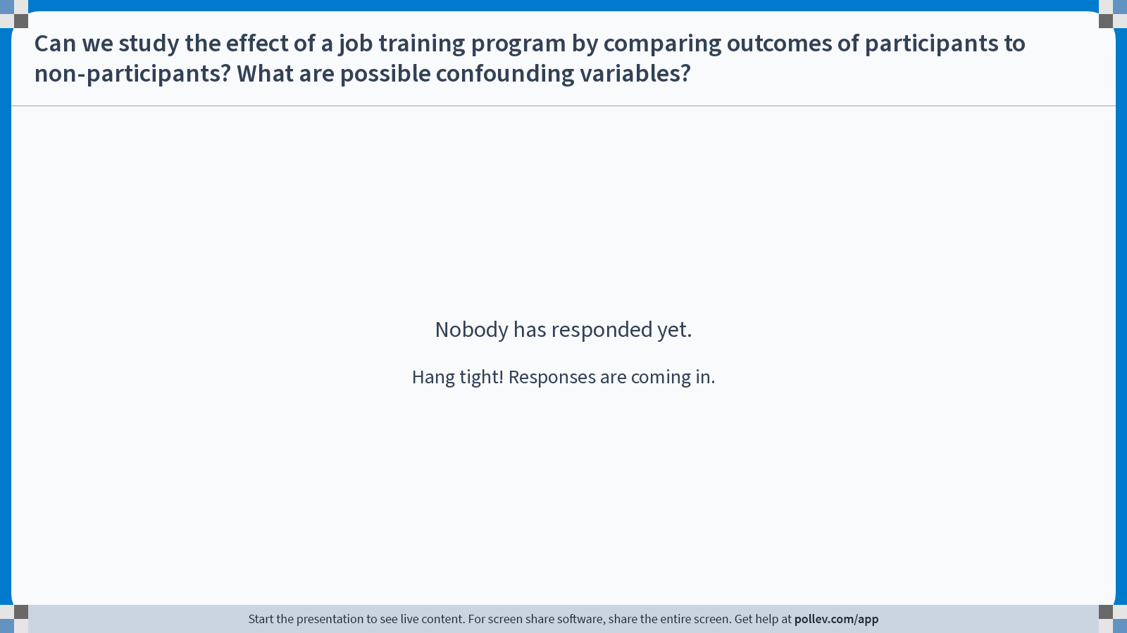
Notes:
Do not modify the notes in this section to avoid tampering with the Poll Everywhere activity. More info at polleverywhere.com/support Can we study the effect of a job training program by comparing outcomes of participants to non-participants? What are possible confounding variables?
https://www.polleverywhere.com/discourses/4aDwl0NTD1oHizODmE5Bm

Slide 65

Notes:
Do not modify the notes in this section to avoid tampering with the Poll Everywhere activity. More info at polleverywhere.com/support Can we study the effect of military service on income by comparing veterans to non-veterans? What are possible confounding variables and why?
https://www.polleverywhere.com/discourses/V0dqCzIMtGw2JGklw9Edj

Slide 66
How would you fix this?
If you wanted to learn the effect of…
Advil on headaches
Education on income
Job training programs on income
Military service on income
…What would you do?
Discuss!

Slide 67
Recap and Looking Ahead

Slide 68
Recap
Correlation and Causation: They’re not the same!
In this class, “Causation” has to do with “what would have happened otherwise.”
Fundamental problem: We can’t know “what would have happened otherwise.”
What we want: Average Treatment Effect
What we have: Observational Comparison
What separates them*: Confounding variables
*Assuming no spillovers, etc.

Slide 69

Next time
The ideal way around selection effects: randomization!

Slide 70
Before next time
Reading response! ☺

Slide 71


Exit ticket
Don’t forget to fill out the exit ticket before you leave class!

