Slide 1
Problems with Experiments
Causality, Decision Making, and Data Science
Lecture 4

Slide 2
Announcements
HW1 Part 1 Due soon!
Monday, 11:59pm

Slide 3
Agenda
Why are randomized experiments good (formally)? And how do we analyze them?
Four experiments
Problems with these experiments, and experiments in general.

Slide 4

Agenda
Finishing up Analyzing RCTs
Four experiments
Problems with these experiments, and experiments in general.
The problems that we’re going to talk about today can show up even if you do all the statistics correctly!
(That is, even if you have big sample sizes, compute accurate p-values, etc).

Slide 5
The Statistical Analysis of RCTs

Slide 6
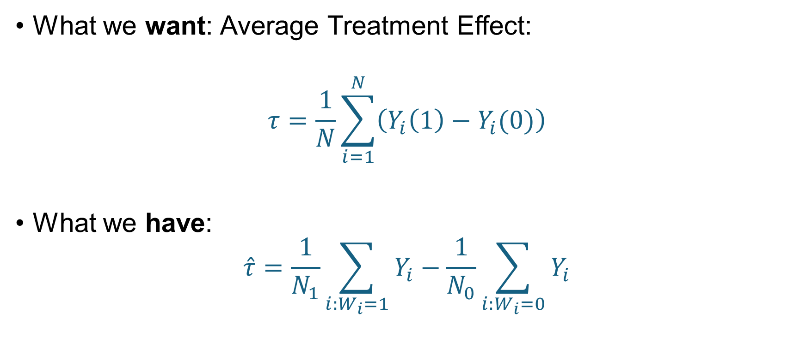
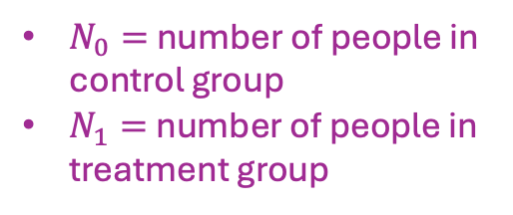
In the RCT context, our “Observational Comparison” from last week is an estimator
What we want: Average Treatment Effect:
$$τ=\frac{1}{N}\sum_{i=1}^{N}{\left(Y_{i}\left(1\right)−Y_{i}(0)\right)}$$
What we have:
$$\hat{τ}=\frac{1}{N_{1}}\sum_{i:W_{i}=1}{Y_{i}}−\frac{1}{N_{0}}\sum_{i:W_{i}=0}{Y_{i}}$$
$N_{0}=$ number of people in control group
$N_{1}=$ number of people in treatment group

Slide 7







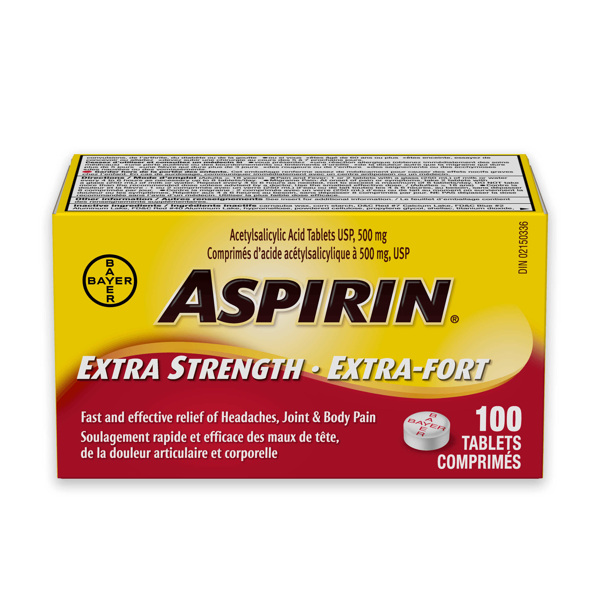















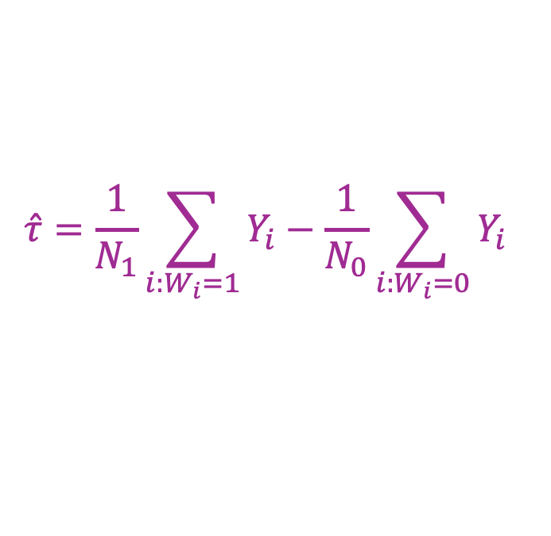










Aspirin example from last week
$$\hat{τ}=\frac{1}{N_{1}}\sum_{i:W_{i}=1}{Y_{i}}−\frac{1}{N_{0}}\sum_{i:W_{i}=0}{Y_{i}}$$
Randomly choose 3 of the 6 units for the control group, the rest are in the treatment group.
$N_{0}=N_{1}=3$
For each $i$, $W_{i}=1$ with probability ½ and $W_{i}=0$ with probability ½
Let’s compute $𝔼\left[\hat{τ}\right]!$
(On the board)
$$1$$
$$2$$
$$3$$
$$4$$
$$5$$
$$6$$
$$i$$
$$Y_{i}(1)$$
$$1$$
$$1$$
$$1$$
$$0$$
$$1$$
$$0$$
$$Y_{i}(0)$$
$$0$$
$$0$$
$$0$$
$$0$$
$$0$$
$$1$$

Slide 8
Aspirin example from last time
$$\hat{τ}=\frac{1}{N_{1}}\sum_{i:W_{i}=1}{Y_{i}}−\frac{1}{N_{0}}\sum_{i:W_{i}=0}{Y_{i}}$$
Randomly choose 3 of the 6 units for the control group, the rest are in the treatment group.
$N_{0}=N_{1}=3$
For each $i$, $W_{i}=1$ with probability ½ and $W_{i}=0$ with probability ½
Let’s compute $𝔼\left[\hat{τ}\right]!$
(On the board)
$$1$$
$$2$$
$$3$$
$$4$$
$$5$$
$$6$$
$$i$$
$$Y_{i}(1)$$
$$1$$
$$1$$
$$1$$
$$0$$
$$1$$
$$0$$
It’s ½! Same as ATE!
$$Y_{i}(0)$$
$$0$$
$$0$$
$$0$$
$$0$$
$$0$$
$$1$$

Slide 9


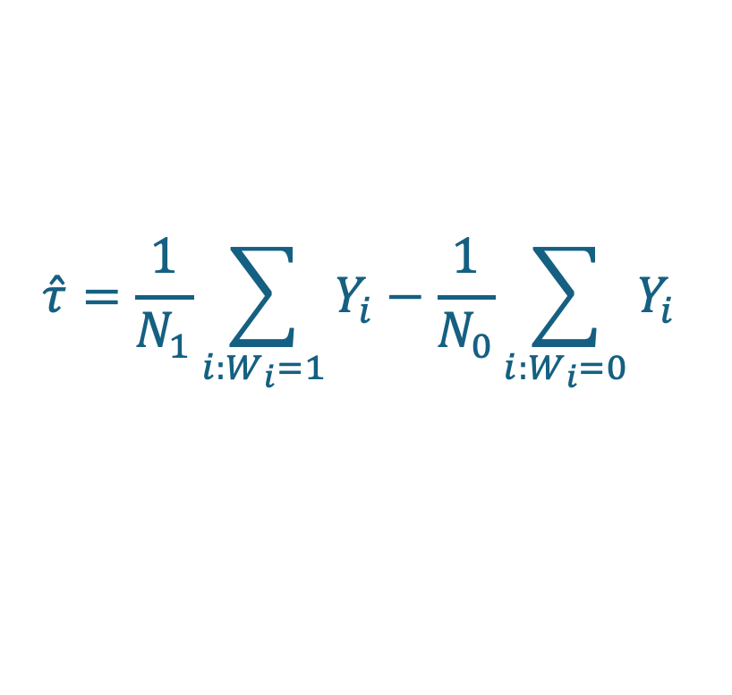
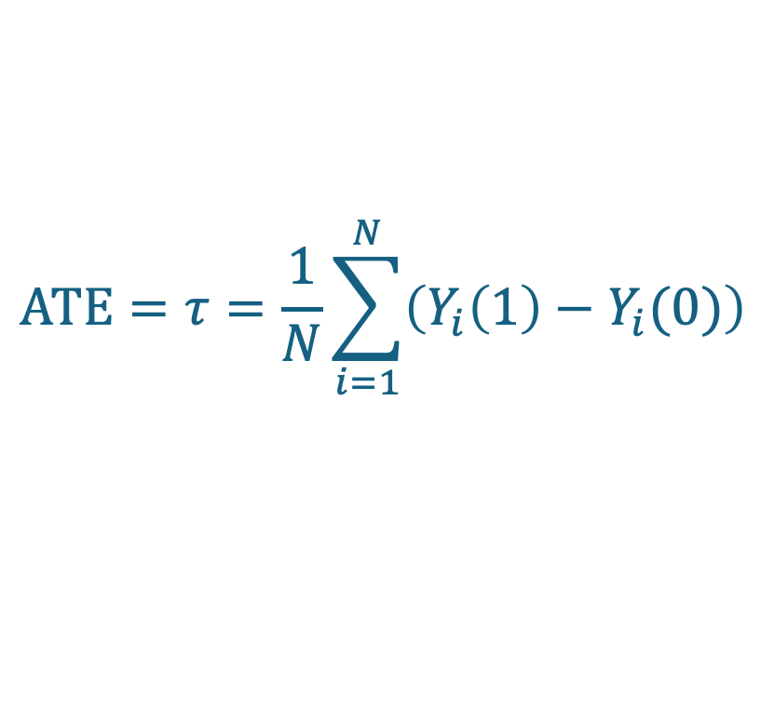
More generally In an RCT, $𝔼\left[\hat{τ}\right]=τ$
Try to prove this yourself if you are into that sort of thing!
Or check out skipped slides from last time
Formally, that’s one reason RCTs are “special”!
What we have:
$$\hat{τ}=\frac{1}{N_{1}}\sum_{i:W_{i}=1}{Y_{i}}−\frac{1}{N_{0}}\sum_{i:W_{i}=0}{Y_{i}}$$
While $\hat{τ}≠τ$ in general,
in an RCT,
$\hat{τ}$ is an unbiased estimator for $τ$!
What we want:
$$ATE=τ=\frac{1}{N}\sum_{i=1}^{N}{\left(Y_{i}\left(1\right)−Y_{i}(0)\right)}$$

Slide 10
But… we want more than “unbiased” We want an accurate estimate of ATE!
More data = more better
How do we quantify that?
Last week and on HW0, we saw two methods for computing standard errors and constructing confidence intervals:
Resampling (aka bootstrapping)
Analytical methods
Both work here!
We’ll just discuss resampling today
See skipped slides from last time if you are interested in analytical methods

Slide 11
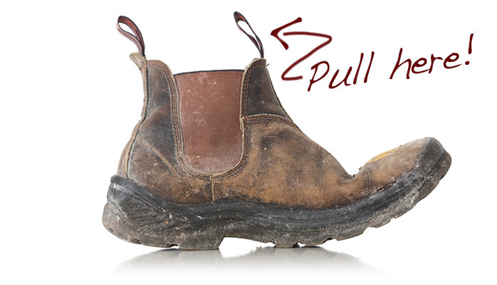
Resampling (aka bootstrapping)
Basic idea:
Use the data you have to construct a bunch of “fake” (bootstrap) datasets at random, by resampling with replacement.
Look at the distribution of those.

Slide 12



Resampling
Suppose we have a treatment group $T$ and a control group $C$
Choose $T$ randomly of size $N_{1}=3$, and $C$ is the rest, of size $N_{0}=3.$
Resample!
Choose $N_{0}$ people with repetition in $C$ at random.
Choose $N_{1}$ people with repetition in $T$ at random.
Create “new” treatment and control groups from these samples.
Actual Treatment Group $T$
Actual Control Group $C$

Slide 13


Resampling
Suppose we have a treatment group $T$ and a control group $C$
Choose $T$ randomly of size $N_{1}=3$, and $C$ is the rest, of size $N_{0}=3.$
Resample!
Choose $N_{0}$ people with repetition in $C$ at random.
Choose $N_{1}$ people with repetition in $T$ at random.
Create “new” treatment and control groups from these samples.
“New/bootstrapped” Treatment Group $T^{∗}$
“New/bootstrapped” Control Group $C^{∗}$

Slide 14


Resampling
Suppose we have a treatment group $T$ and a control group $C$
Resample!
Create “new” treatment and control groups from these samples.
“New/bootstrapped” Treatment Group $T^{∗}$
“New/bootstrapped” Control Group $C^{∗}$

Slide 15

Resampling
Suppose we have a treatment group $T$ and a control group $C$
Resample!
Create “new” treatment and control groups from these samples.
Compute $\hat{τ}$ with these treatment/control groups.
Repeat a bunch of times and look at the distribution of all the $\hat{τ}$’s you get.
“New/bootstrapped” Treatment Group $T^{∗}$
“New/bootstrapped” Control Group $C^{∗}$

Slide 16
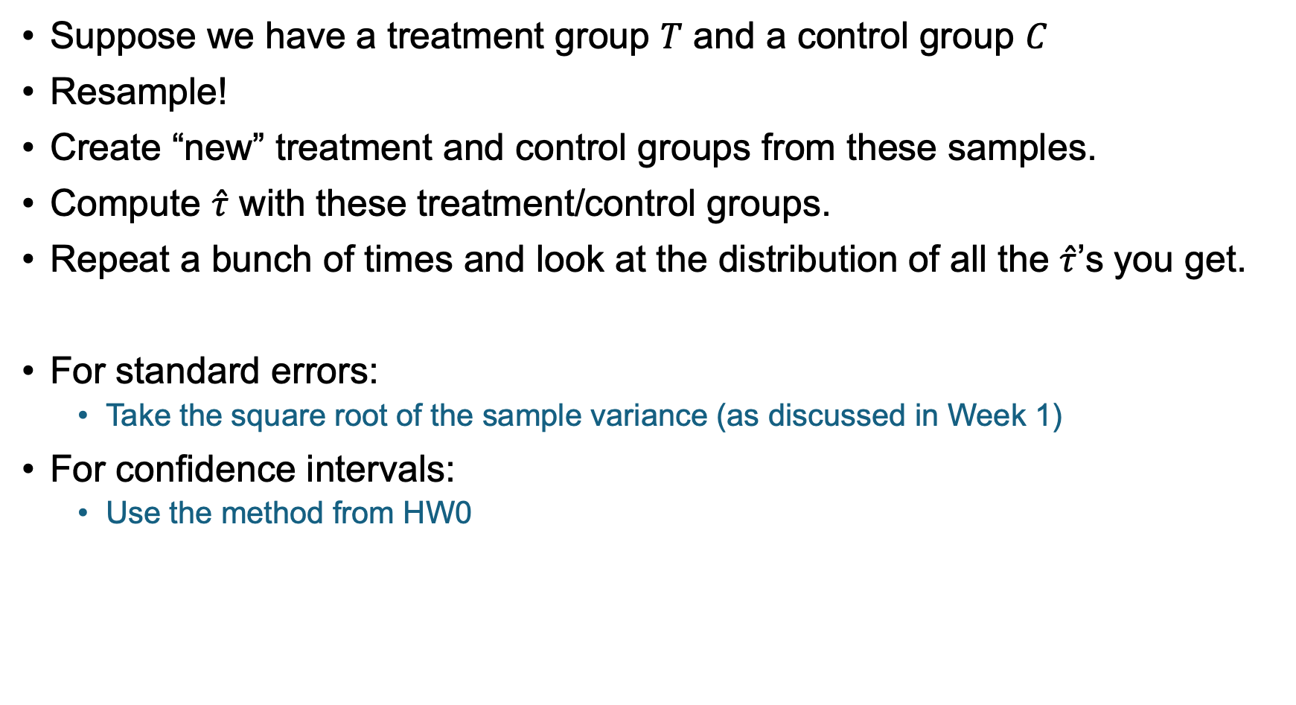
Resampling
Suppose we have a treatment group $T$ and a control group $C$
Resample!
Create “new” treatment and control groups from these samples.
Compute $\hat{τ}$ with these treatment/control groups.
Repeat a bunch of times and look at the distribution of all the $\hat{τ}$’s you get.
For standard errors:
Take the square root of the sample variance (as discussed in Week 1)
For confidence intervals:
Use the method from HW0

Slide 17

Analytical methods
Basic idea:
Do some math to figure out what the distribution of $\hat{τ}$ should be
Maybe we have to plug in some estimates

Slide 18
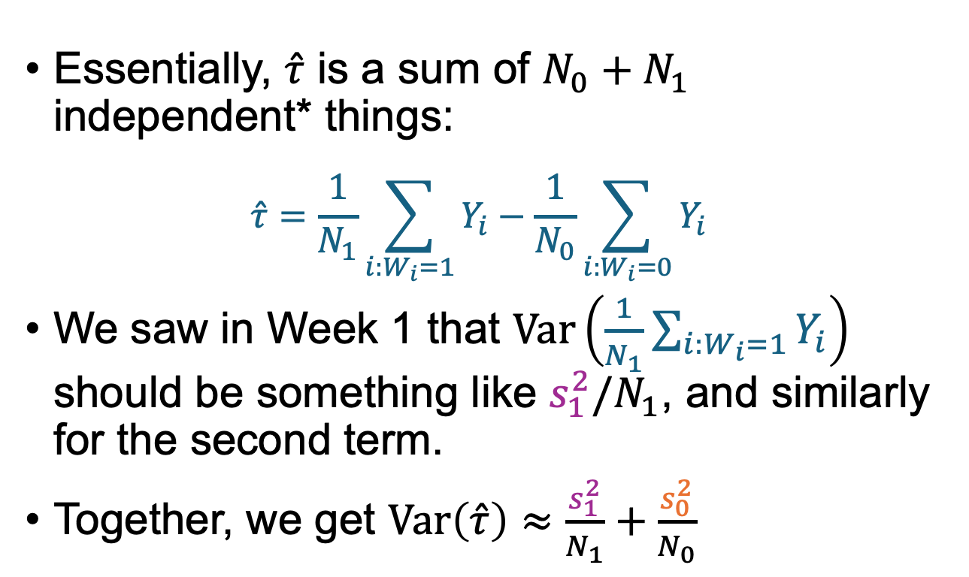
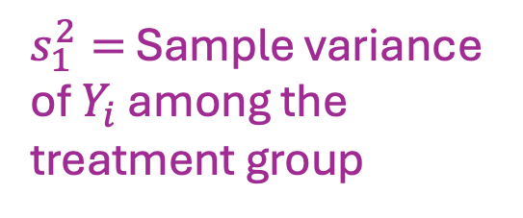
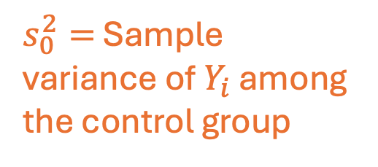
Analytic Variance Estimator
Essentially, $\hat{τ}$ is a sum of $N_{0}+N_{1}$ independent* things:
$$\hat{τ}=\frac{1}{N_{1}}\sum_{i:W_{i}=1}{Y_{i}}−\frac{1}{N_{0}}\sum_{i:W_{i}=0}{Y_{i}}$$
We saw in Week 1 that $Var\left(\frac{1}{N_{1}}\sum_{i:W_{i}=1}{Y_{i}}\right)$ should be something like $s_{1}^{2}/N_{1}$, and similarly for the second term.
Together, we get $Var\left(\hat{τ}\right)≈\frac{s_{1}^{2}}{N_{1}}+\frac{s_{0}^{2}}{N_{0}}$
$s_{1}^{2}=$ Sample variance of $Y_{i}$ among the treatment group
$s_{0}^{2}=$ Sample variance of $Y_{i}$ among the control group
*Not actually independent! This is because, e.g., someone can’t be in both the control group and the treatment group at the same time. But pretty close when N is big.

Slide 19

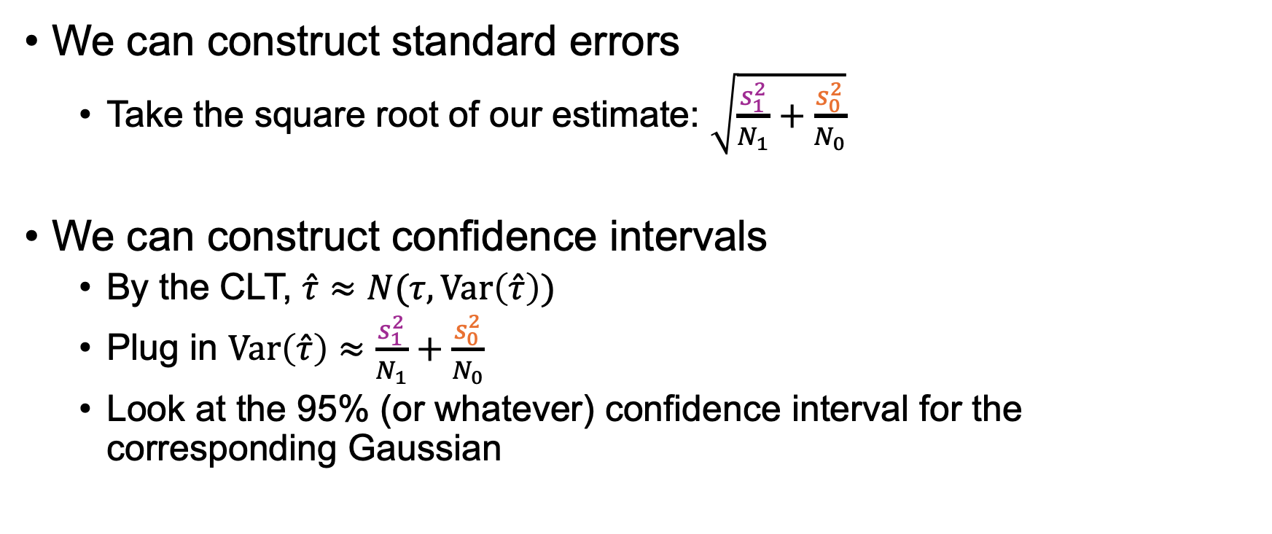
With our estimate of $Var(\hat{τ})$…
We can construct standard errors
Take the square root of our estimate: $\sqrt{\frac{s_{1}^{2}}{N_{1}}+\frac{s_{0}^{2}}{N_{0}}}$
We can construct confidence intervals
By the CLT, $\hat{τ}≈N(τ, Var\left(\hat{τ}\right))$
Plug in $Var\left(\hat{τ}\right)≈\frac{s_{1}^{2}}{N_{1}}+\frac{s_{0}^{2}}{N_{0}}$
Look at the 95% (or whatever) confidence interval for the corresponding Gaussian

Slide 20
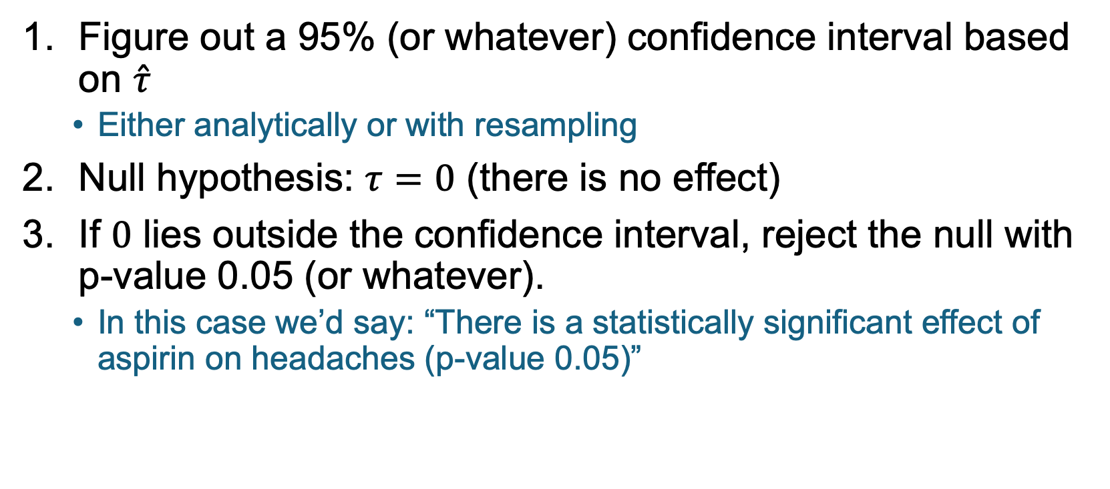
This allows us to do hypothesis testing!
Figure out a 95% (or whatever) confidence interval based on $\hat{τ}$
Either analytically or with resampling
Null hypothesis: $τ=0$ (there is no effect)
If $0$ lies outside the confidence interval, reject the null with p-value 0.05 (or whatever).
In this case we’d say: “There is a statistically significant effect of aspirin on headaches (p-value 0.05)”
Typically we’d do this the other way around ... Instead of first picking “95%” and seeing if we can reject the null hypothesis with p-value 0.05, we’d start with the null and see what p-value would allow us to reject it.

Slide 21
Putting in all together and interpreting results

Slide 22
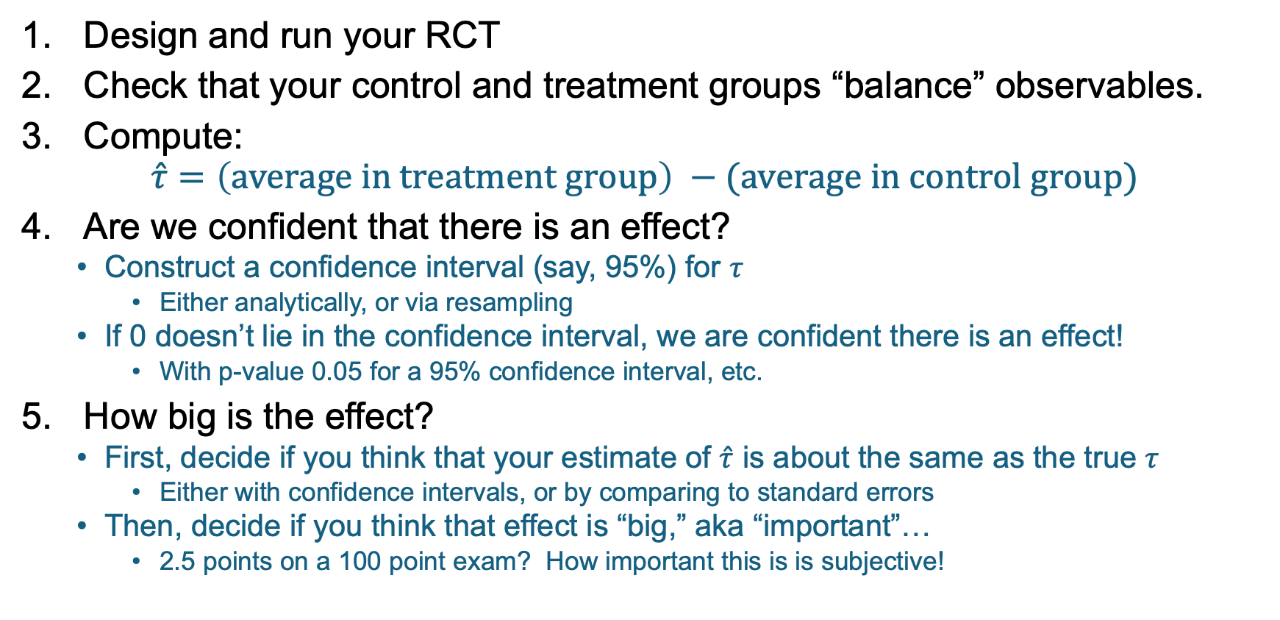
Putting it all together Analyzing an RCT
Design and run your RCT
Check that your control and treatment groups “balance” observables.
Compute:
$$\hat{τ}=\left(average in treatment group\right) −(average in control group)$$
Are we confident that there is an effect?
Construct a confidence interval (say, 95%) for $τ$
Either analytically, or via resampling
If 0 doesn’t lie in the confidence interval, we are confident there is an effect!
With p-value 0.05 for a 95% confidence interval, etc.
How big is the effect?
First, decide if you think that your estimate of $\hat{τ}$ is about the same as the true $τ$
Either with confidence intervals, or by comparing to standard errors
Then, decide if you think that effect is “big,” aka “important”…
2.5 points on a 100 point exam? How important this is is subjective!
A result can be very statistically significant without being very big (aka important)!

Slide 23
Problems with Experiments

Slide 24
Reading responses
Last time in class, and in your reading responses, you thought about problems with the West Point laptop experiment.
The settings are different!
West Point students are different from Stanford students
Technology in 2014-2016 is different from 2024
Intro Econ is different than this class
Are test scores the right thing to measure?
Morally, is it right to take away agency from students?
…
Today we’ll discuss these issues more generally.

Slide 25
Four more experiments
Greater Avenues to Independence (GAIN)
Does a job training program work?
Perry Preschool Program
What is the effect of early childhood education?
Racial Discrimination in the Sharing Economy
Do Airbnb hosts discriminate against Black users?
Facebook Emotional Contagion
Do the emotions that we see expressed on Facebook effect our own emotions?

Slide 26
The plan
We’ll talk about each of these four in a “just-the-facts” way.
We’ll talk about some issues with experiments in general.
Along the way, we’ll revisit each of these four experiments and see which issues apply.
Pay attention to things like:
What population participates in the study?
What outcomes does the study measure?
What question is the study trying to answer?
…and think about other potential issues that might come up.

Slide 27
Four Experiments

Slide 28
Experiment 1 GAIN
Greater Avenues to Independence

Slide 29
Job training programs
Typically aimed at welfare recipients.
Provides some or all of:
Basic education
Vocational training
Support in finding a job

Slide 30
Questions we might want to answer
Are particular job training programs effective?
Which sort of job training program is more effective?

Slide 31
Questions we might want to answer
Are particular job training programs effective?
Which sort of job training program is more effective?
A program which emphasizes getting a job as soon as possible?
A program which emphasizes training and building human capital?

Slide 32
Greater Avenues to Independence (GAIN)
Job training program in CA (since 1986)
Implemented differently in different counties, e.g.:
Riverside:
“find a job first” focused program
Enrolled all welfare recipients in Riverside county
Los Angeles:
“build human capital” focused program
Enrolled long-term welfare recipients in LA county
Each county ran* an RCT.
1988-1990(ish)
*RCTs were run by Manpower Demonstration Research Corporation (MDRC)

Slide 33
Results
The Riverside program (jobs first) did great!
Participants were 39% more likely to find a job in the next 1-3 years.
Participants made 63% more money in the next 1-3 years.
These results were statistically significant (p-value 0.01)
The LA program (human capital first) didn’t look so good.
Nothing statistically significant 1-3 years out.

Slide 34
Results* 1-3 years after enrolling in the program
=Statistically significant (p=0.01)
Also measured:
# quarters employed
Earnings above min. wage
# quarters on AFDC/TANF benefits
Los Angeles (Human Capital first)
Riverside (Jobs first)
Control
Group
Treatment Group
Percentage difference
Control
Group
Treatment Group
Percentage difference
What fraction were employed at all that year?
24.5%
26.1%
+7%
35.3%
49%
+39%
Annual earnings (in 1999 dollars)
$1,849
$1,843
+0%
$2,253
$3,668
+63%
(1458 people total)
(2288 people total)
*Simplified ☺
Notes:
AFDC = Aid to Families with Dependent Children
TANF = California Tribal Temporary Assistance for Needy Families

Slide 35
This was impactful
Based on these data, the Wilson administration in California pushed to have all CA counties adopt the Riverside work-first approach.

Slide 36
Experiment 2: Perry Preschool Program

Slide 37
Perry Preschool Experiment
Experiment in early education conducted from 1962-1967
Population:
153 children at Perry Elementary School in Ypsilanti, MI
To be eligible, children had to be economically disadvantaged, Black, and “low-IQ” as measured by the Stanford-Binet IQ test.
Annual surveys until age 15, follow-ups every 10 years or so until today
Treatment: 2.5-hour educational preschool each weekday, based on active learning techniques, plus weekly home visits by teachers.
Notes:
Children enter at age 3

Slide 38
Findings
Look really good!
Short term improvements in IQ
Long term improvements in all sorts of things:
High-school graduation rate
Incarceration
Teen pregnancies
…
All of these is big and statistically significant effects.

Slide 39
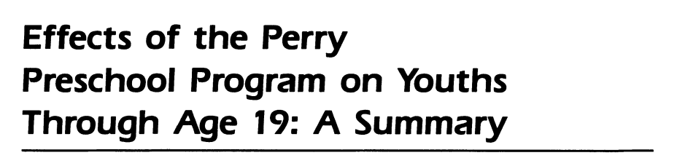
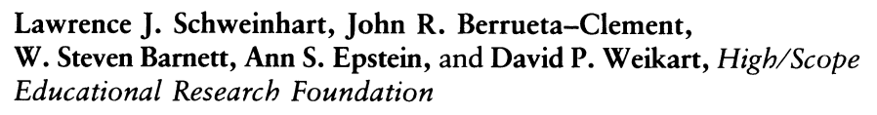
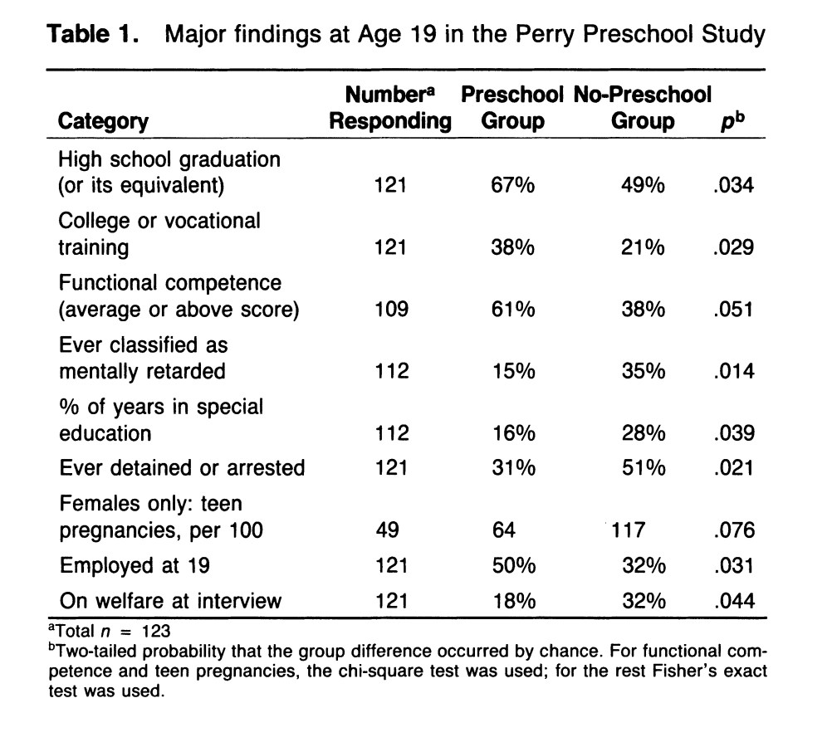
Findings
(1985)
Look really good!
Short-term increase in IQ
Longer-term increase in all sorts of good things.

Slide 40
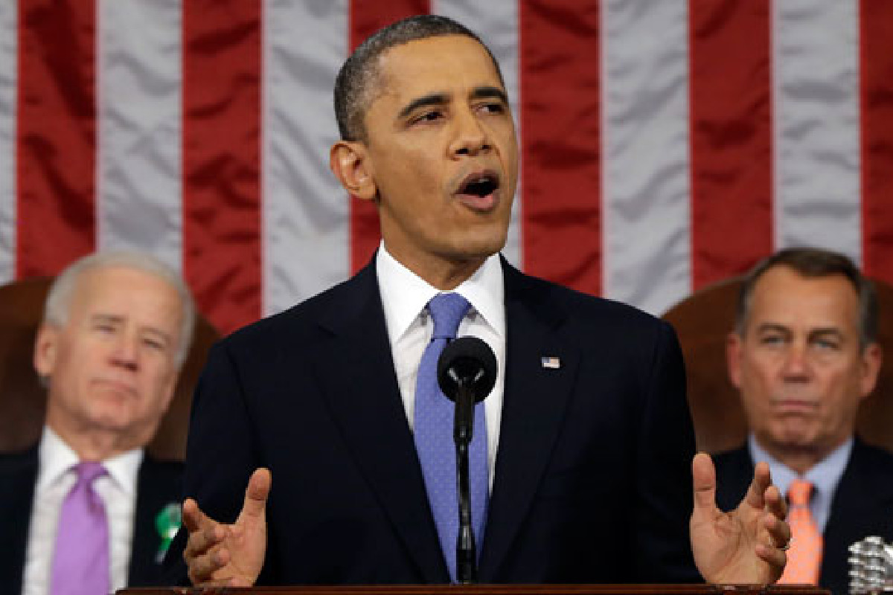
This was impactful
Influenced by this study, about 30% of HeadStart programs use this method.
President Obama referenced it (and follow-up analyses) in the 2013 State of the Union Address when discussing early childhood education.
“Every dollar we invest in high-quality early childhood education can save more than seven dollars later on -- by boosting graduation rates, reducing teen pregnancy, even reducing violent crime.”

Slide 41
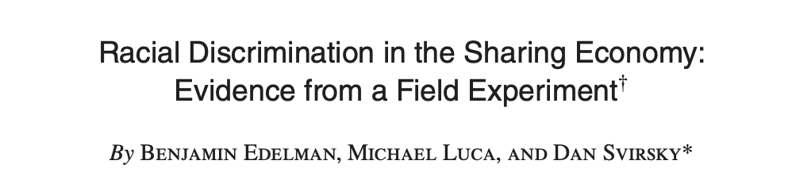

Experiment 3: Racial Discrimination on Airbnb

Slide 42
Do Airbnb hosts discriminate by race?
Back in 2015, “Instant Book” was not so common on Airbnb
You had to contact the host and ask to stay at their place

Slide 43
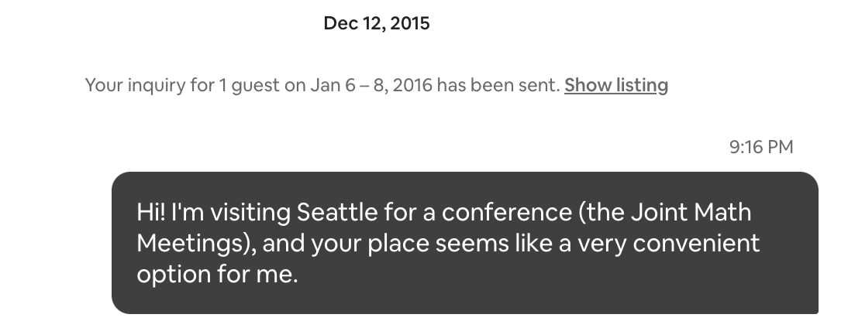
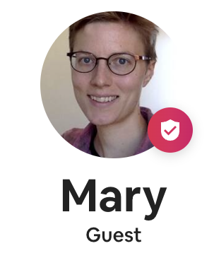
Do Airbnb hosts discriminate by race?
Back in 2015, “Instant Book” was not so common on Airbnb
You had to contact the host and ask to stay at their place
e.g., It looks like Mary sent this to someone in Seattle in 2015:

Slide 44
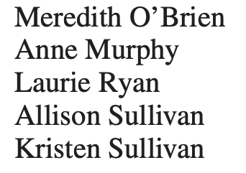
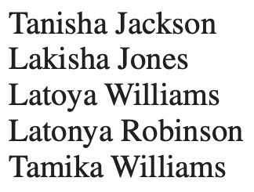
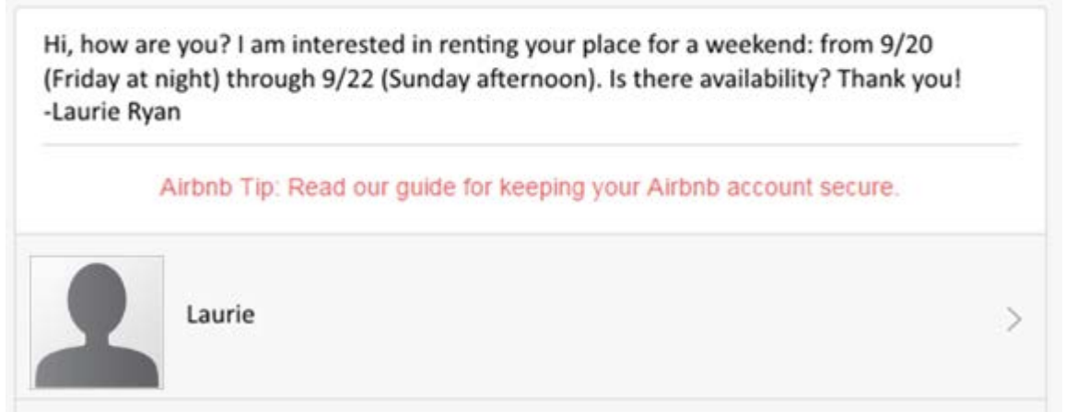
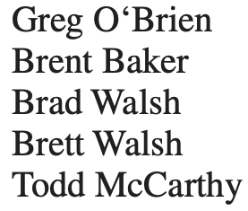
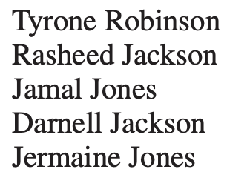
Experiment
The 5 cities:
Baltimore, Dallas, LA,
St. Louis, Washington DC
Randomly contact ~6400 listings in 5 US cities
Everything about the message is the same, except the names.
Names:
Coded “white”
Coded “Black”

Slide 45
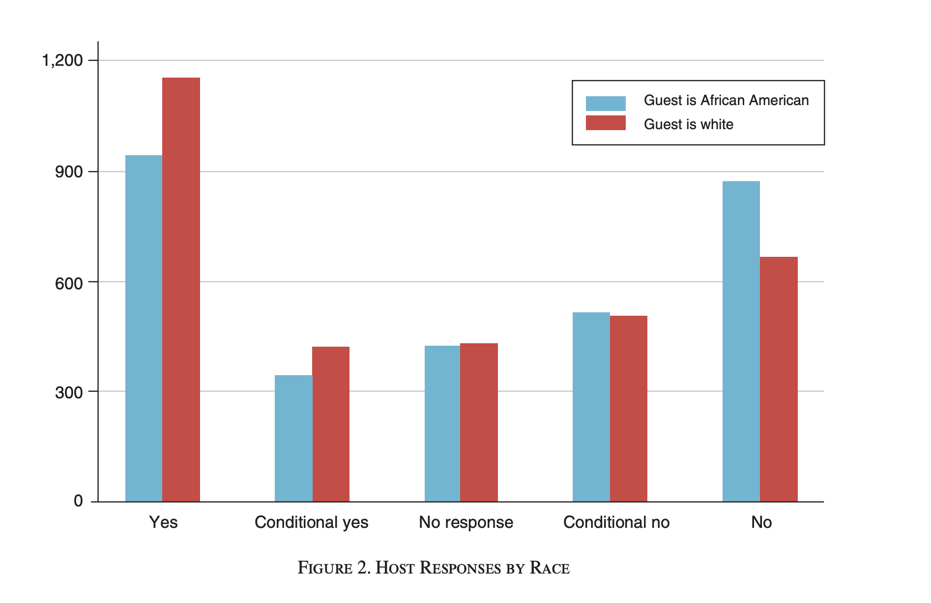
Findings
Black-sounding names got a 42% positive response rate.
White-sounding names got a 50% positive response rate.
p-value: 0.02
The paper also did a breakdown by host demographics, by city, by gender, etc, and found similar trends.

Slide 46
This was impactful?
Correlation does not imply causation, but around the time this paper came out:
Airbnb did their own audit
They have since made some changes to reduce discrimination

Slide 47
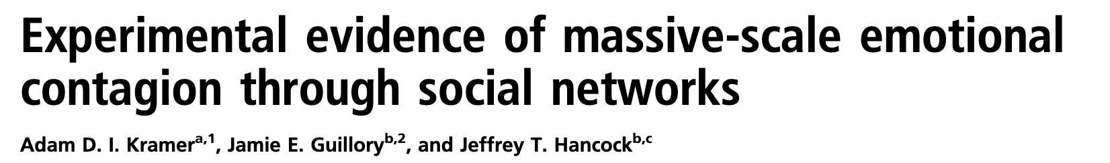

Experiment 4: Facebook Emotional Contagion Experiment
2014

Slide 48
Emotional Contagion
Research in psychology has found:
When people around you are sad, you feel sadder
When people around you are happy, you feel happier
Question: Is this true on social media?
Maybe face-to-face contact is important for the effect
Maybe non-verbal cues are important for the effect
etc

Slide 49
The experiment
Researchers at Facebook randomly manipulated what N=689,003 random users saw in their news feeds in 2012.
Control group: No change
Treatment group 1: Negative-emotion posts reduced in News Feed
Treatment group 2: Positive-emotion posts reduced in News Feed
Dependent Variable: Emotional valence of posts that follow
As measured by number of “positive” or “negative” words
All groups could still see all the posts by, e.g., going to a friend’s “wall” or “timeline”, this only affected their news feed.

Slide 50
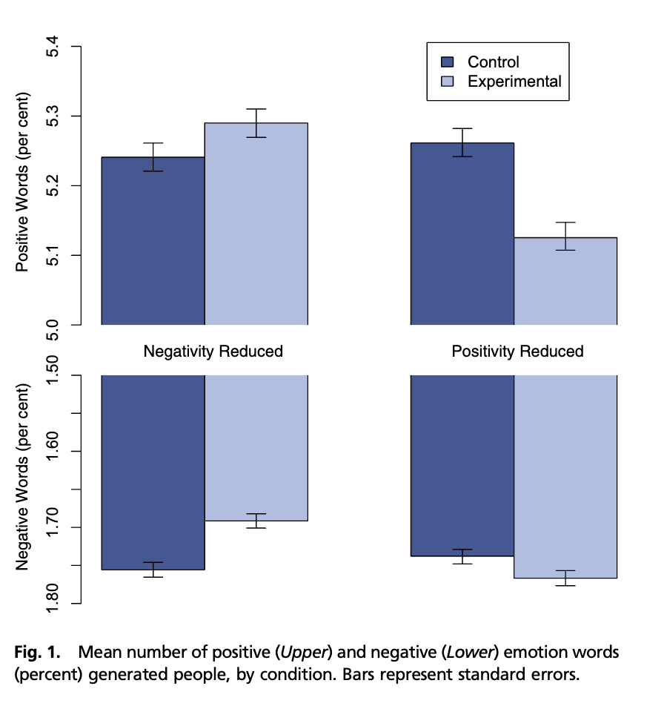
Findings
The emotional valence of your news feed effects the emotional valence of words you use.

Slide 51

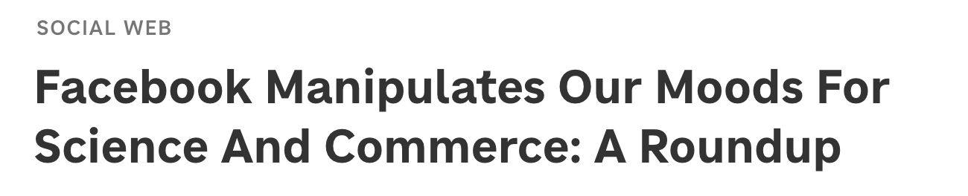
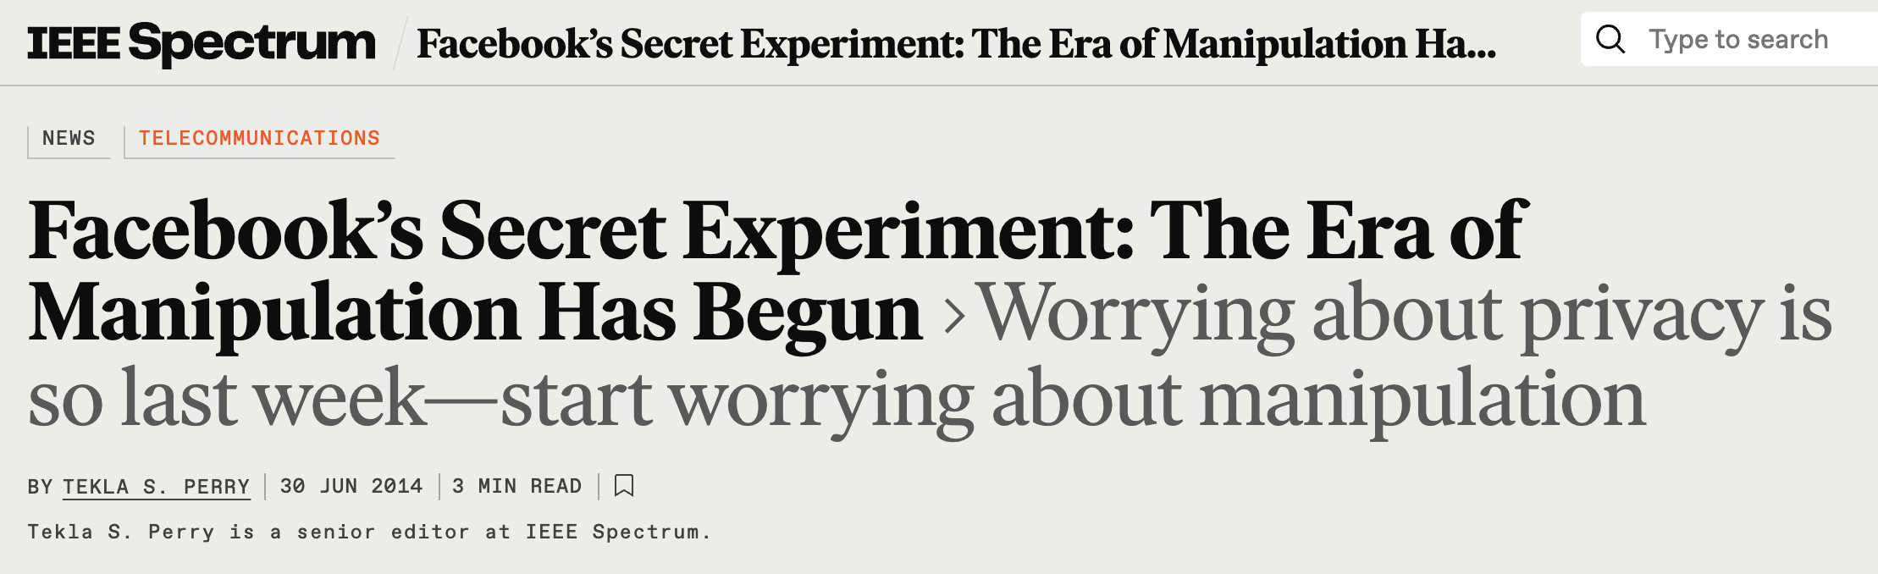
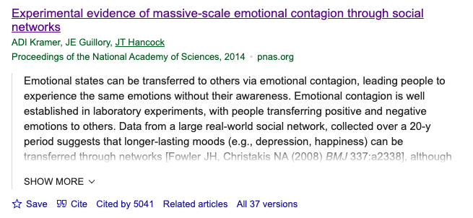
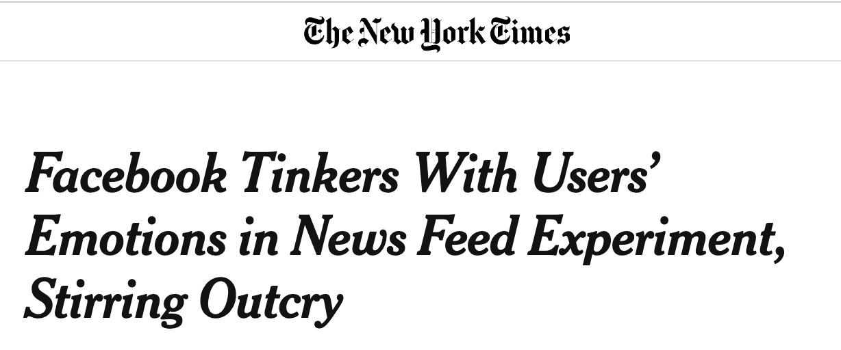
This was impactful?
At least it made a big splash…

Slide 52
Let’s take a quick break ☺
Get up, stretch, talk to your neighbor, start thinking about issues with these experiments…

Slide 53
Issues with Experiments

Slide 54
Four issues
External Validity
Construct Validity
Spillover Effects
Ethical Concerns

Slide 55
External Validity

Slide 56
Internal vs. External Validity
RCTs have good internal validity thanks to the randomization!
An experiment has good internal validity if it tells you something about the population in the study.
An experiment has good external validity if the results generalize to other populations.
Example:
Internal Validity: The laptop experiment tells us something about West Point students taking intro econ in 2016.
External Validity: Does this apply to Stanford students taking our class in 2025?

Slide 57

External Validity
Discuss!
Rate each of our four experiments on external validity:
1) Not externally valid
2) Maybe externally valid
3) Externally valid for an important population
What is one potential concern with external validity for each experiment?
GAIN (job training program in CA)
Perry Preschool Program (early childhood education program)
Racial Discrimination in the Sharing Economy (do Airbnb hosts discriminate?)
Facebook Emotional Contagion (does emotional contagion happen online?)

Slide 58
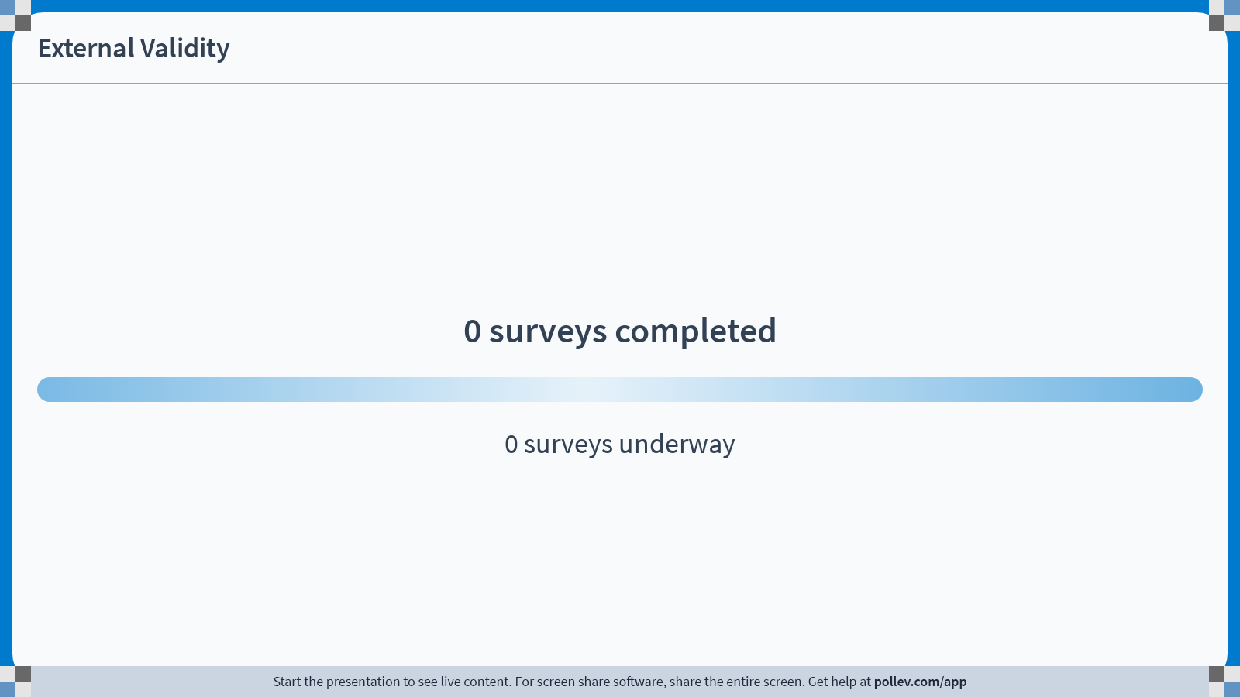
Notes:
Do not modify the notes in this section to avoid tampering with the Poll Everywhere activity. More info at polleverywhere.com/support External Validity
https://www.polleverywhere.com/surveys/rw6o7YWWzEIJx7tH4lVlj?display_state=chart&activity_state=opened&state=opened&flow=Engagement&onscreen=persist

Slide 59
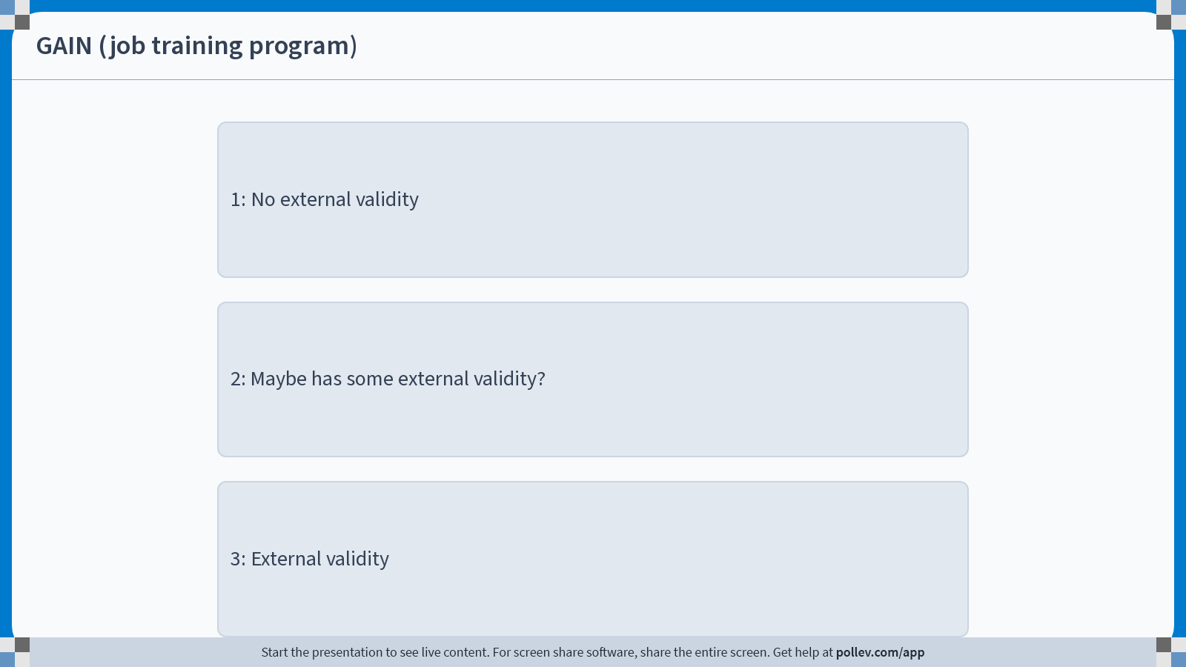
Notes:
Do not modify the notes in this section to avoid tampering with the Poll Everywhere activity. More info at polleverywhere.com/support GAIN (job training program)
https://www.polleverywhere.com/multiple_choice_polls/8mtUCXlK8Wm4FuAXwLYKp?display_state=chart&activity_state=opened&state=opened&flow=Engagement&onscreen=persist&hide=instructions

Slide 60
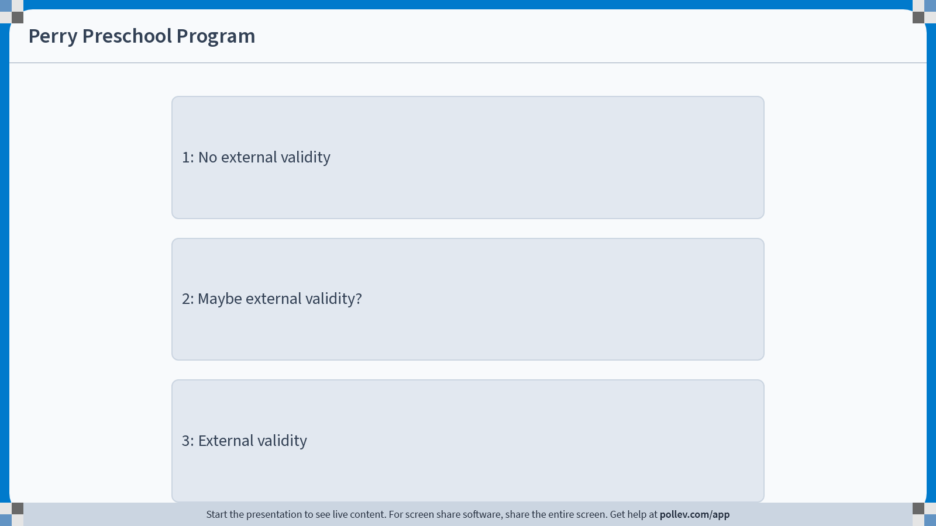
Notes:
Do not modify the notes in this section to avoid tampering with the Poll Everywhere activity. More info at polleverywhere.com/support Perry Preschool Program
https://www.polleverywhere.com/multiple_choice_polls/ch03Uilh2uFj4MhYJ3nHj?display_state=chart&activity_state=opened&state=opened&flow=Engagement&onscreen=persist&hide=instructions

Slide 61
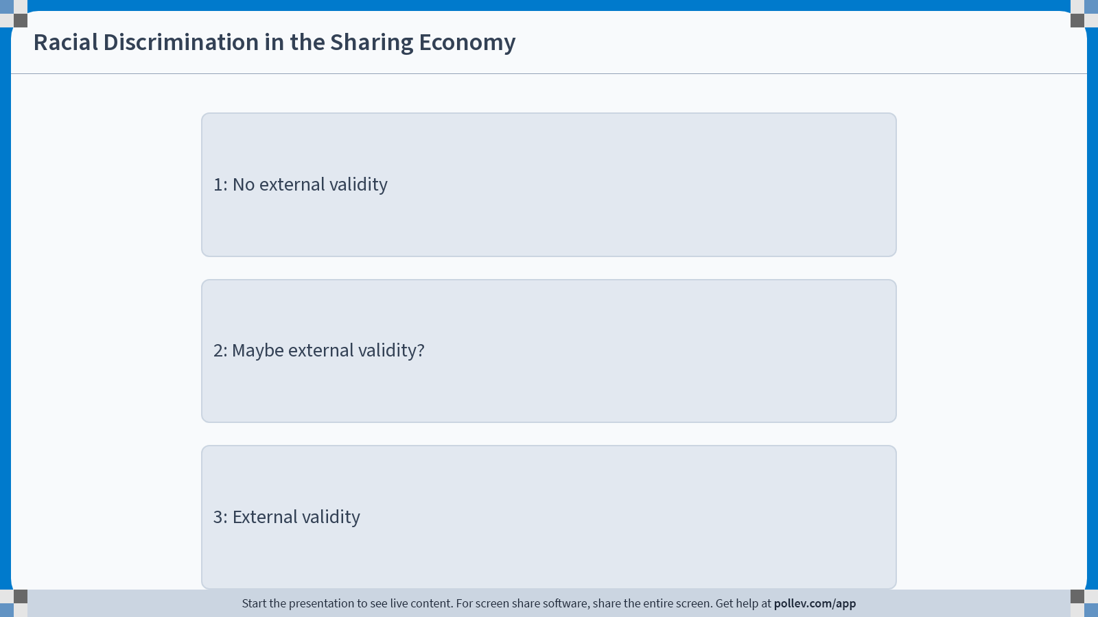
Notes:
Do not modify the notes in this section to avoid tampering with the Poll Everywhere activity. More info at polleverywhere.com/support Racial Discrimination in the Sharing Economy
https://www.polleverywhere.com/multiple_choice_polls/flqevcMK7vT85adzWURoS?display_state=chart&activity_state=opened&state=opened&flow=Engagement&onscreen=persist&hide=instructions

Slide 62
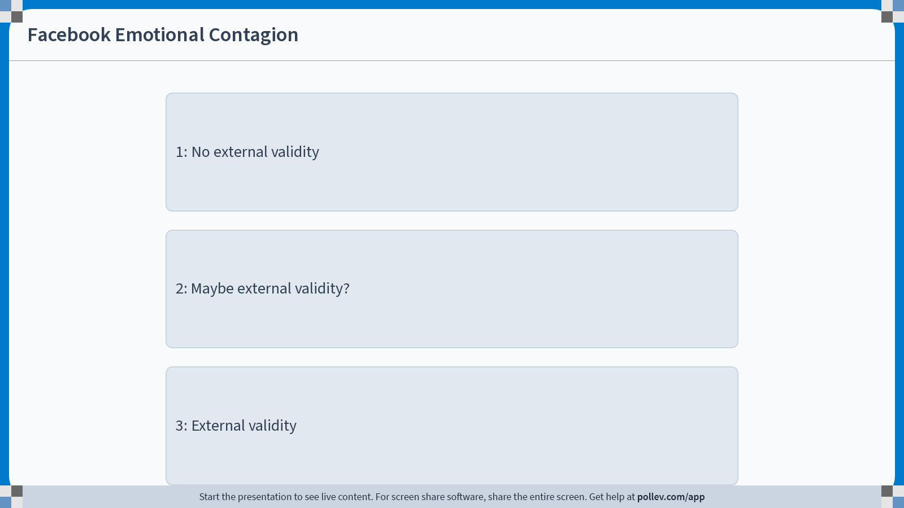
Notes:
Do not modify the notes in this section to avoid tampering with the Poll Everywhere activity. More info at polleverywhere.com/support Facebook Emotional Contagion
https://www.polleverywhere.com/multiple_choice_polls/KjrzT5a0Qr0rboso8T2up?display_state=chart&activity_state=opened&state=opened&flow=Engagement&onscreen=persist&hide=instructions

Slide 63
One concrete concern with external validity in each?
GAIN (job training program in CA)
Perry Preschool Program (early childhood education program)
Racial Discrimination in the Sharing Economy (do Airbnb hosts discriminate?)
Facebook Emotional Contagion (does emotional contagion happen online?)
Notes:
GAIN: Different counties had different ways of deciding who was in which study, and different populations. If I’m interested in “how well does the Riverside approach perform on the LA subjects,” that doesn’t necessarily tell me anything.
Perry Preschool Program: The study is targeted at “low-IQ”, Black, economically disadvantaged children in Ypsilanti. Things like head start and other early-childhood education initiatives are targeted at a much broader audience!
Racial Discrimination in the sharing economy:
Only looked at 5 cities (Airbnb cut them off before they could look at more). Perhaps results would be different in other cities?
Also, by design none of these people had profile pictures. Maybe the population of people with profile pictures would be different? (The paper argues this is not the case; Airbnb has since made it so that hosts can’t see profile pictures)
Facebook Emotional Contagion: This seems pretty good, a very large sample of random users. But it is restricted to Facebook users in 2012, which was a more selective group of people than it is today; maybe the people who choose to have a social life online are those for whom in-person aspects of communication are less important.

Slide 64
Populations in the GAIN study
Different counties chose different populations.
Riverside chose to enroll all welfare recipients for GAIN.
Average last-quarter income: $453
52% white, 27% Hispanic, 16% Black
LA registered mostly long-term welfare recipients.
Average last-quarter income: $221
12% white, 32% Hispanic, 45% Black

Slide 65
Construct Validity

Slide 66
Construct Validity
An experiment has construct validity if it measures the thing we actually care about.
Example:
In the laptop experiment, they looked at scores on a final exam.
Is that what really matters? What about…
long-term retention and/or deep understanding of the material?
Student happiness/success in life?

Slide 67
Construct Validity
Discuss!
Rate each of our four experiments on construct validity:
1) Doesn’t measure what we actually care about
2) Maybe measures what we care about?
3) Measures what we care about.
What is one potential concern with construct validity for each experiment?
GAIN (job training program in CA)
Perry Preschool Program (early childhood education program)
Racial Discrimination in the Sharing Economy (do Airbnb hosts discriminate?)
Facebook Emotional Contagion (does emotional contagion happen online?)

Slide 68
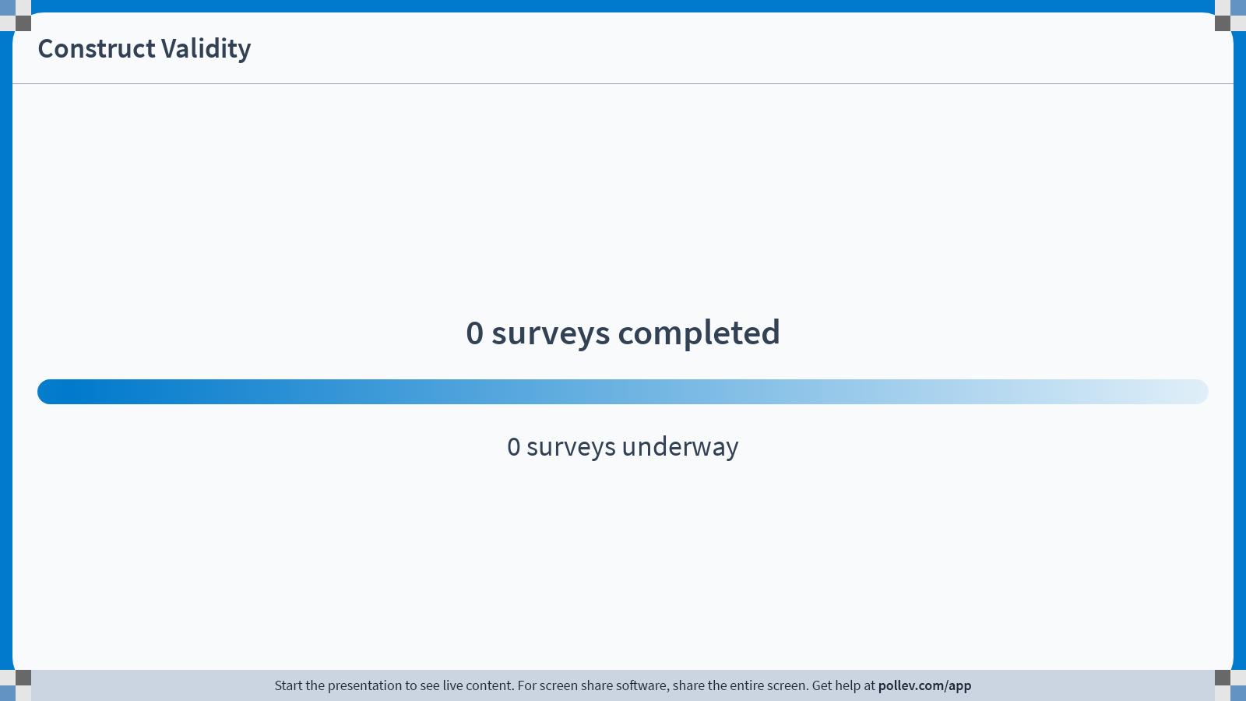
Notes:
Do not modify the notes in this section to avoid tampering with the Poll Everywhere activity. More info at polleverywhere.com/support Construct Validity
https://www.polleverywhere.com/surveys/rolcpIkupg9wpi5ECPrQb?display_state=chart&activity_state=opened&state=opened&flow=Engagement&onscreen=persist

Slide 69
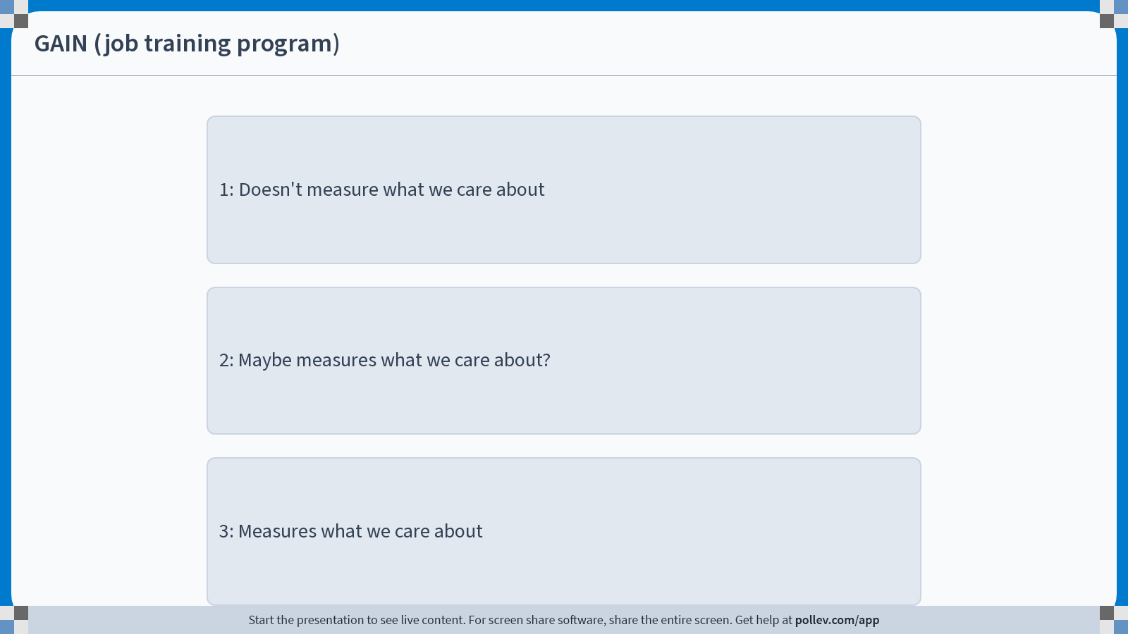
Notes:
Do not modify the notes in this section to avoid tampering with the Poll Everywhere activity. More info at polleverywhere.com/support GAIN (job training program)
https://www.polleverywhere.com/multiple_choice_polls/34sFZkrQoqQGq7PtQ4zrs?display_state=chart&activity_state=opened&state=opened&flow=Engagement&onscreen=persist&hide=instructions

Slide 70
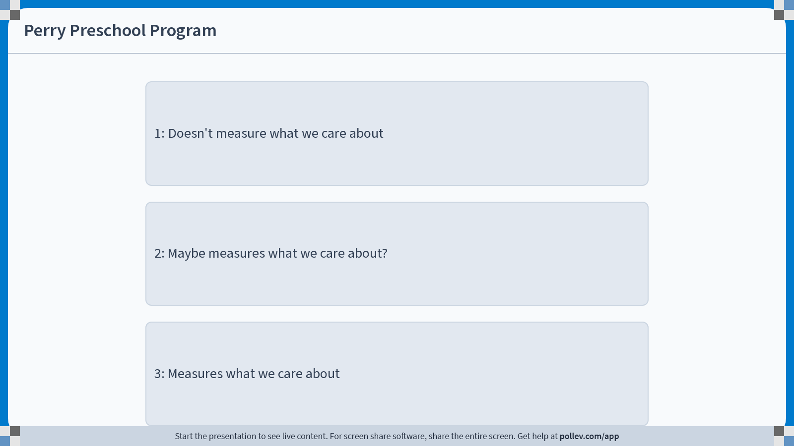
Notes:
Do not modify the notes in this section to avoid tampering with the Poll Everywhere activity. More info at polleverywhere.com/support Perry Preschool Program
https://www.polleverywhere.com/multiple_choice_polls/mqYuhBMhkg9QCLys3PIAn?display_state=chart&activity_state=opened&state=opened&flow=Engagement&onscreen=persist&hide=instructions

Slide 71
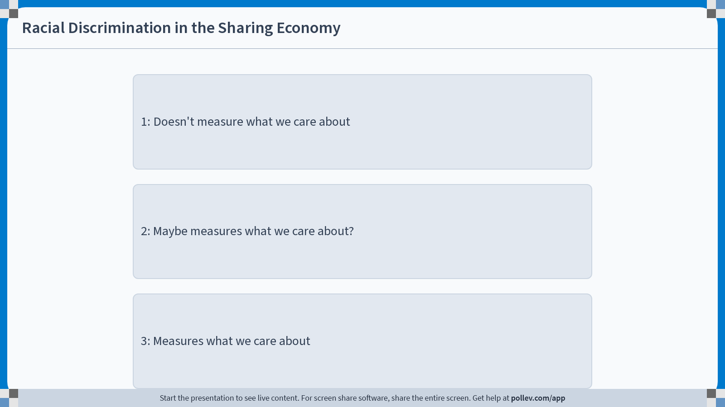
Notes:
Do not modify the notes in this section to avoid tampering with the Poll Everywhere activity. More info at polleverywhere.com/support Racial Discrimination in the Sharing Economy
https://www.polleverywhere.com/multiple_choice_polls/uf6Y7TLNoKI6RJQTLakDk?display_state=chart&activity_state=opened&state=opened&flow=Engagement&onscreen=persist&hide=instructions

Slide 72
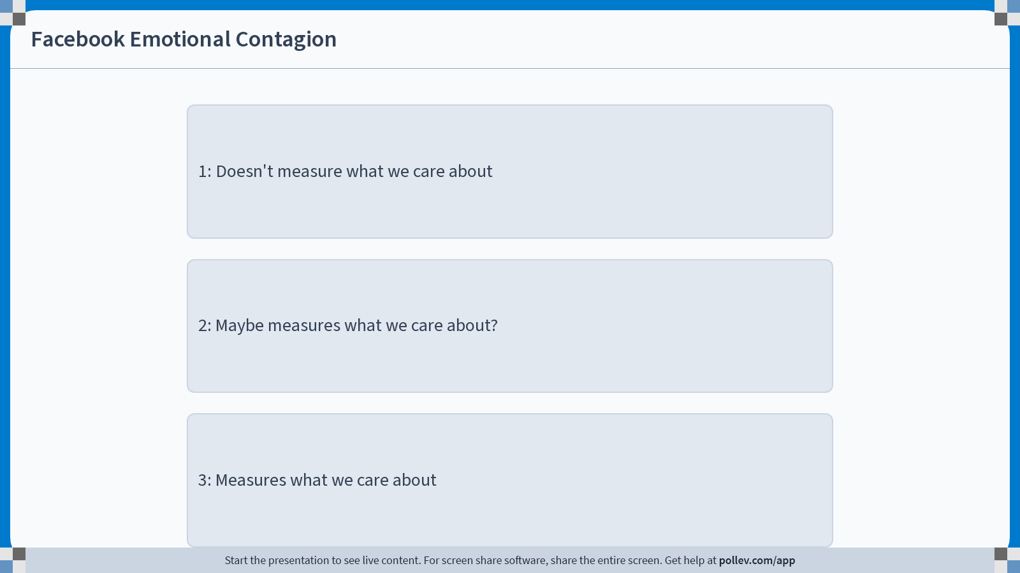
Notes:
Do not modify the notes in this section to avoid tampering with the Poll Everywhere activity. More info at polleverywhere.com/support Facebook Emotional Contagion
https://www.polleverywhere.com/multiple_choice_polls/S0OzecDxUN7kdWhotLVnf?display_state=chart&activity_state=opened&state=opened&flow=Engagement&onscreen=persist&hide=instructions

Slide 73
One concrete concern with construct validity in each?
GAIN (job training program in CA)
Perry Preschool Program (early childhood education program)
Racial Discrimination in the Sharing Economy (do Airbnb hosts discriminate?)
Facebook Emotional Contagion (does emotional contagion happen online?)
Notes:
GAIN: Measures things like “fraction employed” and “annual earnings” 1-3 years out. Maybe we care about longer-term effects? (Indeed, things look different! See next slide.). Maybe we also care about how happy or fulfilled people are, or how well their children do later on.
Perry Preschool Program: This measured a lot of things that we care about. But maybe we also care about whether it’s worth the cost? (Follow-up work has tried to say that it is).
Racial Discrimination in the sharing economy:
A general criticism at this sort of design is that the “Black-coded names” are also associated with low-SES (i.e., they are more prevalent among low-income Black people than high-income Black people). So perhaps this study is measuring the effect of being low SES, not the effect of being Black.
This measures fraction of hosts who say yes, while maybe what we care about is the fraction of users who are able to eventually find a place to stay. It would be worse if Black users were generally not able to find any place to stay than if they had to ask a few more times than white users (although of course both are bad).
Facebook Emotional Contagion: It’s not really clear what this is measuring at all. If I use more negative words, is it because I’m feeling bad? Or is it because I’m spending more time happily engaging with and responding to the negative content that I’m seeing?

Slide 74

Longer-Term Results*
*Simplified ☺
=Statistically significant (p=0.01)
Los Angeles (Human Capital first)
Riverside (Jobs first)
Control
Group
Treatment Group
Percentage difference
Control
Group
Treatment Group
Percentage difference
1-3 yrs
24.5%
26.1%
+7%
35.3%
49%
+39%
What fraction were employed at all that year?
3-5 yrs
25.8%
29.2%
+13%
33.5%
40.4%
+21%
5-7 yrs
33.1%
36.9%
+11%
37.8%
39.3%
+4%
Annual earnings (in 1999 dollars)
1-3 yrs
$1,849
$1,843
+0%
$2,253
$3,668
+63%
3-5 yrs
$2,493
$2,615
+5%
$3,201
$4,363
+36%
5-7 yrs
$3,386
$3,689
+9%
$4,171
$4,585
+10%

Slide 75


Even more outcomes for the Perry Preschool Experiment
Follow-up work has also tried to quantify how much money such a program would save.
“Each dollar invested returns in present value terms 7 to 12 dollars back to society”

Slide 76
Spillovers

Slide 77
Spillovers
When treating one individual “spills over” into affecting a non-treated individual, this can mess up how you interpret results.
Also called interference effects.
Notes:
Example?
Student A is in a class with laptops allowed. A learns nothing in class.
Student A’s roommate, Student B, is in a class without laptops.
B learns lots and teaches it to A after class.
Both perform well on the exam.
However, if student B were in a class with laptops, both would have performed poorly.

Slide 78

Stylized example Job placement program: helps workers find a job
We need 3 workers.
5 people need a job:
Put no one in the job placement program
3/5 of people get a job.

Slide 79
Stylized example Job placement program: helps workers find a job
We need 3 workers.
5 people need a job:
Put no one in the job placement program
3/5 of people get a job.
Randomly assign 2 people to the program
Everyone in the treatment group finds a job!
Only 1/3 of the control group finds a job.
The program looks like it helps a lot! ☺

Slide 80
Stylized example Job placement program: helps workers find a job
We need 3 workers.
5 people need a job:
Put no one in the job placement program
3/5 of people get a job.
Randomly assign 2 people to the program
Everyone in the treatment group finds a job!
Only 1/3 of the control group finds a job.
The program looks like it helps a lot! ☺
Put everyone in the program
3/5 of people get a job….the program doesn’t help ☹
This is an example of spillovers: Someone else being in the treatment group negatively affects people in the control group.

Slide 81

There’s evidence that this happens
Quarterly Journal of Economics, 2013
Notes:
They did the above RCT in 235 cities.
Each city was randomly assigned a value, P% = 0%, 25%, 50%, 75%, 100%
Then P% of the job-seekers in each city were randomly assigned to a job placement program
The study found that the gains seen by workers in the program came partially at the expense of workers not in the program

Slide 82
Spillovers
Discuss!
Rate each of our four experiments on spillovers:
1) Very concerned about spillovers
2) Somewhat concerned about spillovers
3) Not concerned about spillovers
What is one potential concern with spillovers for each experiment?
GAIN (job training program in CA)
Perry Preschool Program (early childhood education program)
Racial Discrimination in the Sharing Economy (do Airbnb hosts discriminate?)
Facebook Emotional Contagion (does emotional contagion happen online?)

Slide 83

Notes:
Do not modify the notes in this section to avoid tampering with the Poll Everywhere activity. More info at polleverywhere.com/support Spillovers
https://www.polleverywhere.com/surveys/30cCRLDScNkv3AIB7ujLx?display_state=chart&activity_state=opened&state=opened&flow=Engagement&onscreen=persist

Slide 84

Notes:
Do not modify the notes in this section to avoid tampering with the Poll Everywhere activity. More info at polleverywhere.com/support GAIN (job training program)
https://www.polleverywhere.com/multiple_choice_polls/MfT8nabLrDK0veiml6mBh?display_state=chart&activity_state=opened&state=opened&flow=Engagement&onscreen=persist&hide=instructions

Slide 85

Notes:
Do not modify the notes in this section to avoid tampering with the Poll Everywhere activity. More info at polleverywhere.com/support Perry Preschool Program
https://www.polleverywhere.com/multiple_choice_polls/81UShyCnxkhjuNOVFa0oA?display_state=chart&activity_state=opened&state=opened&flow=Engagement&onscreen=persist&hide=instructions

Slide 86

Notes:
Do not modify the notes in this section to avoid tampering with the Poll Everywhere activity. More info at polleverywhere.com/support Racial Discrimination in the Sharing Economy
https://www.polleverywhere.com/multiple_choice_polls/hp3eDLIhRFBlax6sw2Ozd?display_state=chart&activity_state=opened&state=opened&flow=Engagement&onscreen=persist&hide=instructions

Slide 87

Notes:
Do not modify the notes in this section to avoid tampering with the Poll Everywhere activity. More info at polleverywhere.com/support Facebook Emotional Contagion
https://www.polleverywhere.com/multiple_choice_polls/5ilsEEMIxncQcOkflDe40?display_state=chart&activity_state=opened&state=opened&flow=Engagement&onscreen=persist&hide=instructions

Slide 88
One concrete concern with spillovers in each?
GAIN (job training program in CA)
Perry Preschool Program (early childhood education program)
Racial Discrimination in the Sharing Economy (do Airbnb hosts discriminate?)
Facebook Emotional Contagion (does emotional contagion happen online?)
Notes:
* GAIN: Maybe folks in the program share tips with those not in the program. OR maybe folks in the program crowd out job opportunities from folks not in the program, like we saw in the stylized example.
* Perry Preschool Program: Maybe the fact that parents whose kids aren’t in the program “give up” after hearing that their friends’ kids are in the program. Or maybe parents with kids in the program share tips with those outside the program.
Discrimination in Airbnb: Hard to think of spillover effects here… (unless the hosts are talking to each other, which seems unlikely…)
Facebook emotional contagion: If I’m in the “positive” group and it makes more more positive, I may make my friends more positive, even if they were in the “negative” group. (But I’m not sure how close in facebook-graph-distance the random folks in the study were).

Slide 89
Ethical Concerns

Slide 90


Ethical Concerns
Sometimes a randomized experiment might not be ethical…
I mean, I’m glad I’m in the treatment group, but is this really necessary?
I’m going to do an RCT to see if parachutes work!

Slide 91
More serious examples
Laptop experiment:
If we really believe that laptops hurt student learning, is it ethical to let half of students use laptops in class?
Is it ethical to purposely give half of students a different experience than another half?
Is it ethical to not give students a choice?
Medical RCTs are very tightly regulated
But, say, RCTs that tech companies do are not
Notes:
e.g., Uber can do an RCT on you – maybe charge you more than someone else for the same ride – without you knowing that you are participating in a study.
(Example: it seems like maybe Uber did an RCT on the effect of surge pricing to find out that folks with lower batter life are more willing to pay for a ride.)

Slide 92
Ethical Concerns
Discuss!
Rate each of our four experiments on ethics:
1) Major ethical concerns
2) Some ethical concerns
3) No ethical concerns
What is one potential ethical concern for each experiment?
GAIN (job training program in CA)
Perry Preschool Program (early childhood education program)
Racial Discrimination in the Sharing Economy (do Airbnb hosts discriminate?)
Facebook Emotional Contagion (does emotional contagion happen online?)
Notes:
GAIN: Is it ethical to give this opportunity to some people but not others? (Though probably they had to ration due to budget constraints anyway)
Perry Preschool Program: ditto
Racial Discrimination in Airbnb study: Is it ethical to do this without hosts’ knowledge? (These requests are deceiving hosts and arguably mis-using the platform; the study actually was stopped early since Airbnb shut them down).
Facebook Emotional Contagion: Students will probably be very concerned about this. (Participant consent, arguably making people more unhappy, etc) But to play devil’s advocate… the facebook status quo manipulates users’ emotions somehow – is it ethical for them to do that *without* understanding the impact? One can argue that it’s unethical *not* to do the study!
Slate on whether this experiment had IRB approval (it did not): “But the Cornell IRB concluded that the study was “conducted independently by Facebook” and as such was exempt from review at Cornell. Facebook didn’t have an IRB at all. (After the backlash to the study, it created an internal review process, a kind of IRB Lite.) The result was that an experiment run by academics and published for other academics escaped from IRB oversight entirely."

Slide 93

Notes:
Do not modify the notes in this section to avoid tampering with the Poll Everywhere activity. More info at polleverywhere.com/support Ethical Concerns
https://www.polleverywhere.com/surveys/j15Y713PtRtp1ykWiwGiI?display_state=chart&activity_state=opened&state=opened&flow=Engagement&onscreen=persist

Slide 94

Notes:
Do not modify the notes in this section to avoid tampering with the Poll Everywhere activity. More info at polleverywhere.com/support GAIN (job training program)
https://www.polleverywhere.com/multiple_choice_polls/pMjJ9Pytyrn5vOrN3SfmY?display_state=chart&activity_state=opened&state=opened&flow=Engagement&onscreen=persist&hide=instructions

Slide 95

Notes:
Do not modify the notes in this section to avoid tampering with the Poll Everywhere activity. More info at polleverywhere.com/support Perry Preschool Program
https://www.polleverywhere.com/multiple_choice_polls/kB19ViGNfqN6LIdlwxzsP?display_state=chart&activity_state=opened&state=opened&flow=Engagement&onscreen=persist&hide=instructions

Slide 96

Notes:
Do not modify the notes in this section to avoid tampering with the Poll Everywhere activity. More info at polleverywhere.com/support Racial Discrimination in the Sharing Economy
https://www.polleverywhere.com/multiple_choice_polls/8T4lBLas6zzhP8OQmnCB3?display_state=chart&activity_state=opened&state=opened&flow=Engagement&onscreen=persist&hide=instructions

Slide 97

Notes:
Do not modify the notes in this section to avoid tampering with the Poll Everywhere activity. More info at polleverywhere.com/support Facebook Emotional Contagion
https://www.polleverywhere.com/multiple_choice_polls/XfHEDRzXpW4KRUd62AqFS?display_state=chart&activity_state=opened&state=opened&flow=Engagement&onscreen=persist&hide=instructions

Slide 98
One concrete ethical concern in each?
GAIN (job training program in CA)
Perry Preschool Program (early childhood education program)
Racial Discrimination in the Sharing Economy (do Airbnb hosts discriminate?)
Facebook Emotional Contagion (does emotional contagion happen online?)
Notes:
GAIN: Is it ethical to give this opportunity to some people but not others? (Though probably they had to ration due to budget constraints anyway)
Perry Preschool Program: ditto
Racial Discrimination in Airbnb study: Is it ethical to do this without hosts’ knowledge? (These requests are deceiving hosts and arguably mis-using the platform; the study actually was stopped early since Airbnb shut them down).
Facebook Emotional Contagion: Students will probably be very concerned about this. (Participant consent, arguably making people more unhappy, etc) But to play devil’s advocate… the facebook status quo manipulates users’ emotions somehow – is it ethical for them to do that *without* understanding the impact? One can argue that it’s unethical *not* to do the study!
Slate on whether this experiment had IRB approval (it did not): “But the Cornell IRB concluded that the study was “conducted independently by Facebook” and as such was exempt from review at Cornell. Facebook didn’t have an IRB at all. (After the backlash to the study, it created an internal review process, a kind of IRB Lite.) The result was that an experiment run by academics and published for other academics escaped from IRB oversight entirely."

Slide 99

https://xkcd.com/1390/

Slide 100
To play devil’s advocate:
Shouldn’t tech companies try to understand the impact they have on users’ emotions?
Doesn’t that mean that it would be unethical not to run an RCT?
https://xkcd.com/1390/

Slide 101
Recap and Looking Ahead
Don’t forget to stick around until the exit ticket!

Slide 102
Recap
Four things to be concerned about with experiments:
External Validity
Construct Validity
Spillovers
Ethics
And we learned last time that we should be concerned about, say, doing good statistics!
Getting big enough sample sizes
Computing accurate standard errors, p-values, etc, and interpreting them thoughtfully

Slide 103
Side note
There are other things to be worried about with experiments!
Attrition
Non-Compliance
…
We’ll talk about these more later!

Slide 104
Next time
Adaptive Experiments!
And multi-armed bandits!

Slide 105
Before next time
Reading response!
HW1.1 due Monday!

Slide 106


Exit ticket
Don’t forget to fill out the exit ticket before you leave class!

