Slide 1
Regression!
Motivated by Understanding the Effect of UBI
Causality, Decision Making and Data Science
Lecture 7

Slide 2
Announcements
HW2 part 1 due Monday!
Project ideas also due Monday!
  Note: Project groups can have max size 3, but we are open to petitions for 4, if you do a very ambitious project.

Slide 3
Agenda
Recap and Motivation for Regression
Regression
Using regression to measure the effects of windfall income

Slide 4
Recap and Motivation
Effect of transitory income

Slide 5

Last time
How do we model consumption as a function of income?
  Let’s focus today on transitory income: a one-time payment.
The theory (PIH) says that if someone gets $1 of transitory income, they will spend some small fraction of it:
Consumption
My consumption
Slope is “supposed” to be very small: $\frac{r}{1+r}$
Consumption with no transitory income
Transitory
Income

Slide 6

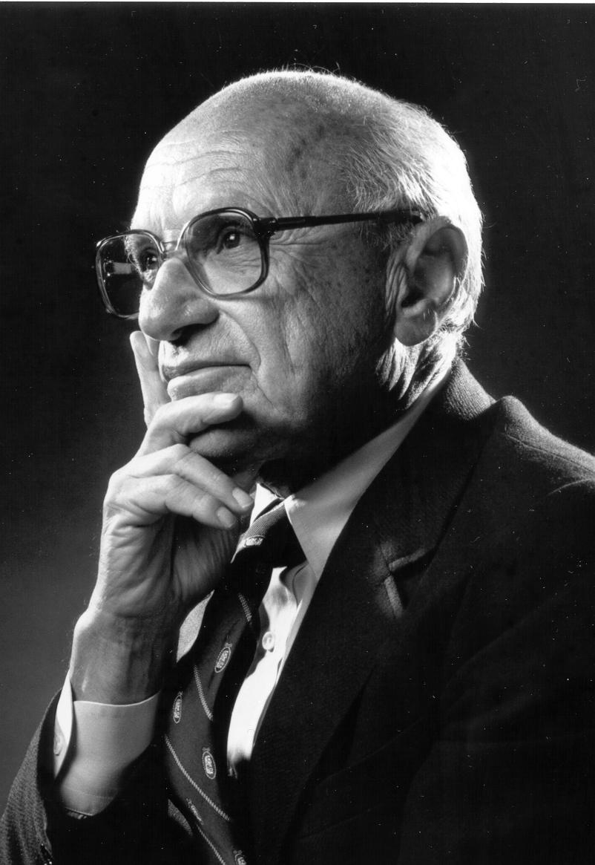





The debate
When people win a one-time lottery, they will only increase consumption by a little bit.
Oh is that so?
Milton Friedman
“Common Sense”

Slide 7
The debate
When people win a one-time lottery, they will only increase consumption by a little bit.
Oh is that so?
You read about three studies that tried to settle this debate.
What do you think, based on those studies and on your own intuition/experience?
Milton Friedman
“Common Sense”

Slide 8
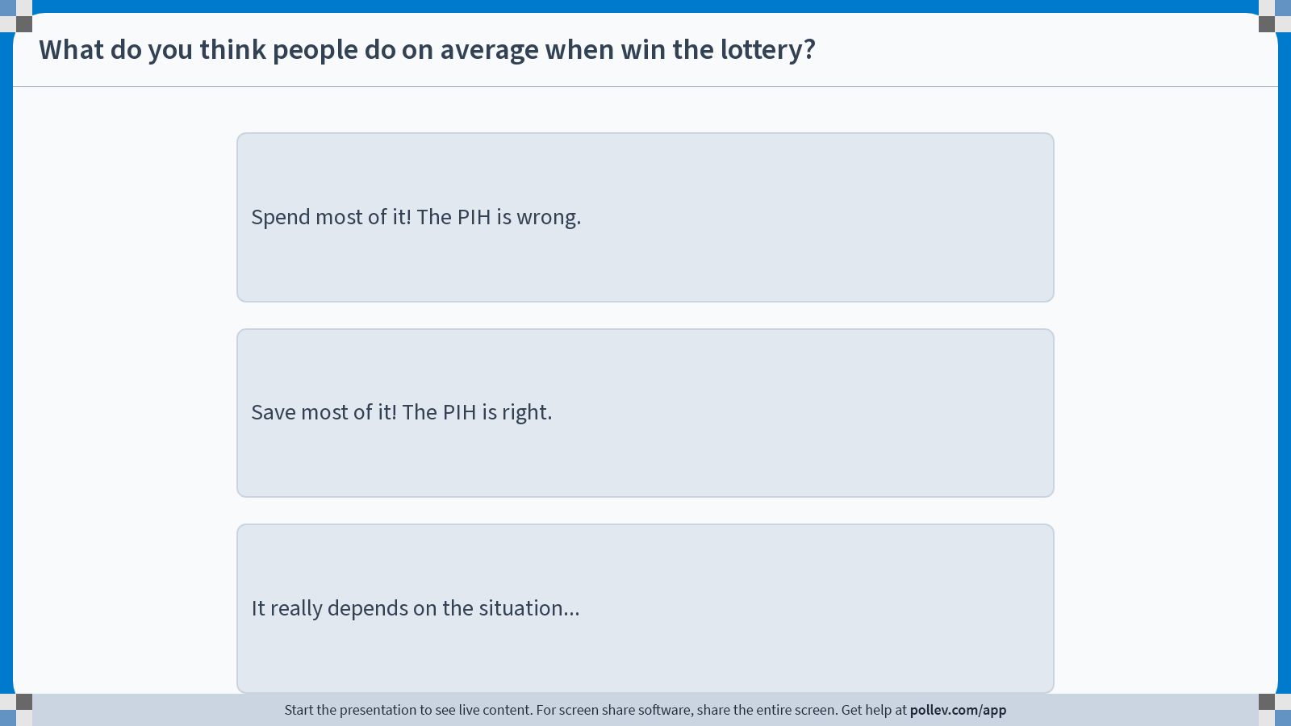
Notes:
Do not modify the notes in this section to avoid tampering with the Poll Everywhere activity.
More info at polleverywhere.com/support
What do you think people do on average when win the lottery?
https://www.polleverywhere.com/multiple_choice_polls/FJKydE94dYVvyOZ22fyhX?display_state=instructions&activity_state=opened&state=opened&flow=Engagement&onscreen=persist

Slide 9
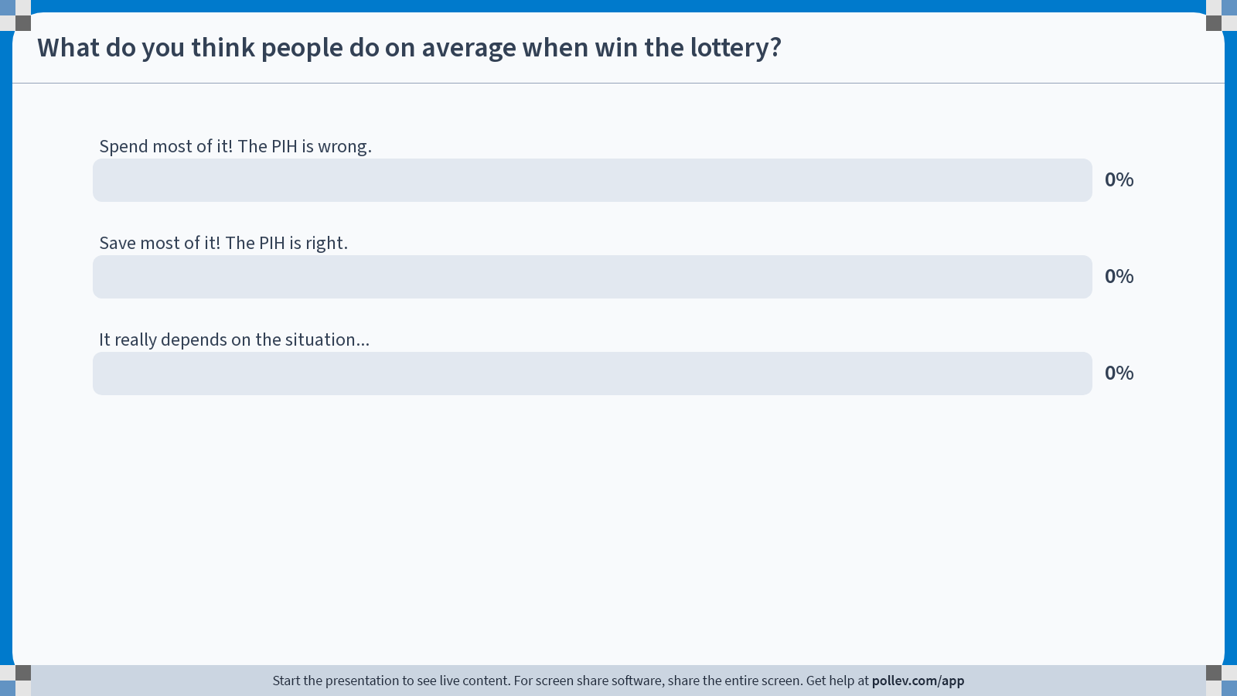
Notes:
Do not modify the notes in this section to avoid tampering with the Poll Everywhere activity.
More info at polleverywhere.com/support
What do you think people do on average when win the lottery?
https://www.polleverywhere.com/multiple_choice_polls/FJKydE94dYVvyOZ22fyhX?display_state=chart&activity_state=opened&state=opened&flow=Engagement&onscreen=persist

Slide 10
Notes:
Do not modify the notes in this section to avoid tampering with the Poll Everywhere activity.
More info at polleverywhere.com/support
What do you think people do on average when win the lottery?
https://www.polleverywhere.com/multiple_choice_polls/FJKydE94dYVvyOZ22fyhX?display_state=chart&activity_state=closed&state=closed&flow=Engagement&onscreen=persist

Slide 11
The debate
When people win a one-time lottery, they will only increase consumption by a little bit.
Oh is that so?
Milton Friedman
“Common Sense”
How can we test this?
Let’s dig a bit deeper into the methodology behind those studies.

Slide 12



Setting up the problem
Assume that consumption is a linear function of windfall income.
Different people might have different slopes and y-intercepts:
Consumption
Windfall income

Slide 13

Setting up the problem
Assume that consumption is a linear function of windfall income.
Different people might have different slopes and y-intercepts:
The slope of one of these lines is the treatment effect of getting $1 of windfall income on consumption!
(for a particular person)
Consumption
How should I interpret the slope of one of these lines?
Windfall income

Slide 14
The average of these lines corresponds to average treatment effect (ATE)
We’d like to know the slope of this line
Consumption
Windfall income

Slide 15
What do we observe?
Each person only gets one outcome
Consumption
Windfall income
$0
$10,000

Slide 16
What do we observe?
Each person only gets one outcome
Consumption
Windfall income
$0
$10,000

Slide 17
What do we observe?
Each person only gets one outcome
Consumption
Windfall income
$0
$10,000

Slide 18
What do we observe?
Each person only gets one outcome
Let’s find the line of best fit!
Mathematically, we want to find the line that minimizes the sum of the squares of the errors.
Consumption
Windfall income
$0
$10,000

Slide 19
Regression

Slide 20

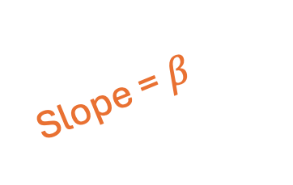

(Univariate) Regression
Noise that depends on the person
Suppose we have a linear model:
$$c_{t}=β⋅y_{t}+α+noise$$
Consumption
Average “baseline” consumption
Slope of the “average” line.
This is ATE of windfall income on consumption
Windfall income
Consumption
Slope = $β$
$$α$$
Windfall Income

Slide 21

(Univariate) Regression
Noise that depends on the person
Suppose we have a linear model:
$$Y=β⋅X+α+noise$$
Dependent Variable
Average “baseline”
ATE of X on Y
Independent variable
Y
Slope = $β$
$$α$$
X

Slide 22


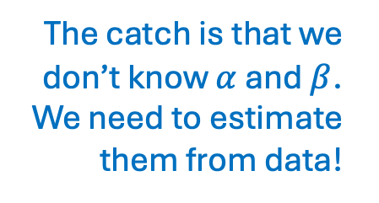
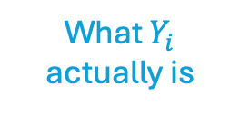
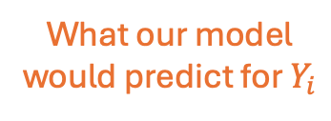
(Univariate) Regression
The catch is that we don’t know $α$ and $β$. We need to estimate them from data!
Suppose we have a linear model:
$$Y=βX+α+noise$$
Goal: Given data $(X_{i}, Y_{i})$ for $i=1,…,N$, find $\hat{α},\hat{β}$ that minimizes
$$\sum_{i=1}^{N}{{\left(\hat{β}X_{i}+\hat{α}−Y_{i}\right)}^{2}}$$
This is called “Mean Squared Error” or MSE.
What $Y_{i}$ actually is
What our model would predict for $Y_{i}$

Slide 23

(Univariate) Regression
The catch is that we don’t know $α$ and $β$. We need to estimate them from data!
Suppose we have a linear model:
$$Y=βX+α+noise$$
Goal: Given data $(X_{i}, Y_{i})$ for $i=1,…,N$, find $\hat{α},\hat{β}$ that minimizes
$$\sum_{i=1}^{N}{{\left(\hat{β}X_{i}+\hat{α}−Y_{i}\right)}^{2}}$$
How to find $\hat{α}, \hat{β}$?
  Linear Algebra (closed form solution)
  Optimization algorithms (e.g., SGD: faster approximate solution)
  In this class: use Python’s built-in version ☺
This is called “Mean Squared Error” or MSE.

Slide 24

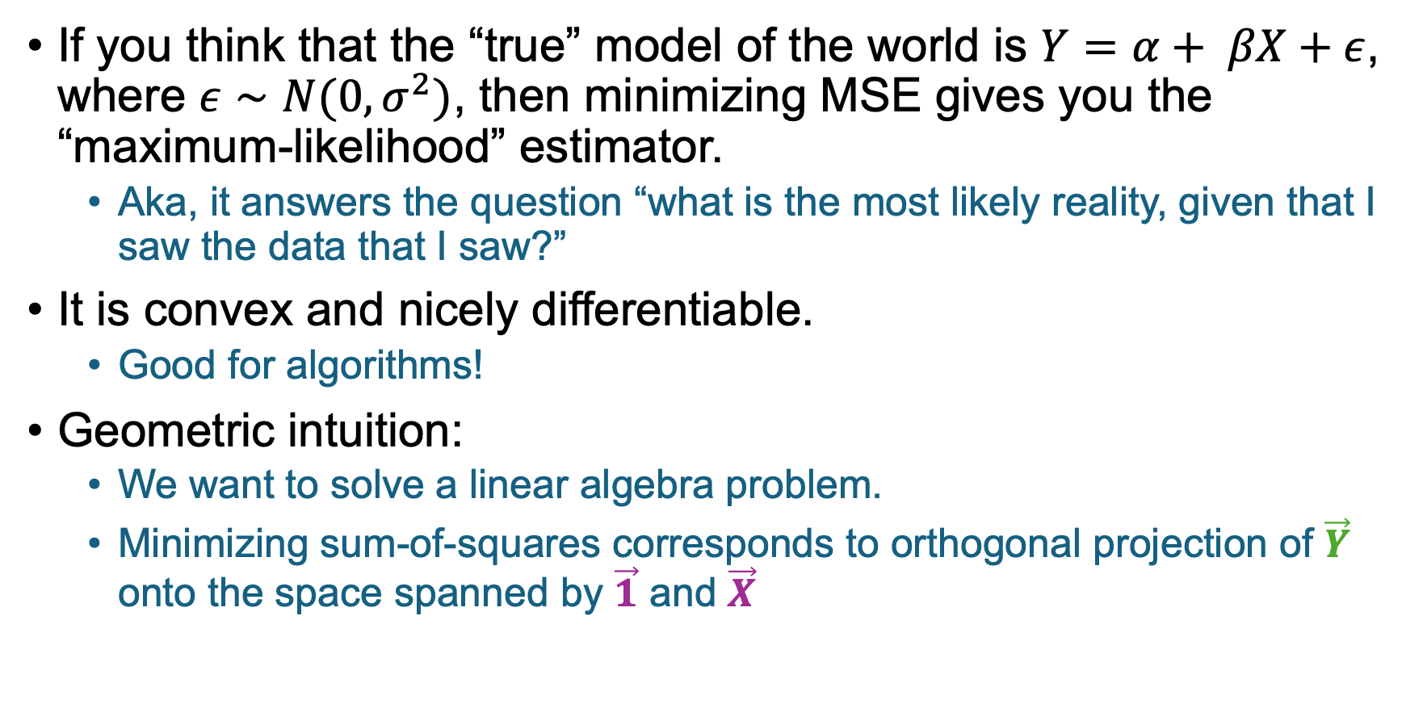



Aside: Why the sum of the squares??
If you think that the “true” model of the world is $Y=α+ βX+ε$, where $ε∼N(0,σ^{2})$, then minimizing MSE gives you the “maximum-likelihood” estimator.
  Aka, it answers the question “what is the most likely reality, given that I saw the data that I saw?”
It is convex and nicely differentiable.
  Good for algorithms!
Geometric intuition:
  We want to solve a linear algebra problem.
  Minimizing sum-of-squares corresponds to orthogonal projection of $\vec{Y}$ onto the space spanned by $\vec{1}$ and $\vec{X}$
1
1
1
1
1
$$X_{1}$$
$$X_{2}$$
$$X_{3}$$
$$⋮$$
$$X_{n}$$
$$α$$
$$β$$
$$Y_{1}$$
$$Y_{2}$$
$$Y_{3}$$
$$⋮$$
$$Y_{n}$$
$$≈$$

Slide 25
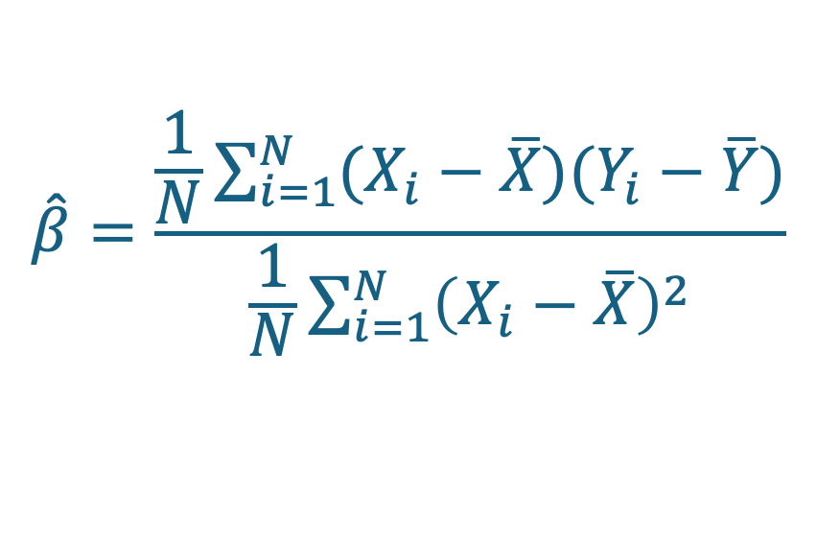




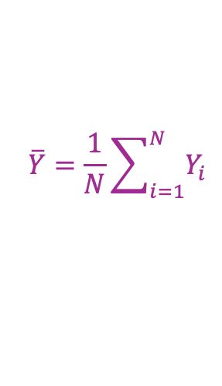
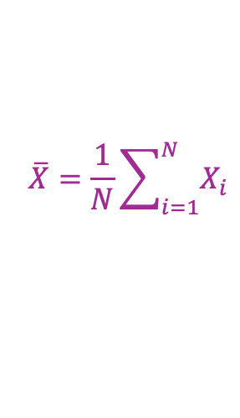
Closed-Form Solution
$$\overline{X}=\frac{1}{N}\sum_{i=1}^{N}{X_{i}}$$
$$\overline{Y}=\frac{1}{N}\sum_{i=1}^{N}{Y_{i}}$$
$Y=βX+α+noise$
Given $(X_{i},Y_{i})$ for $i=1,…,N$, the $\hat{β}$ that minimizes MSE is
$$\hat{β}=\frac{\frac{1}{N}\sum_{i=1}^{N}{(X_{i}−\overline{X})(Y_{i}−\overline{Y})}}{\frac{1}{N}\sum_{i=1}^{N}{{\left(X_{i}−\overline{X}\right)}^{2}}}$$
The formula isn’t so important. The important part is that it’s the slope of the line of best fit!
$$Y$$
Slope is $\hat{β}$
$$X$$

Slide 26

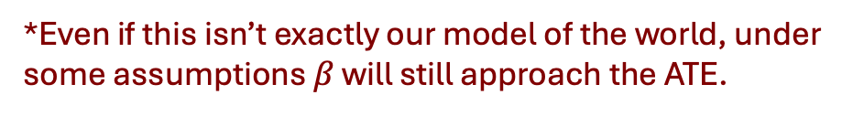

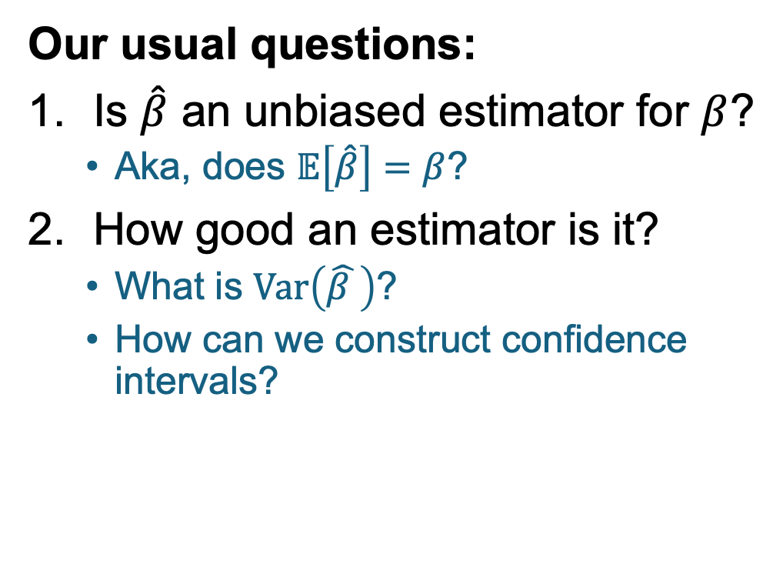
How do we analyze $\hat{β}$?
$Y=βX+α+noise$
If that’s our model of the world*, $β$ is ATE of $X$ on $Y$
$\hat{β}$ is our estimate of $β$
Our usual questions:
Is $\hat{β}$ an unbiased estimator for $β$?
  Aka, does $𝔼\left[\hat{β}\right]=β$?
How good an estimator is it?
  What is $Var\left(\hat{β }\right)$?
  How can we construct confidence intervals?
Our usual answers:
Yes!
  Under some assumptions on the noise
Resampling/Bootstrapping!
*Even if this isn’t exactly our model of the world, under some assumptions $β$ will still approach the ATE.

Slide 27





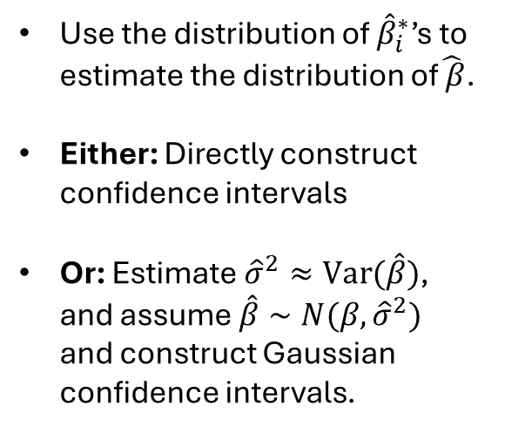









Resampling
$$Y$$
Slope is $\hat{β}$
Original Sample:
$$Y$$
$$Y$$
Slope is ${\hat{β}}_{3}^{∗}$
$$X$$
Slope is ${\hat{β}}_{1}^{∗}$
Use the distribution of ${\hat{β}}_{i}^{∗}$’s to estimate the distribution of$\hat{ β}$.
Either: Directly construct confidence intervals
Or: Estimate${\hat{σ}}^{2}≈Var(\hat{β})$, and assume $\hat{β}∼N(β, {\hat{σ}}^{2})$ and construct Gaussian confidence intervals.
$$X$$
$$X$$
$$Y$$
$$Y$$
Slope is ${\hat{β}}_{4}^{∗}$
Slope is ${\hat{β}}_{2}^{∗}$
$$X$$
$$X$$

Slide 28
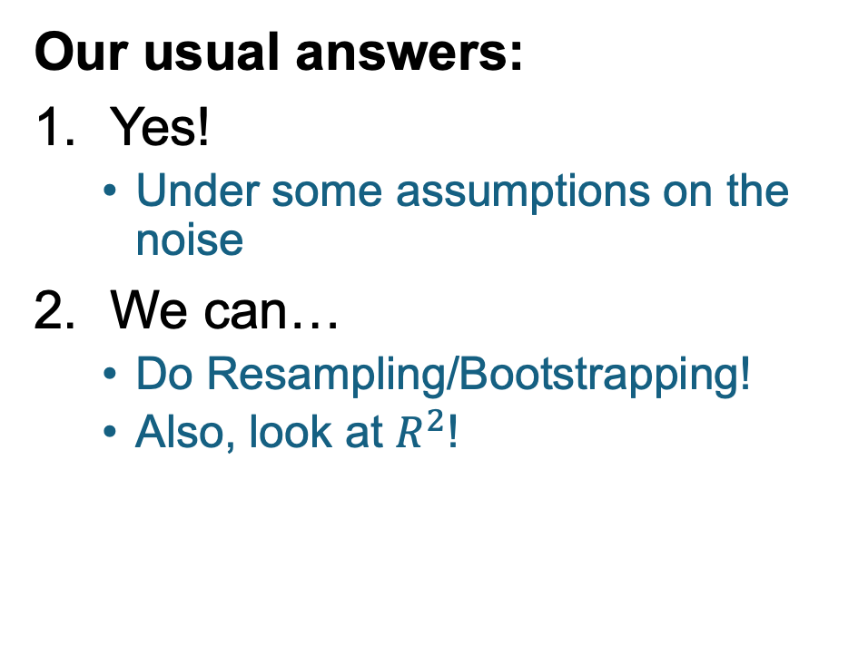
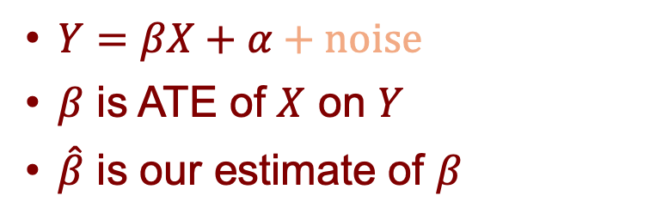
How do we analyze $\hat{β}$?
$Y=βX+α+noise$
$β$ is ATE of $X$ on $Y$
$\hat{β}$ is our estimate of $β$
Our usual questions:
Is $\hat{β}$ an unbiased estimator for $β$?
  Aka, does $𝔼\left[\hat{β}\right]=β$?
How good an estimator is it?
  What is $Var\left(\hat{β }\right)$?
  How can we construct confidence intervals?
Our usual answers:
Yes!
  Under some assumptions on the noise
We can…
  Do Resampling/Bootstrapping!
  Also, look at $R^{2}$!

Slide 29

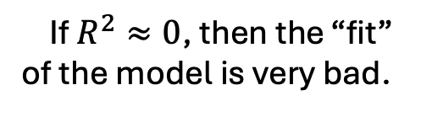
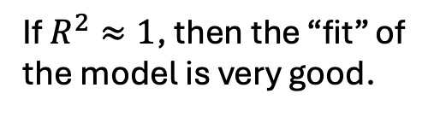

Analyzing regressions: $R^{2}$
In a regression (say, $Y=βX+α+noise$), the coefficient of determination is
$$R^{2}=1 −\frac{\sum_{i=1}^{N}{{\left(βX_{i}+α−Y_{i}\right)}^{2}}}{\sum_{i=1}^{N}{{\left(\overline{Y}−Y_{i}\right)}^{2}}}$$
Top: mean squared error.
Bottom: variance of our observations
If $R^{2}≈0$, then the “fit” of the model is very bad.
If $R^{2}≈1$, then the “fit” of the model is very good.

Slide 30

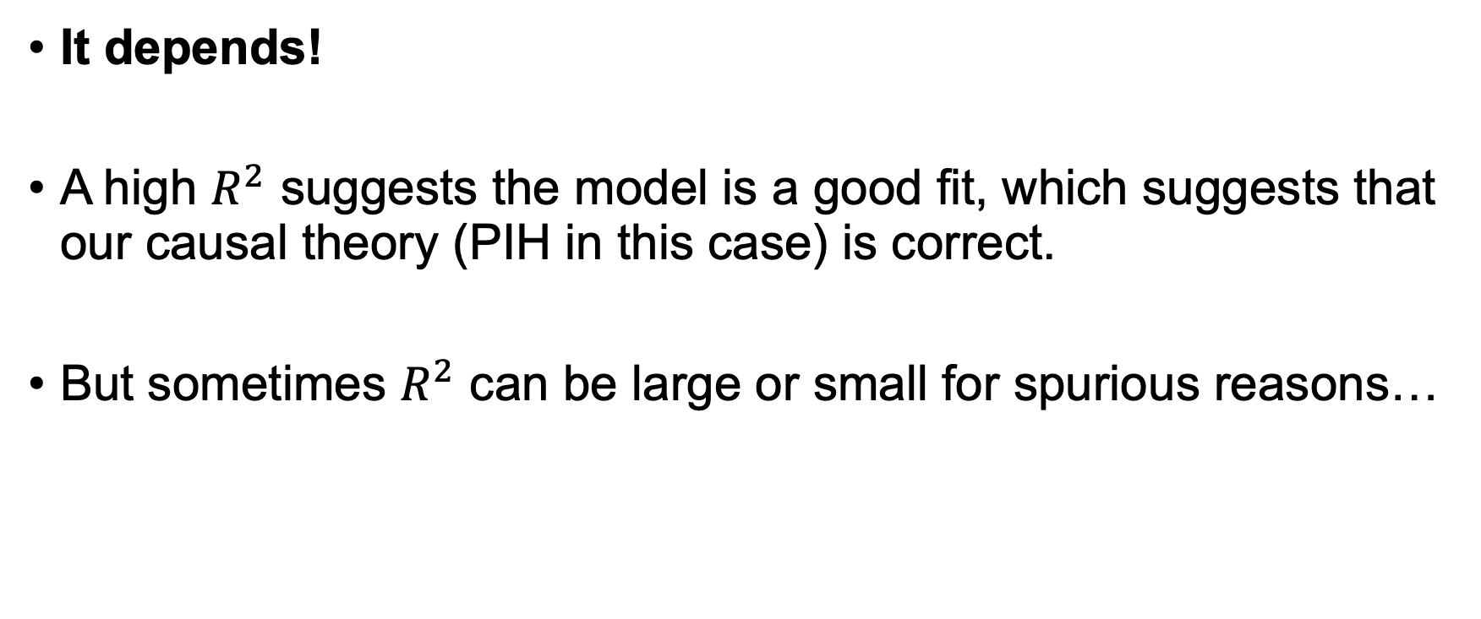
Aside: Should we care about $R^{2}$?
It depends!
A high $R^{2}$ suggests the model is a good fit, which suggests that our causal theory (PIH in this case) is correct.
But sometimes $R^{2}$ can be large or small for spurious reasons…

Slide 31

When should we not care about $R^{2}$?
Example: Say we run an RCT. The treatment is very effective.

Slide 32




When should we not care about $R^{2}$?
Example: Say we run an RCT. The treatment is very effective.
  Example A: The control group is much bigger than the treatment group.
The treatment explains very little of the variance, since all the variance happens in the control group.
$R^{2}$ is tiny.
Control Group
Treatment Group

Slide 33

When should we not care about $R^{2}$?
Example: Say we run an RCT. The treatment is very effective.
  Example B: The control group is the same size as the treatment group.
Control Group
The treatment explains a lot of the variance, since it is driven by the difference between groups.
$R^{2}$ is large.
Treatment Group

Slide 34
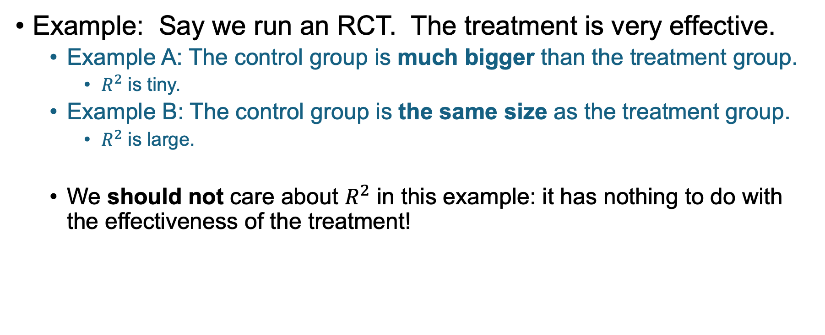
When should we not care about $R^{2}$?
Example: Say we run an RCT. The treatment is very effective.
  Example A: The control group is much bigger than the treatment group.
    $R^{2}$ is tiny.
  Example B: The control group is the same size as the treatment group.
    $R^{2}$ is large.
  We should not care about $R^{2}$ in this example: it has nothing to do with the effectiveness of the treatment!

Slide 35

(End Aside)
Moral of the story: look at $R^{2}$, but not without thinking ☺

Slide 36
Is regression a good idea in our example?
If we regress “savings” on “lottery winnings,” what are we learning about ATE?

Slide 37
Thought Experiment
To measure the effect of “windfall” income
Assume that we can accurately measure consumption for now.
Look at a bunch of people who won the lottery
  One-time payout of $10,000
And look at a bunch of people who didn’t
  and possibly who didn’t play…
Measure the consumption of both groups and run a regression!

Slide 38
Thought Experiment
To measure the effect of “windfall” income
Assume that we can accurately measure consumption for now.
Look at a bunch of people who won the lottery
  One-time payout of $10,000
And look at a bunch of people who didn’t
  and possibly who didn’t play…
Measure the consumption of both groups and run a regression!
Lottery winners
Consumption
Non-Lottery winners
Lottery Winnings
0
$10,000

Slide 39
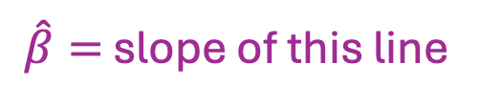
Thought Experiment
To measure the effect of “windfall” income
Assume that we can accurately measure consumption for now.
Look at a bunch of people who won the lottery
  One-time payout of $10,000
And look at a bunch of people who didn’t
  and possibly who didn’t play…
Measure the consumption of both groups and run a regression!
Lottery winners
Consumption
Non-Lottery winners
$\hat{β}=$ slope of this line
Our estimate of ATE
Lottery Winnings
0
$10,000

Slide 40

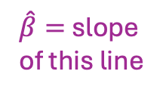
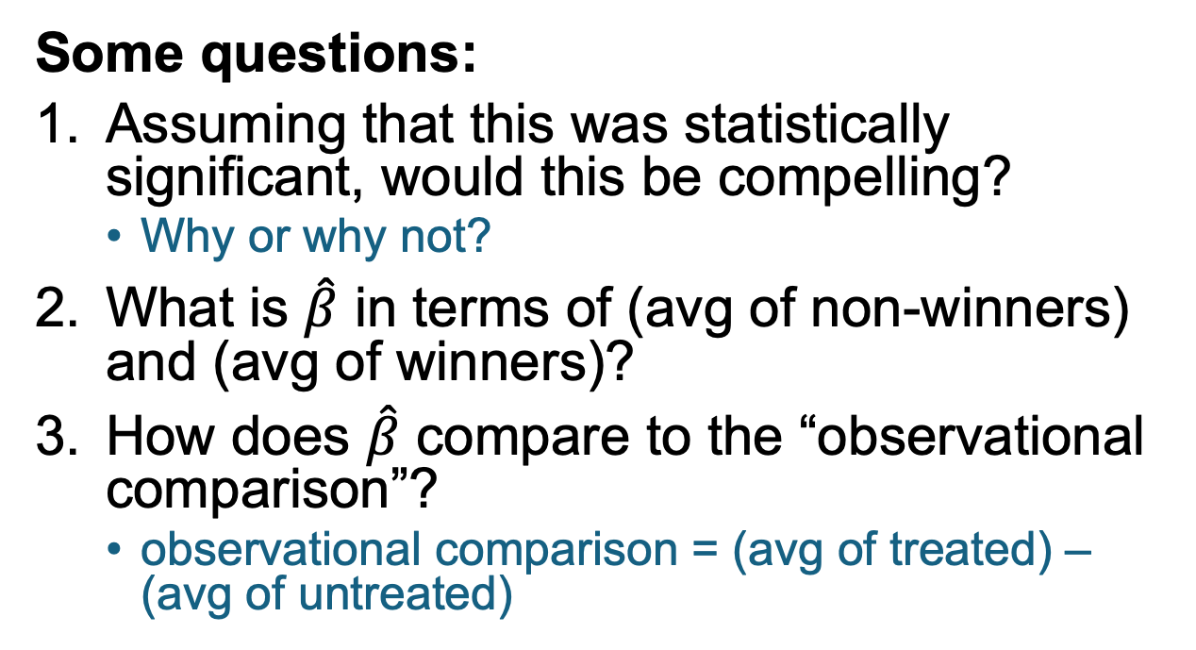
Thought Experiment
To measure the effect of “windfall” income
Consumption
Lottery winners
Non-Lottery winners
$\hat{β}=$ slope of this line
Lottery Winnings
Some questions:
Assuming that this was statistically significant, would this be compelling?
  Why or why not?
What is $\hat{β}$ in terms of (avg of non-winners) and (avg of winners)?
How does $\hat{β}$ compare to the “observational comparison”?
  observational comparison = (avg of treated) – (avg of untreated)
0
$10,000
Discuss!

Slide 41
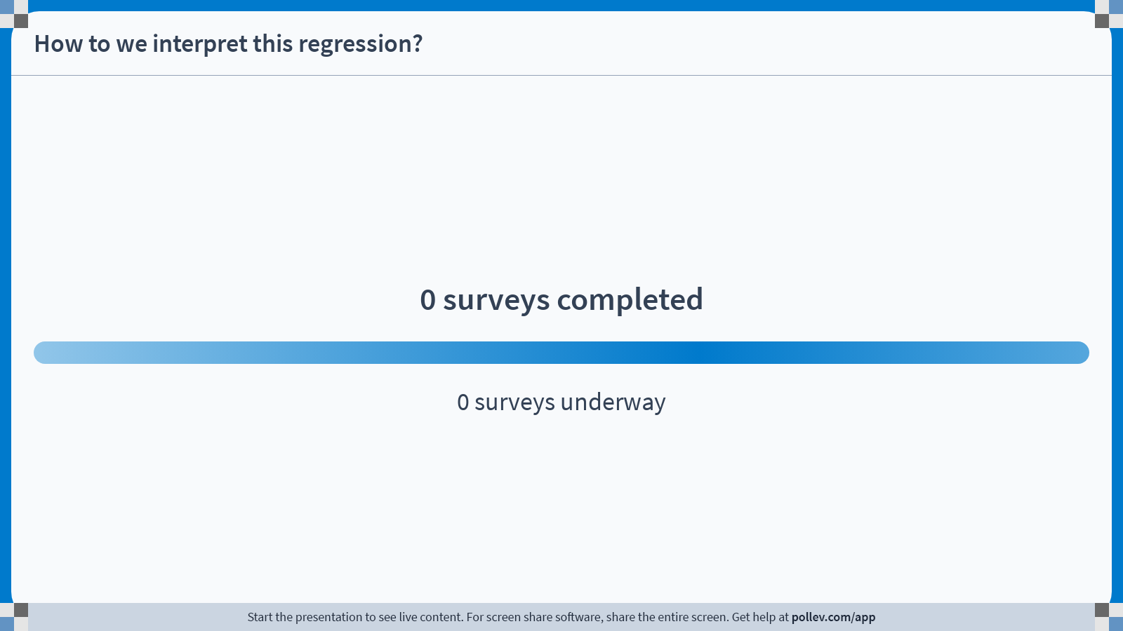
Notes:
Do not modify the notes in this section to avoid tampering with the Poll Everywhere activity.
More info at polleverywhere.com/support
How to we interpret this regression?
https://www.polleverywhere.com/surveys/dVwi6n0ZC0kztE2AvTX8L?display_state=chart&activity_state=opened&state=opened&flow=Engagement&onscreen=persist

Slide 42
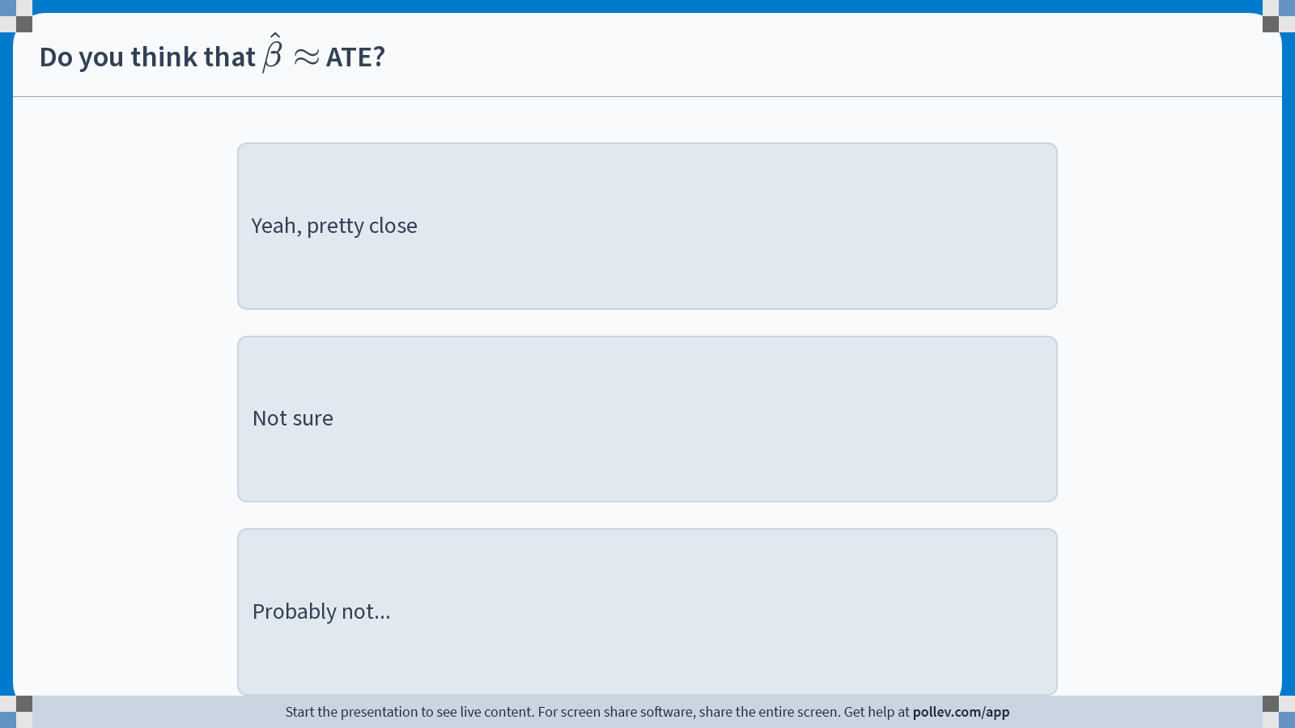
Notes:
Do not modify the notes in this section to avoid tampering with the Poll Everywhere activity.
More info at polleverywhere.com/support
Do you think that $$\hat{\beta}\approx$$ ATE?
https://www.polleverywhere.com/multiple_choice_polls/tW32pqsxffu1LpK65s2Zf?display_state=chart&activity_state=opened&state=opened&flow=Engagement&onscreen=persist&hide=instructions

Slide 43
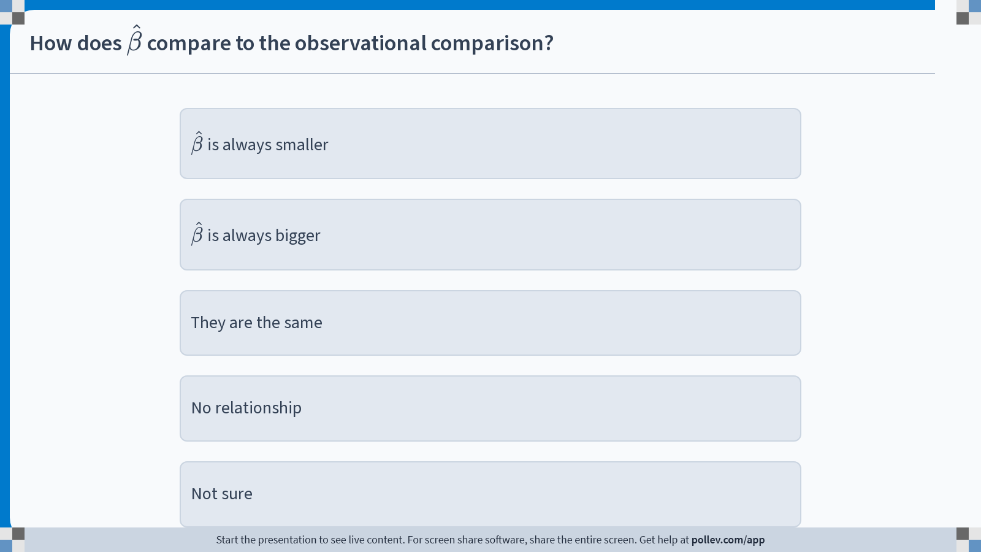
Notes:
Do not modify the notes in this section to avoid tampering with the Poll Everywhere activity.
More info at polleverywhere.com/support
How does $$\hat{\beta}$$ compare to the observational comparison?
https://www.polleverywhere.com/multiple_choice_polls/GBQYipXZtefhuAC6PC0qa?display_state=chart&activity_state=opened&state=opened&flow=Engagement&onscreen=persist&hide=instructions

Slide 44




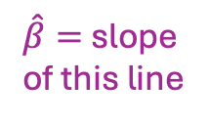
Regression generalizes the observational comparison!
${\overline{Y}}_{0}=$ avg of untreated
${\overline{Y}}_{1}=$ avg of treated
The line of best fit passes through $\left(0,{\overline{Y}}_{0}\right)$ and $(10000, {\overline{Y}}_{1})$
$\left(Consumption\right)={\overline{Y}}_{0}+\left(\frac{{\overline{Y}}_{1}−{\overline{Y}}_{0}}{10000}\right)⋅(Winnings)$
This is $\hat{β}$
We interpret it as “the effect of winning $1.”
Consumption
Lottery winners
Non-Lottery winners
$\hat{β}=$ slope of this line
Lottery Winnings
0
$10,000

Slide 45
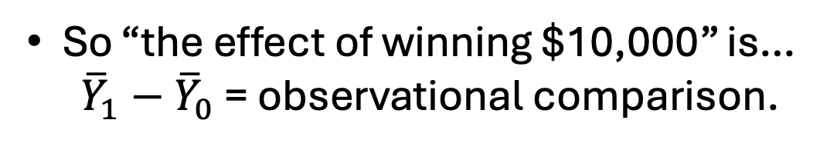
Regression generalizes the observational comparison!
${\overline{Y}}_{0}=$ avg of untreated
${\overline{Y}}_{1}=$ avg of treated
The line of best fit passes through $\left(0,{\overline{Y}}_{0}\right)$ and $(10000, {\overline{Y}}_{1})$
$\left(Consumption\right)={\overline{Y}}_{0}+\left(\frac{{\overline{Y}}_{1}−{\overline{Y}}_{0}}{10000}\right)⋅(Winnings)$
This is $\hat{β}$
We interpret it as “the effect of winning $1.”
Consumption
Lottery winners
So “the effect of winning $10,000” is…
${\overline{Y}}_{1}−{\overline{Y}}_{0}$ = observational comparison.
Non-Lottery winners
$\hat{β}=$ slope of this line
Lottery Winnings
0
$10,000

Slide 46
Regression generalizes the observational comparison!
On the one hand, that’s great! Now we have an analog for when the “treatment” isn’t just “yes” or “no.”
On the other hand, we’ve seen that the observational comparison is not a good way to establish causality!!
Lottery winners
Non-Lottery winners
0
$10,000
0
$10,000

Slide 47
As usual
The problem: Confounding Variables
E.g., people who buy more lottery tickets are different than those who don’t.
  Maybe people with more permanent income will be more/less likely to buy lottery tickets.
We need to control for confounding variables.

Slide 48

As usual
The problem: Confounding Variables
E.g., people who buy more lottery tickets are different than those who don’t.
  Maybe people with more permanent income will be more/less likely to buy lottery tickets.
We need to control for confounding variables.
Solution: put it into our model!
Windfall income
Consumption
$$C=β⋅W+α+noise$$
$$C=β⋅W+β_{Y}⋅Y+ α+noise$$
Add net income:
$$C=β⋅W+β_{Y}⋅Y+β_{A}⋅A+ α+noise$$
Add age:

Slide 49
Let’s take a quick break!
If you want something to think about…
Why would throwing more variables into the model
help establish causality?

Slide 50
Multivariate Regression!

Slide 51
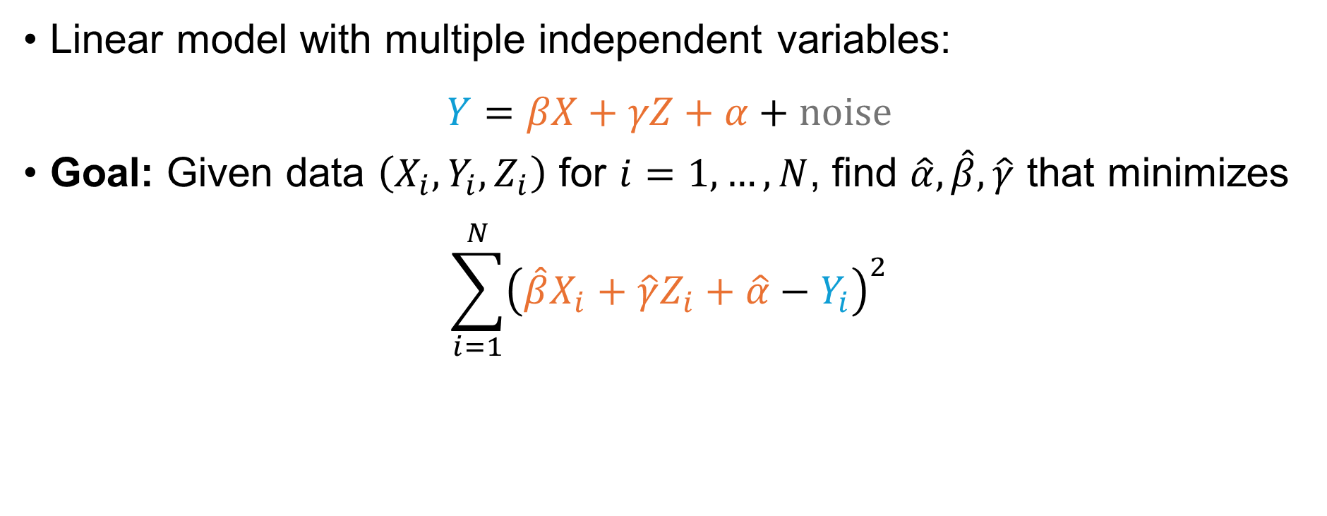
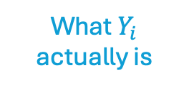
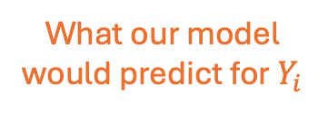
Multivariate Regression
More generally, you can include as many variables as you want!
Linear model with multiple independent variables:
$$Y=βX+γZ+α+noise$$
Goal: Given data $\left(X_{i}, Y_{i}, Z_{i}\right)$ for $i=1,…,N$, find $\hat{α},\hat{β},\hat{γ}$ that minimizes
$$\sum_{i=1}^{N}{{\left(\hat{β}X_{i}+\hat{γ}Z_{i}+\hat{α}−Y_{i}\right)}^{2}}$$
What our model would predict for $Y_{i}$
What $Y_{i}$ actually is

Slide 52




“Plane” of best fit
$$Y=βX+γZ+α+noise$$
$$Y$$
$$X$$
$$Z$$

Slide 53
How does this fix the problem?
Confounding variables
Suppose that the only confounding variable was (non-windfall) income.
Consumption
Cha-ching! $$$
Low permanent income
Low windfall income
Low permanent income
High windfall income
High permanent income
Low windfall income
Windfall Income
Permanent Income

Slide 54
How does this fix the problem?
Confounding variables
Suppose that the only confounding variable was (non-windfall) income.
Consumption
Suppose also that lower-income people buy more lottery tickets, and are more likely to win the lottery.
Windfall Income
Permanent Income

Slide 55
How does this fix the problem?
Confounding variables
Suppose that the only confounding variable was (non-windfall) income.
Consumption
Suppose also that lower-income people buy more lottery tickets, and are more likely to win the lottery.
Windfall Income
Permanent Income

Slide 56
How does this fix the problem?
Confounding variables
Suppose that the only confounding variable was (non-windfall) income.
Consumption
Suppose also that lower-income people buy more lottery tickets, and are more likely to win the lottery.
Windfall Income
Permanent Income

Slide 57
How does this fix the problem?
Confounding variables
Suppose that the only confounding variable was (non-windfall) income.
Consumption
Project!
Suppose also that lower-income people buy more lottery tickets, and are more likely to win the lottery.
Windfall Income
Permanent Income

Slide 58
How does this fix the problem?
Confounding variables
Suppose that the only confounding variable was (non-windfall) income.
Consumption
Project!
Suppose also that lower-income people buy more lottery tickets, and are more likely to win the lottery.
Windfall Income
Permanent Income

Slide 59
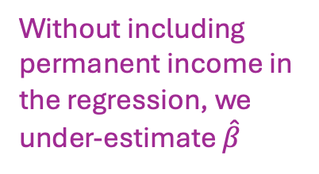
How does this fix the problem?
Confounding variables
Suppose that the only confounding variable was (non-windfall) income.
Consumption
Without including permanent income in the regression, we under-estimate $\hat{β}$
Project!
Suppose also that lower-income people buy more lottery tickets, and are more likely to win the lottery.
It should be like this!
Windfall Income
Permanent Income

Slide 60

How does this fix the problem?
Confounding variables
Suppose that the only confounding variable was (non-windfall) income.
Consumption
Suppose also that lower-income people buy more lottery tickets, and are more likely to win the lottery.
When we include permanent income in the regression, we get the right value for $\hat{β}$!
Windfall Income
Permanent Income

Slide 61
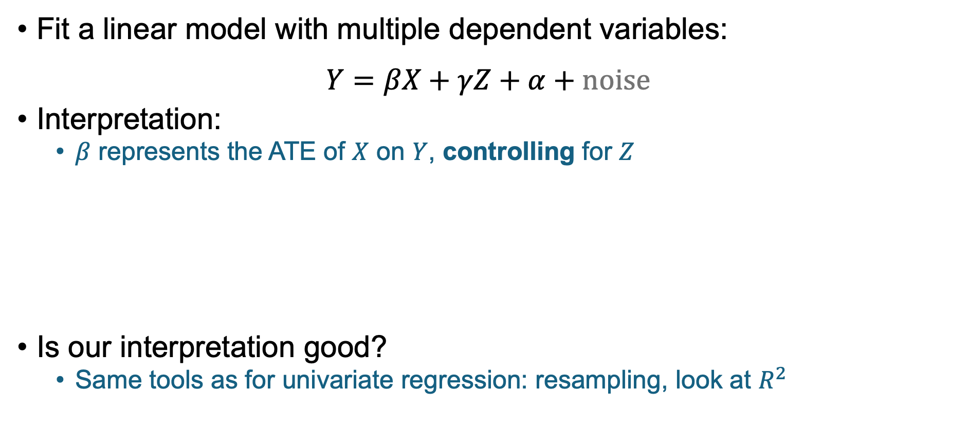
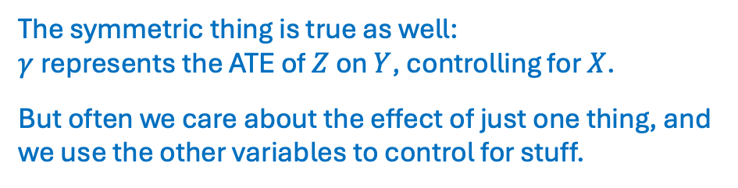
Multivariate Regression
More generally, you can include as many variables as you want!
Fit a linear model with multiple dependent variables:
$$Y=βX+γZ+α+noise$$
Interpretation:
  $β$ represents the ATE of $X$ on $Y$, controlling for $Z$
Is our interpretation good?
  Same tools as for univariate regression: resampling, look at $R^{2}$
The symmetric thing is true as well:
$γ$ represents the ATE of $Z$ on $Y$, controlling for $X$.
But often we care about the effect of just one thing, and we use the other variables to control for stuff.

Slide 62
So…What is the effect of windfall income?
Today:
  Quick look at three papers from the 1950’s and 1960’s
  You read about these for your pre-reading response!
Next time:
  Deeper look at more recent papers

Slide 63
The debate
When people win the lottery, they will only increase consumption by a little bit.
Oh is that so?
Milton Friedman
“Common Sense”
How can we test this?

Slide 64
The debate
When people win the lottery, they will only increase consumption by a little bit.
Milton Friedman

Slide 65
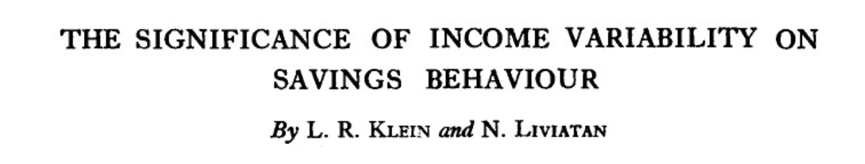
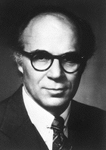

The debate
When people win the lottery, they will only increase consumption by a little bit.
Bulletin of the Oxford University Institute of Economics & Statistics, 1957
That’s not what the data say…
Milton Friedman
Lawrence Klein
Nissan Liviatan

Slide 66

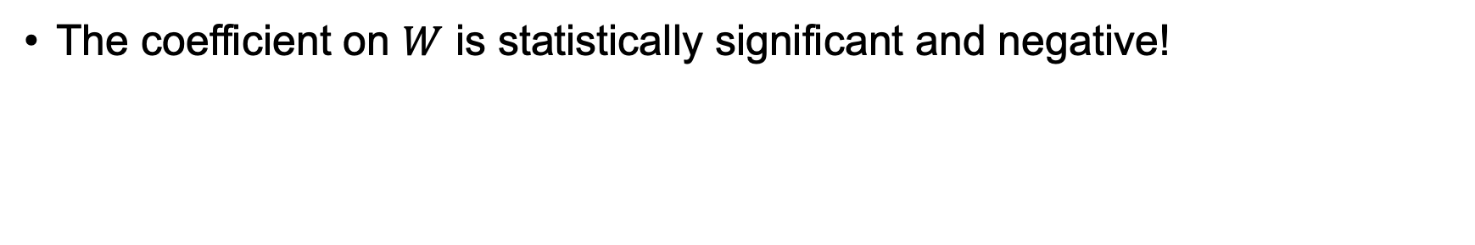
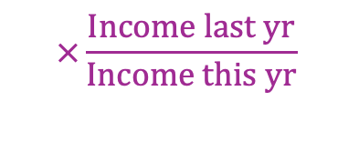
They ran a multivariate regression
*Disclaimer: This expression has been simplified a bit for clarity, it’s not their exact results.
Data from the 1953 UK “Savings Survey”
“Windfall income consisted of life insurance benefits, gambling winnings, cash gifts, cash legacies, postwar credits, and other lump-sum transfers of money”
(0.002)
(0.143)
(0.009)
(0.001)
(0.28)
$$S_{d}≈−0.081 W+ 0.026⋅Y −0.030 L ×Y^{′}+0.0011 A −0.12 S_{c}$$
Discretionary savings
Windfall Income
Net Income
Liquid assets
$$×\frac{Income last yr}{Income this yr}$$
Age of head of household
Compulsory Savings
$$R^{2}=0.28$$
The coefficient on $W$ is statistically significant and negative!
People are “clearly using [windfall income] in order to enjoy a higher temporary level of living than would otherwise be possible.”
Notes:
“ For retired and unoccupied units, the implied marginal propensity to consume out of windfall income is .92“

Slide 67

The debate
When people win the lottery, they will only increase consumption by a little bit.
That’s not what the data say…
Friedman
It is what my data say!
Klein + Liviatan
Mordechai Kreinin

Slide 68
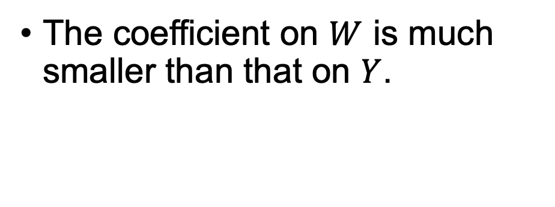

Another multivariate regression…
M. Kreinin
American Economic Review, 1961
Data: Israeli Survey of Family Savings, 1957/1958
  Looked at about 80 families who received I£ 3000 in restitution payments from Germany.
  Average disposable income of these families was about I£ 3400
(412)
(0.105)
(0.156)
$$C=397+0.857⋅Y+0.167⋅W$$
$$R^{2}= 0.591$$
Consumption
Disposable income without restitution
Windfall income (restitution payment)
The coefficient on $W$ is much smaller than that on $Y$.
“The smallness of this figure [0.167] is consistent with the
permanent income hypothesis”

Slide 69

The debate
When people win the lottery, they will only increase consumption by a little bit.
That’s not what the data say…
Friedman
It is what my data say!
Klein + Liviatan
It’s not what my data say!
Kreinin
Ronald Bodkin

Slide 70



Yet another multivariate regression…
American Economic Review, 1959 and 1966
In 1949, the US Government announced that National Life Insurance dividends would be paid out to WWII veterans.
  Not anticipated
  Payments averaged $255 per veteran in the sample
(76)
(0.017)
(0.145)
$$C=\$964+0.757 Y+0.966 W$$
$$R^{2}=0.601$$
Consumption, including on durable goods
Post-tax family income, not including W
Windfall income (life insurance dividends)
“This result, however, is not necessarily inconsistent with the permanent income hypothesis. It is possible that the greater part of these consumption expenditures were purchases of consumer durables.”
Ronald Bodkin
Notes:
Data from the 1950 Bureau of Labor Statistics Survey of Consumer Expenditure

Slide 71

Yet another multivariate regression…
American Economic Review, 1959 and 1966
In 1949, the US Government announced that National Life Insurance dividends would be paid out to WWII veterans.
  Not anticipated
  Payments averaged $255 per veteran in the sample
(57)
(0.012)
(0.109)
$$C′=\$959+0.560 Y+0.723 W$$
$$R^{2}=0.601$$
Consumption, not including durable goods
Post-tax family income, not including W
Windfall income (life insurance dividends)
“It would appear that an absolute income hypothesis [as opposed to PIH] serves as a superior explanation for this body of data.”
Ronald Bodkin

Slide 72
The debate
When people win the lottery, they will only increase consumption by a little bit.
That’s not what the data say…
Friedman
It is what my data say!
Klein + Liviatan
It’s not what my data say!
Kreinin
…
Ronald Bodkin

Slide 73
One of
Bodkin’s critiques of Klein+Liviatan
“Transitory income” is what is perceived as one-time income…
…But how do we know what people perceive?
I’m an excellent gambler! I view my gambling winnings as permanent income.
I went to Vegas on a lark and won $100! That’s transitory income for me!

Slide 74
What’s happening here???
Why do the same techniques get radically different results???
Lots of challenges:
How can we measure “transitory income”?
  It has to do with whether people perceive it to be one-time, and whether they anticipated it…how can we know that?
How do we measure consumption?
  In the PIH, “consumption” means “stuff I consumed this time period, even if I paid for it in a different time period.” That’s hard to measure!
What about heterogeneous effects?
  Maybe poor people and rich people treat windfall income differently? (In a way that’s not captured in a linear model).
  Maybe people treat big windfalls and small windfalls differently?
All these studies are on very different populations! (And maybe not the ones we care about now…)
  Retirees in the UK; families in Israel; WWII veterans in the US
…

Slide 75
Next time
More recent studies on the effects of income on spending/saving/working!

Slide 76
Wrap Up and Looking Ahead
Make sure to stick around for the exit ticket!

Slide 77
Take-Aways from Today
Regression!
  We fit a linear model
  Multivariate regression lets us “control” for observed variables
Multivariate regression seems to give us lots of conflicting answers about “What is the effect of windfall income.”
  It’s a hard problem!

Slide 78
Next Time
More recent (and maybe more believable?) studies on the effects of UBI / windfall income.

Slide 79


Exit ticket
Don’t forget to fill out the exit ticket before you leave class!

Slide 80
Extra Slides for Anticipated Questions on Multicollinearity ☺

Slide 81

Q: Do we care about multicollinearity?
Multicollinearity: Regression variables have an (approximately) linear relationship
Example:
  Dependent Variable:
    C = Consumption
  Independent Variables:
    W = Lottery Winnings
    T = Money spend on lottery tickets
Say that the expected return on $1 of lottery tickets is $0.70.
Then $W≈0.70 T$
Linear Relationship!

Slide 82


Lots of places on the internet suggest that we should remove collinearities
That is, drop W or T in this example.

Slide 83

But! Other places on the internet…
“There is no justification for the practice of removing collinear variables as part of regression analysis, and doing so may constitute scientific misconduct.”

Slide 84





Q: Do we care about multicollinearity?
Example:
  Dependent Variable:
    C = Consumption
  Independent Variables:
    $W$ = Lottery Winnings
    $T$ = Money spend on lottery tickets
    $W≈0.70 T$
Extreme case: What if we have exact collinearity? $W=0.70 T$ exactly.
If we include both $W$ and $T$ in the regression:
If we include only $W$:
$$C=β⋅W+γ⋅T+α+noise$$
$$C=β⋅W+α+noise$$

Slide 85

Q: Do we care about multicollinearity?
Example:
  Dependent Variable:
    C = Consumption
  Independent Variables:
    $W$ = Lottery Winnings
    $T$ = Money spend on lottery tickets
    $W≈0.70 T$
Extreme case: What if we have exact collinearity? $W=0.70 T$ exactly.
If we include both $W$ and $T$ in the regression:
If we include only $W$:
$$C=β⋅W+γ⋅T+α+noise$$
$$C=β⋅W+α+noise$$
There isn’t a unique optimal choice of $\hat{β}$!
e.g., If $C=1⋅W+0⋅T+5,$
then also $C=0⋅W+0.7⋅T+5$
But…we shouldn’t be able to distinguish “the effect of W” from “the effect of T” in this case!
So it’s “correct” that there’s not a unique answer.

Slide 86

Q: Do we care about multicollinearity?
Example:
  Dependent Variable:
    C = Consumption
  Independent Variables:
    $W$ = Lottery Winnings
    $T$ = Money spend on lottery tickets
    $W≈0.70 T$
Extreme case: What if we have exact collinearity? $W=0.70 T$ exactly.
If we include both $W$ and $T$ in the regression:
If we include only $W$:
$$C=β⋅W+γ⋅T+α+noise$$
$$C=β⋅W+α+noise$$
There isn’t a unique optimal choice of $\hat{β}$!
e.g., If $C=1⋅W+0⋅T+5,$
then also $C=0⋅W+0.7⋅T+5$
There probably is a unique soln:
e.g., $C=1⋅W+5$
We’d conclude that
“the ATE of W on C is 1.”
But is that really the effect of W?
It might be the effect of T!
But…we shouldn’t be able to distinguish “the effect of W” from “the effect of T” in this case!
So it’s “correct” that there’s not a unique answer.
Notes:
NOTE: In last year’s class (Unit 2 Lecture 3) there’s more stuff about imperfect multicollinearity (deleted here)

Slide 87

Q: Do we care about multicollinearity?
A: Maybe, but blindly removing variables isn’t the right thing to do.
Perfect collinearity means we can’t distinguish the contribution of one variable from another.
  But we shouldn’t be able to!
Imperfect collinearity may lead to large standard errors.
  But they should!
  We don’t get much statistical power about the effect of lottery winnings on consumption if almost all of the variation is explained by how much money is spent on lottery tickets.
If there’s collinearity, some regression solvers might break or have errors.
    Find a better solver! ADVERTISEMENT: CME 302 ☺

